Slide 1
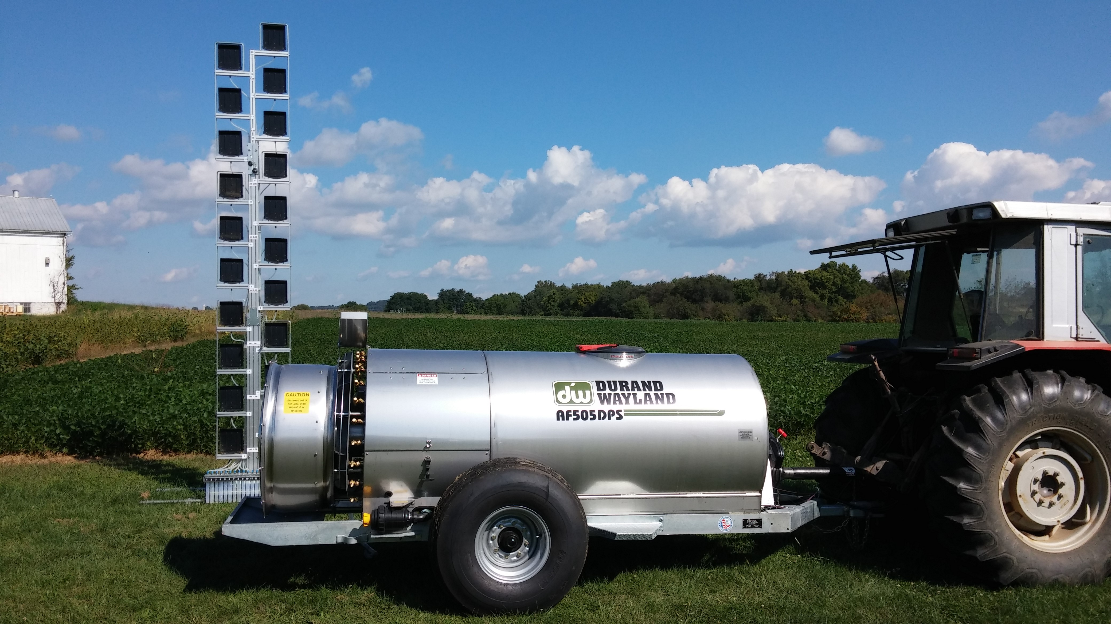

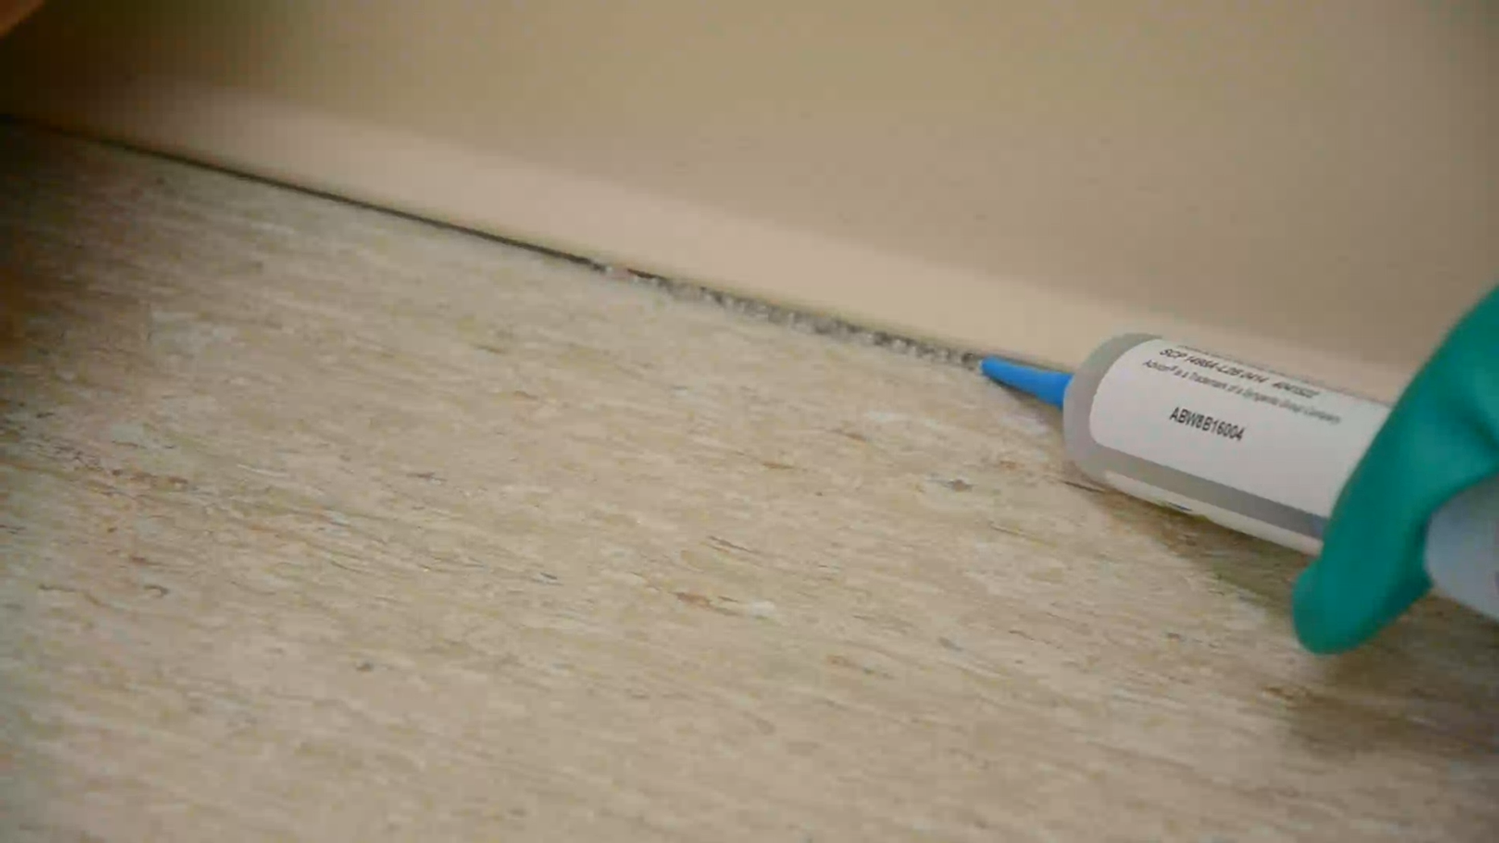
2023-2024
Pesticide Regulatory Update
Virginia Department of Agriculture and Consumer Services
Office of Pesticide Services
Notes:
This 2020-2021 Pesticide Regulatory Update meets the requirements for the legal update as part of all approved pesticide applicator recertification programs. All information contained in Slides 1-27 must be presented as part of all approved recertification courses including those for commercial applicators (all categories), registered technicians and private applicators. In addition, for recertification of commercial applicators and registered technicians, the information contained in Slides 27-51 must be presented. For recertification courses for private applicators, the information contained in Slides 52-67 must be presented. The items in the Legal Update are required for the Board to approve the training for credit. Should the complete Legal Update not be provided, recertification credit will not be given to attendees.
Presenters are free to add to this presentation to suit different audiences, if appropriate. Slides may be added as appropriate for course attendees.
Talking points are provided in the notes for many of the slides. Should you have any questions, please contact:
-Applicator Certification, Business License, Product Registration, and Training – Micah Raub, Supervisor, at micah.raub@vdacs.virginia.gov or 804-786-4845;
-Enforcement & Field Operations – Clint Shettle, Supervisor, at clinton.shettle@vdacs.virginia.gov or 804-786-8943;
-Compliance – Christine Trostler, Compliance Officer, at christine.trostler@vdacs.virginia.gov or 804-371-8485;
-Pesticide Disposal & Recycling Programs – Jeff Rogers, Environmental Program Planner, at jeffrey.rogers@vdacs.virginia.gov or 804-371-6561.
All other inquiries should be directed to the Office of Pesticide Services at 804-786-3798.
Contact information for the Office of Pesticide Services is also included at the end of the presentation.
Notes:
When offering testing as part of a recertification course, sponsors should ensure that the applications are submitted in a timely manner well in advance of the test date. Applications should be received no less than 30 days in advance of the testing date to allow for processing and issuance of a Letter of Authorization (LOA). Some sponsors are waiting until a week or two before the exam date to get applications submitted and expecting that OPS will expedite the processing and email or fax the LOAs at the last minute. If applications are not submitted in a timely manner, it is possible that sponsors and prospective applicators will not have them by the exam date. A LOA is required to sit for examination.
For course sponsors/instructors seeking recertification credit for their own course, you are required, like all attendees, to participate in the entire program and all sessions and complete all required forms. Course sponsors can not “self recertify” rather the course must include presenters others than the course sponsor.

Slide 2

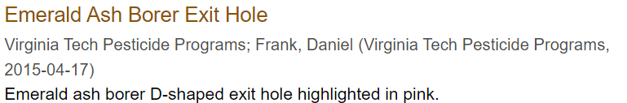
Discussion points
Regulatory Authority
Common Violations & Enforcement Actions
Label is the Law
Storage, Disposal & Recycling
Supervision
Recordkeeping
Incident Reporting
Pesticide Product Registration
Federal and State Regulatory Activities
Notes:
During today’s presentation, we will be covering those items that are required as part of recertification as a pesticide applicator. This includes:
The laws and regulations that govern the use of pesticides;
The most common violations during the last fiscal year and what can happen if you don’t follow the law and regulations;
Important reminders about following the label; storage and disposal of pesticides and recycling of empty containers; who can supervise who; recordkeeping; what do to if there is an incident and registration requirements for pesticides; and
Ongoing federal and state regulatory activities that affect you
As a reminder, you can add additional information to the presentation that is appropriate for your specific audience.

Slide 3


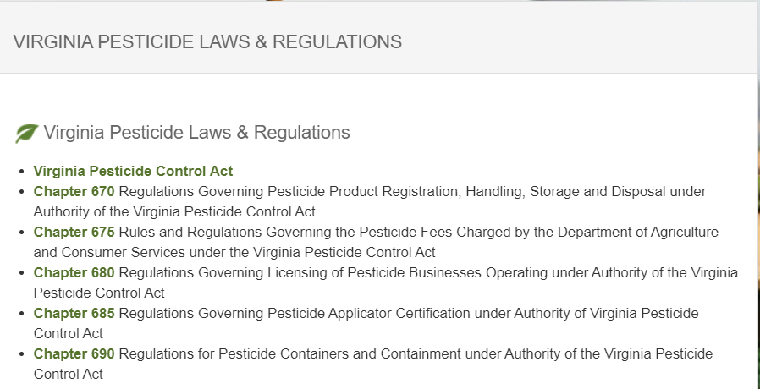
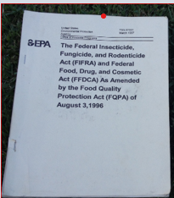
Pesticide Regulation in Virginia
(Co)Regulators
VDACS’ Office of Pesticide Services (OPS): Administers the pesticide program and supports VDACS and the Board of Agriculture and Consumer Services (Board)
  Protect consumers and the environment; and
  Ensure the safe and effective control of pests that adversely affect crops, structures, health, and domestic animals.
OPS authority is derived from: the Virginia Pesticide Control Act (Act) and the Regulations Pursuant to the Act (Regulations).
Staff also has federal credentials to: enforce provisions of the Federal Insecticide, Fungicide and Rodenticide Act (FIFRA).
Notes:
The Virginia Department of Agriculture and Consumer Services (VDACS) Office of Pesticide Services (OPS) is responsible for regulating pesticides in Virginia. Simply stated, OPS regulates pesticides and the people and businesses that use or sell them. Regulatory requirements are contained within the Virginia Pesticide Control Act (Act) and Regulations Pursuant to the Act (Regulations). In addition to ensuring compliance with the Act and Regulations, OPS also has the authority to enforce the Federal Insecticide, Fungicide and Rodenticide Act (FIFRA).

Slide 4

Ensuring Proper Use of Pesticides
Certifying pesticide applicators
Registering pesticide products
Licensing businesses
Conducting inspections and investigations
Reviewing and approving recertification courses
Coordinating recycling and collection programs
All OPS activities work to ensure pesticides are used in accordance with the law and regulations.

Slide 5

Inspections & Investigations
EPA REGION III WORKSHOP 2023, WASHINGTON, DC
OPS conducts routine inspections and investigations to determine compliance with all applicable laws & regulations;
Standard inspection/investigation procedures may include:
  Conducting interviews
  Visiting site
  Observing an application
  Taking photographs
  Collecting samples (residue/formulation)
  Collecting weather data
  Reviewing pesticide label and application records
Totality of evidence collected will be reviewed in a two-stage independent review process to determine if the application was made in compliance with all applicable laws and regulations;
Respondents will be notified of any alleged violations prior to any final enforcement action is taken; and
Should there be an enforcement action, for example, a monetary penalty, the respondent will have the right to appeal in keeping with the Administrative Process Act.
Notes:
Pesticide Investigators conduct routine inspections and investigate all tips/complains/reports alleging potential violations of pesticide laws or regulations. As part of any inspection or investigation, the Pesticide Investigator may complete one or more of the following activities:
Conducting interviews
Visiting site
Observing an application
Taking photographs
Collecting samples (residue/formulation)
Collecting weather data
Reviewing pesticide label and application records
Once all the information is collected, the totality of the information or evidence that the Pesticide Investigator is able to collect is reviewed in a 2 stage process. In those cases in which there is substantial evidence of a violation is found, the respondent is notified and provided an opportunity, by law, to provide additional information prior to any final action. Should an enforcement action be taken, the respondent has the right to appear the action.

Slide 6
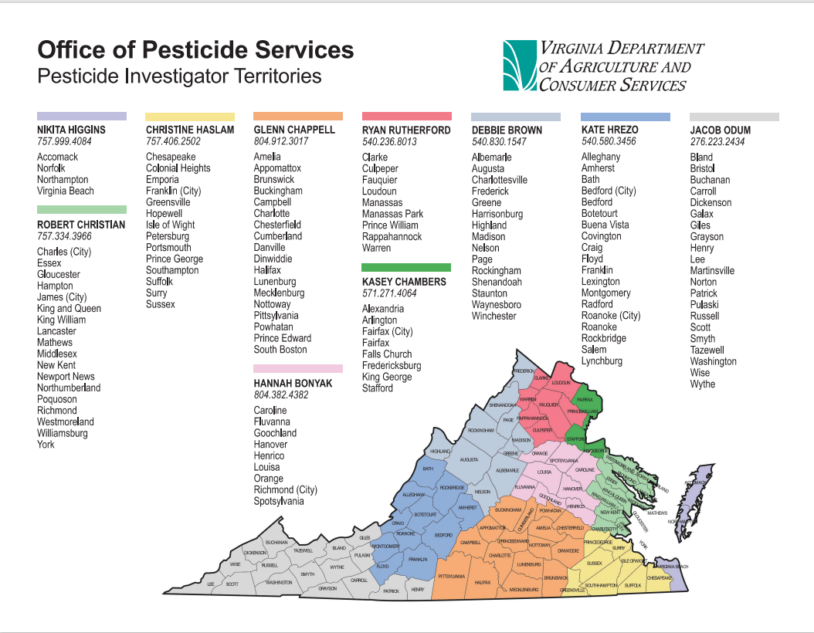

Slide 7
Violations - Enforcement Actions
Types of Enforcement Actions
VDACS can take enforcement action against any person, business or agency that violates any provision of the Virginia Pesticide Control Act, Regulations, or the Federal Insecticide, Fungicide and Rodenticide Act (FIFRA).
Letter of Caution
Civil Penalties per violation
  Up to $1,000 for a non-serious first time violation
  Up to $20,000 for knowing or repeat violations
  Up to $100,000 additional in the event of death or serious physical harm to any person.
Suspension, modification, revocation or denial of business license and/or applicator certification
Filing of criminal charges
Refer to U.S. Environmental Protection Agency for federal action
Notes:
VDACS has the legal authority to take an enforcement action for any violation of the Act or Regulation against any person (including certified applicators and the general public), businesses and other agencies. There are a number of different types of actions that VDACS can take depending on the circumstances including:
1. type of violation;
2. damages or potential for damage;
3. culpability;
4. history of violations; and
5. good faith attempt to come into compliance.
For any enforcement action, the person, business or agency has the right to appeal.
VDACS may also refer any violations to the US Environmental Protection Agency for action.

Slide 8
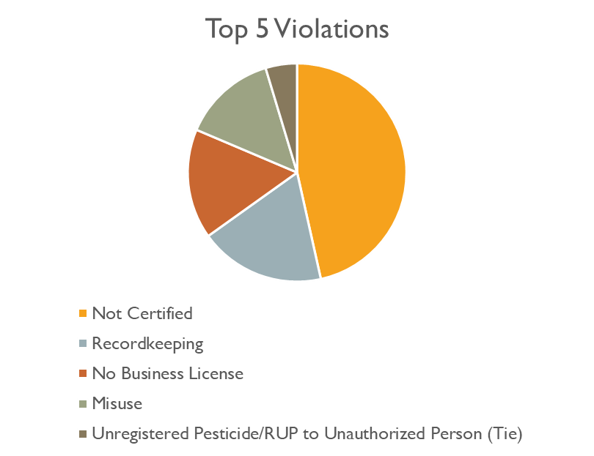
FY23 Violations & Enforcement Actions
Actions for Non-Compliance
40 Unique Cases
  Civil Penalties = $14,080
  Stop Sale = 8
  Other Actions = 1
  Letter of Caution
  Advisory Letter
1 July 2022 - 30 June 2023
Notes:
The most common violations for FY21 are the same as in past years – just in a different order.
#1: Sale or Use of Unregistered Product: Every product that is manufactured, distributed, sold, offered for sale, used or offered for use must be registered both by United States Environmental Protection Agency (EPA) and with VDACS (there are some exemptions to the requirement to be federally registered, however, ALL pesticides must be registered in Virginia). Investigators inspecting pesticide businesses and retailers found a number of products not registered in VA but offered for sale. Violations included both discontinued products and those that were never registered.
#2: Not Certified: This includes both applicators that have never been certified as well as applicators that did not maintain their certification or did not renew their certification as required. The Virginia Pesticide Control Act requires:
Any person who uses (except under supervised conditions of training for certification) or supervises the use of any pesticide in exchange for compensation of any kind be certified as either a commercial applicator or registered technician. All commercial applicator or registered technician certifications expire on June 30 of either the odd or even year; and
Any person who applies restricted use on any property in the production of an agricultural commodity be certified as private applicator. All private applicator certifications expire on December 31 of either the odd or even year.
#3: Misuse and Negligence:
Misuse covers a wide range of things, including failure to wear the personal protection equipment (PPE) required by the label. However, any failure to follow the label is “misuse”.
Negligence refers to “applying any pesticide in a negligent manner” and includes pesticides applied in a way that may have adverse impacts to human health or the environment.
#4: No Business License: This is includes those companies that apply pesticides for-hire or sell pesticides that have never had a business license or who did not renew their business license. All pesticide business licenses expire annually on March 31.
#5: Recordkeeping: This refers to not keeping complete records of applications by applicators and pesticide businesses. For Private Applicators, this includes Worker Protection Standards (WPS) records and records of Restricted Use Products (RUPs). Commercial Applicators, Registered Technicians, and Licensed Pesticide Businesses (for-hire applicators) must keep records of ALL pesticides they apply including general use and restricted use pesticides. (In addition, licensed Pesticide Businesses must keep sales records of RUPs.)

Slide 9
§ 3.2-3930. All applicators must be certified as a commercial applicator or a registered technician when making a pesticide application in exchange for compensation of any kind.
Read, Understand and Follow the Act and Regulations!
2VAC5-685-210. Commercial applicators not-for hire and registered technicians not-for-hire must maintain a record of every pesticide applied. The record must contain the 9 requirements listed.
2VAC5-680-65. All licensed pesticide businesses must keep a record of every pesticide applied. The record must contain the 9 requirements listed.
§ 3.2-3932. In order to lawfully use or supervise the use of a RUP on any property, an applicator must be certified as a private applicator.
§ 3.2-3939. It is a violation to use or cause someone else to use a product in a manner that is inconsistent with the label or the regulations.
§ 3.2-3914. All pesticide sold, offered for sale, used, or offered for use in VA must be registered by paying an annual fee.
§ 3.2-3940(B)(3). It is a violation for a certified applicator to apply any pesticide in a negligent manner.
§ 3.2-3924. A business must have a pesticide business license in order to sell, distribute or store any pesticide unless the business meets one of the exemptions. If a person wants to apply or recommend for use any pesticide commercially, they must obtain a pesticide business license and employ a certified commercial applicator.
Notes:
To avoid violations and a possible enforcement action, all pesticide applicators must follow the Virginia Pesticide Control and its related regulations. A violation can be avoided by following the requirements contained in the Act and regulations. The sections included here are only highlights of the many requirement for applying a pesticide in Virginia. It is the responsibility of all pesticide applicators and all pesticide businesses to read, understand, and follow the Act and Regulations!

Slide 10
Appeal Process: If You Don’t Agree
Informal Fact Finding
Formal Hearing
Officer appointed by the Program Manager (Office of Pesticide Services)
Opportunity for respondent to offer additional information, ask questions
Officer is authorized to affirm, raise, lower, abate or negotiate a settlement
Decision can be appealed to Formal Hearing
Officer is Court appointed Attorney
Hears all relevant information and considers facts of all violations in the case
Makes recommendation to Board to affirm, raise, lower, abate or may recommend another outcome
Notes:
The person, business or agency (known as the respondent) issued a letter of caution or a civil penalty by VDACS has the right to appeal either the fact of the violation or any civil penalty taken.
The first level of appeal is to an “Informal Fact Finding Conference”. In an informal fact finding conference, a member of the Office of Pesticide Services Staff not involved in either enforcement or compliance will serve as the fact finding conference officer. He/she will listen to any information from the respondent regarding the violation and may ask additional questions. The fact finding conference officer will make a decision at the end of the conference. If the respondent does not agree with the decision of the fact finding conference officer, they have the right to appeal during a “Formal Hearing”.
In a formal hearing, the Hearing Officer is an attorney appointed by the Supreme Court of Virginia. During a formal hearing, VDACS will be represented by the Office of the Attorney General who will present the Department’s case. The respondent may present their own case or may elect to have an attorney. After listening to both sides, the Hearing Officer will have 30 days to make a recommendation to the Board of Agriculture and Consumer Services. The Board will make the final decision regarding the case.

Slide 11
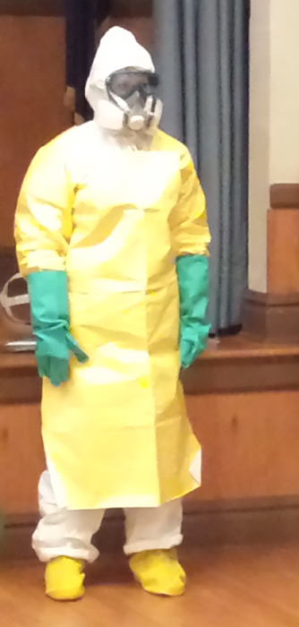

The Label is the Law
ALWAYS READ AND FOLLOW PESTICIDE PRODUCT LABELING
It is a violation of Federal and state law to use any pesticide product in a manner inconsistent with its labeling.​​​​​​​​​..
In Virginia, "pesticide use" is defined as the application or supervision of an application of a pesticide.
This includes all of the routine activities that are part of a normal pesticide application:
  mixing,
  loading,
  applying,
  handling a pesticide after the container seal is broken,
  clean up, and
  storage and disposal of excess product & empty containers.
Notes:
Virginia is what is referred to as a “label state”. This means that the legal application of a pesticide is determined by compliance with the label. Some states have additional requirements to the label, for example, for termiticide applications. Virginia does not currently have any additional requirements outside the Act and Regulations and of course the label.

Slide 12
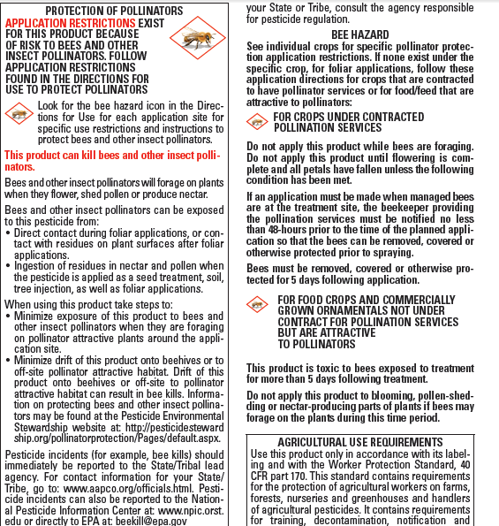
The Label…
Is a legal agreement between the registrant, the EPA, the end-user and the State Lead Agency for pesticide regulation.
Mitigates the risk of the use of the pesticide to an acceptable level
  Human Health
  Environmental Health
Includes risk mitigation measures that may be implemented throughout label, for example: use rate; use site; PPE; weather conditions; buffer zones; storage; disposal, etc…
Prescribes proper use which ensures continued use and availability of pesticide.
WHICH PESTICIDE LABEL MUST BE FOLLOWED BY USERS?
HOW OFTEN SHOULD THE PESTICIDE LABEL BE READ?

Slide 13


The Pesticide Label
The Intersect of ESA & FIFRA
Endangered Species Act
Federal Insecticide, Fungicide,
and Rodenticide Act
“Actions” for EPA are all pesticide registration decisions (new or registration review).
  Pesticides are one of many factors that can contribute to population declines of listed species.
Risk/Benefit Act
  Many pesticide products and amendments that require EPA assessment and over 1,600 listed species in the United States.
  Information on the vulnerability, biology, and location of many of these species is limited, especially information on how pesticides may impact their survival
Provides for the conservation of threatened and endangered plants and animals and the habitats in which they are found.
  US Fish & Wildlife Services (FWS)
  US National Oceanic and Atmospheric Administration (NOAA)
Requires federal agencies, in consultation with the U.S. Fish and Wildlife Service and/or the NOAA Fisheries Service, to ensure that actions they authorize, fund, or carry out are not likely to jeopardize the continued existence of any listed species or result in the destruction or adverse modification of designated critical habitat of such species.

Slide 14

The Label & Pesticide Use Limitation Areas
If limitations on pesticide use are necessary to protect listed species or their habitats, they will be referenced on the pesticide label.
Any limitations in an area are considered Pesticide Use Limitation Area (PULA).
PULA’s are contained within Endangered Species Protection Program (ESPP) Bulletins and are accessed through Bulletins Live! Two
A bulletin consists of:
  Spatial location of pesticide use limitations
  Product/application/formulation information
  Limitation/mitigation language
Bulletins are an extension of the label and are enforceable.
Allows for location-specific protections.
Bulletins can be converted into a ‘printable’ pdf.
Notes:
Pesticide users who fail to follow label provisions for their pesticide application, whether that failure results in harm to a listed species or not, will be subject to enforcement under the misuse provisions of FIFRA and the Virginia Pesticide Control Act and related regulations.

Slide 15
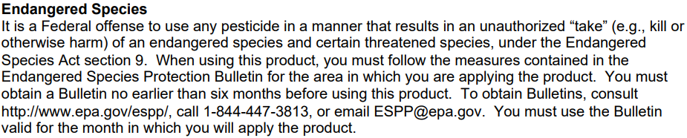
Example Label Language
Enlist Duo (EPA Registration No. 62719-649)

Slide 16
Accessing ESPP Bulletins
If pesticide label directs user to the Bulletins Live! Two website they are required to follow the pesticide use limitations (if any) found in the Bulletin for your county, pesticide active ingredient and application month.
Pesticide users who fail to follow label provisions for their pesticide application, whether that failure results in harm to a listed species or not, will be subject to enforcement under the misuse provisions of FIFRA.
Bulletins are available using EPA’s Bulletins Live! Two system through the website https://www.epa.gov/endangered-species/bulletins-live-two-view-bulletins/
*Available on your cell phone web browser however, it does not currently exist as an app.
If you are not able to access Bulletins Live! Two using your cell phone browser, or if you have other questions, you can contact EPA for assistance at:
  1) EPA Help Desk Inbox espp@epa.gov; or
  2) EPA Hotline at 1-844-447-3813.
16

Slide 17
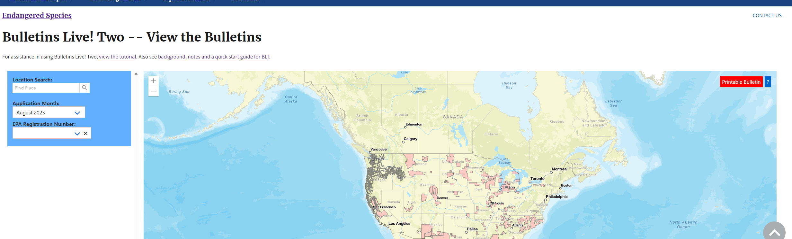
Finding Mitigation Requirements
Bulletins Live! Two allows pesticide users to search by:
  Location (field, address, crossroads, zip code, GPS coordinates, or other location area)
  Application Month
  EPA Registration Number
Works on a computer.
Notes:
Note: Bulletins Live! Two is not currently available using a smartphone.

Slide 18
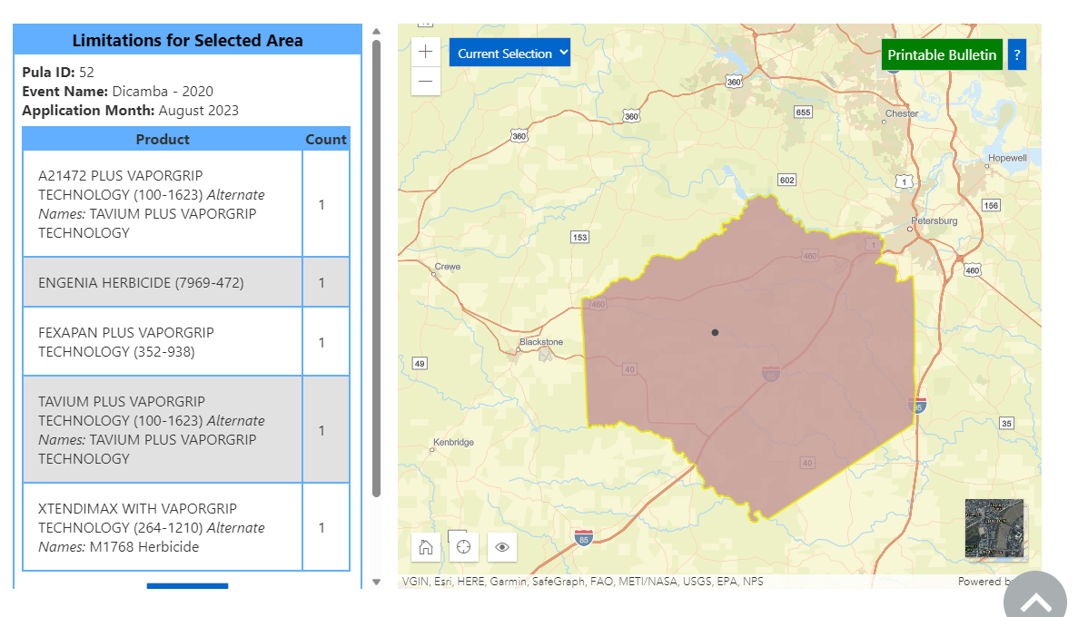
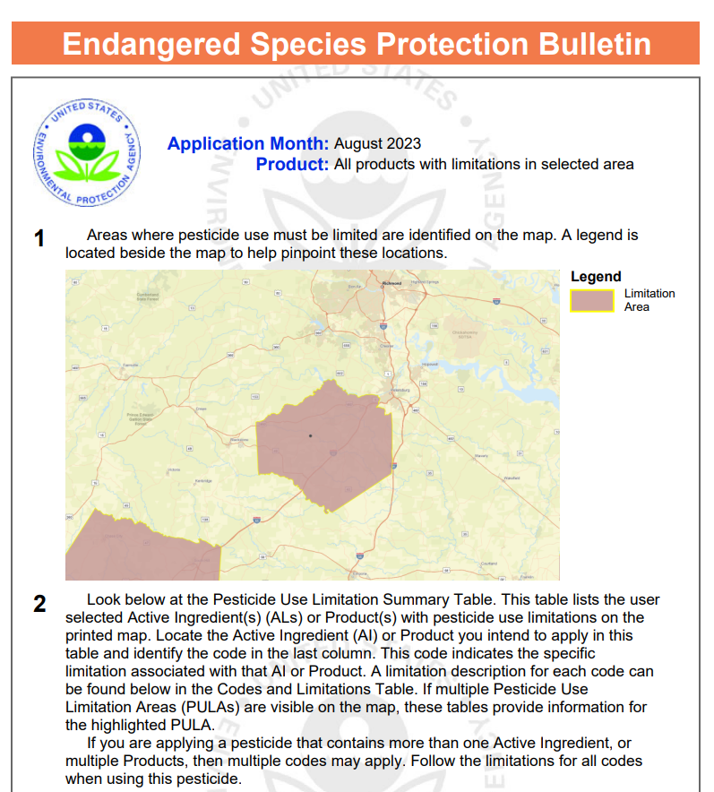
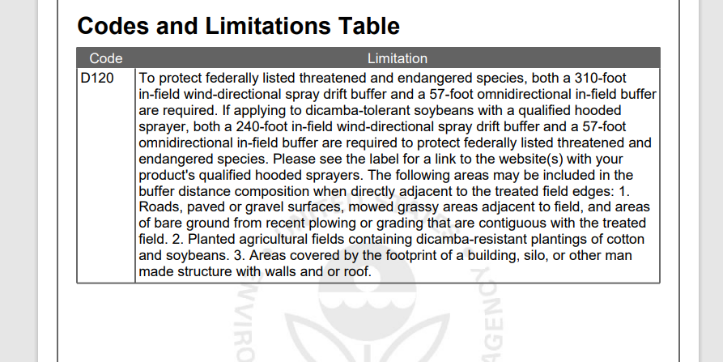
In this example, there is a pesticide use limitation in place.

Slide 19
IMPORTANT! IMPORTANT!
Not all pesticides that reference Bulletins Live! Two on the label will have geographically specific ESA mitigation.
The pdf will show a blank map.
The text will read “Currently, no pesticide use limitations exist within the printed map view for the month/year and product you selected, beyond the instructions specified on the pesticide label”.
Absence of a bulletin one season does not indicate absence of a bulletin for the following season.
Applicators must check the system within 6 months of planned application.
It is a violation of Federal and state law to use any pesticide product in a manner inconsistent with its labeling.​​​​​​​​​..

Slide 20
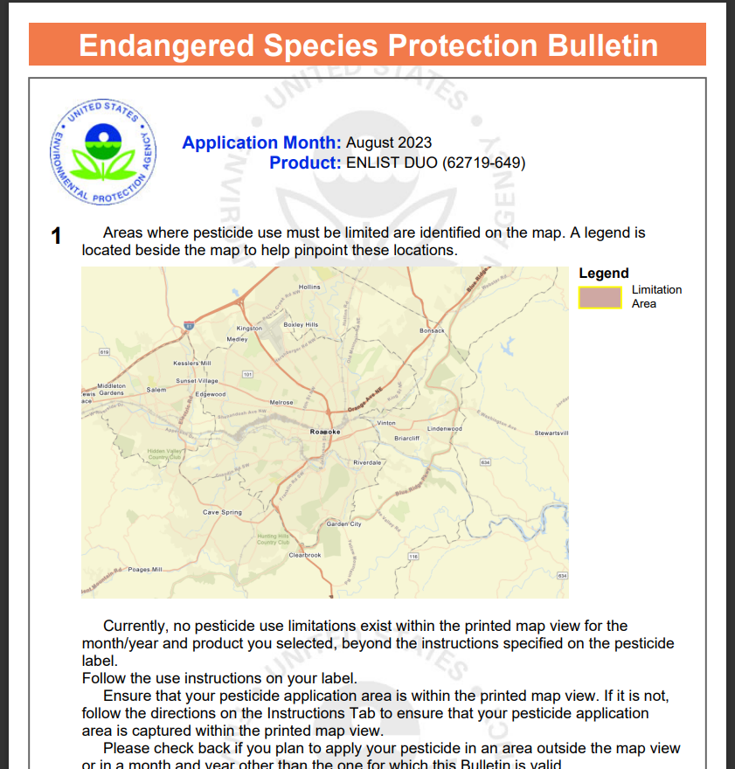
In this example, there are no pesticide use limitation in place.

Slide 21

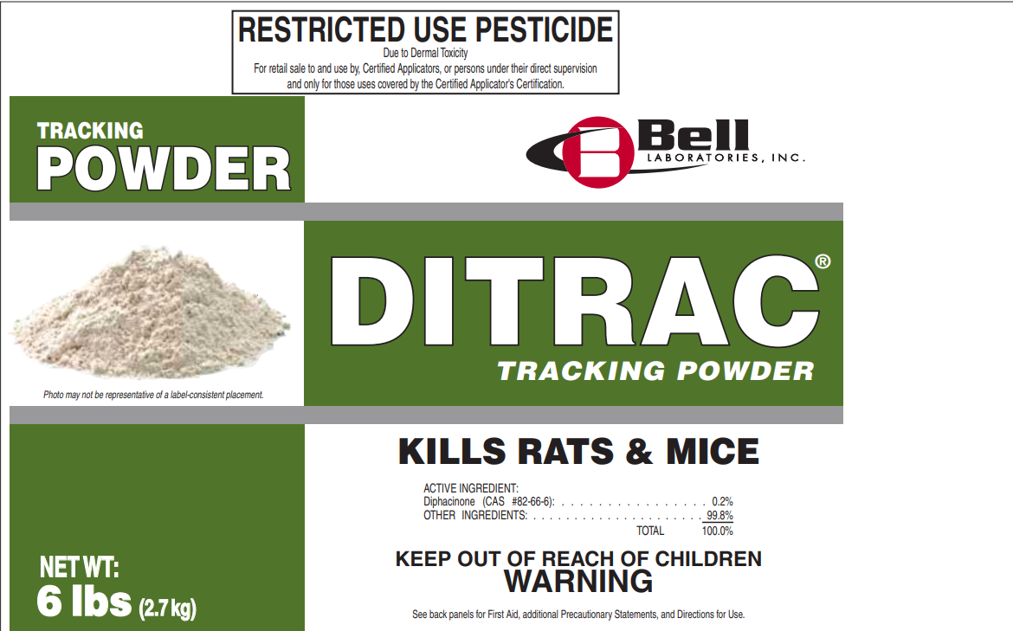
Pesticide Product Registration
All Pesticides
§ 3.2-3914 of the Virginia Pesticide Control Act requires…Every pesticide manufactured, distributed, sold, offered for sale, used, or offered for use shall be registered …
Pesticides classified by EPA as 25(b) Exempt products are not exempt from state registration.
To check the state registration status of a pesticide or to find a registered pesticide for a specific pest visit the Pesticide Product Registration page of our website.
http://www.vdacs.virginia.gov/pesticide-product-registration.shtml
Notes:
All pesticides manufactured, distributed, sold, offered for sale, used, or offered for use are required to be registered in Virginia. Pesticides are registered annually and registrations expire December 31 of each year. Even if you have a product you bought in 2021, if the company does not renew the registration for 2022, it is not legal to sell or use in Virginia.
Suggestion: Please note that there may be additional reporting requirements outside of those required under the Virginia Pesticide Control Act and its regulations; for example, accidents and incidents involving surface or groundwater.

Slide 22

Implications of Label PROVISION
“To be used By Certified Applicators only”
RESTRICTED USE PESTICIDE
To be used by certified applicators only; NOT to be used by uncertified persons working under the supervision of a certified applicator
While some restricted use pesticides allow uncertified persons to work under the supervision of a certified applicator, pesticides that contain the above statement may only be applied by certified (commercial and private) applicators (i.e.: Dicamba and Paraquat); and
Virginia’s Certified Registered Technicians do not meet the federal definition of a certified applicator thus are prohibited from making applications of any pesticide with the above statement (40 CFR Part 171).

Slide 23
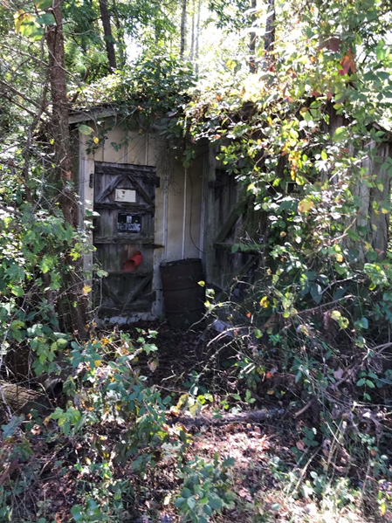
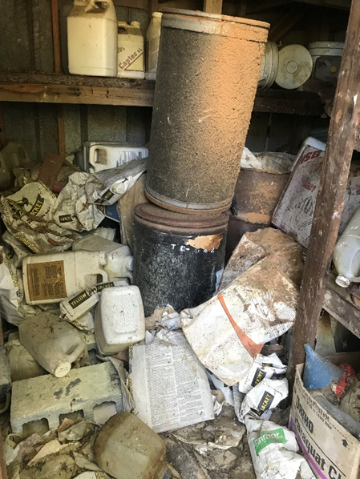
Storage
Store pesticides in original container in a well-ventilated area and away from food, pet food, feed, seed, fertilizers, and veterinary supplies.
Avoid cross-contamination with other pesticides. Keep container closed to prevent spills and contamination
NEVER store pesticides, for even a short time, in a food or drink container.
JUST SAY NO!
Notes:
As we covered earlier, “storage” is considered part of the routine use of pesticides. It is very important to store pesticides correctly. Proper storage ensures the integrity of the product and may help reduce the incidences of accidental poisonings. Check the pesticide label for storage requirements. Every year there are cases where pesticides have been stored improperly resulting in accidental ingestion or other exposure. These two photos are perfect examples of what NOT to do.

Slide 24
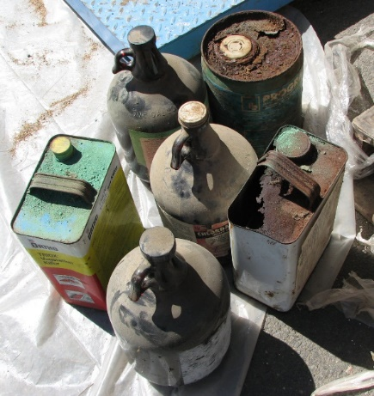
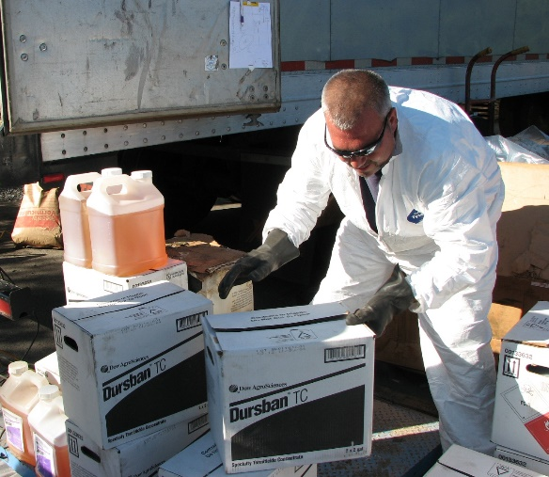
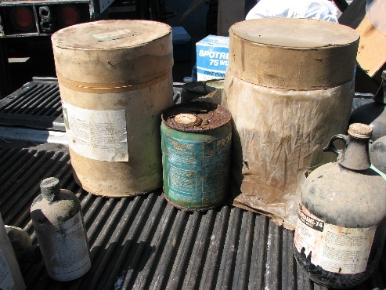
Pesticide Collection Program
The disposal of canceled, banned or unwanted pesticides poses a significant challenge to agricultural producers and other pesticide users due to its high cost.
Program Status
  FY23 program collected a total of ~60,000 lbs.
  Since its’ inception, a total of over 1.8 million lbs. has been collected.
  .
For more information:
http://www.vdacs.virginia.gov/pesticide-collection.shtml
Notes:
Like with pesticide storage, pesticide labels provide specific information about how to properly dispose of unused products.
To reduce the potential for unused pesticides, mix only enough pesticide for the job(s) you have planned and if possible, use up small amounts of excess pesticides. Should you have unwanted pesticides, they can be stored until the program is again available in your area:
• Pesticides should be stored out of reach of children and pets and in a secure location that is well-ventilated.
• Pesticides should never be stored in cabinets with or near food, animal feed, or medical supplies and should not be stored in places where flooding is possible or where they might spill or leak into wells, drains, ground water, or surface water.
• Always store pesticides in their original containers with their tops tightly closed if possible. If the pesticide label is damaged, provide as much information about the product as possible.
• If the integrity of the packing is compromised, place inside another container.
If you are unable to store your unwanted pesticides please be aware that, unless allowed on the pesticide label, pesticides cannot be disposed of in the same manner as other household trash since they are considered hazardous substances, As hazardous substances, pesticides need to be carried to a hazardous waste collection site or facility. Some municipalities may offer hazardous waste collection sites or hold annual hazardous waste collections. If a hazardous waste collection program is not offered in your area and you are unable to store your unwanted pesticides until the pesticide disposal program is in your area, you should contact an Environmental/Hazardous Waste Contractor to dispose of your unwanted pesticides.

Slide 25
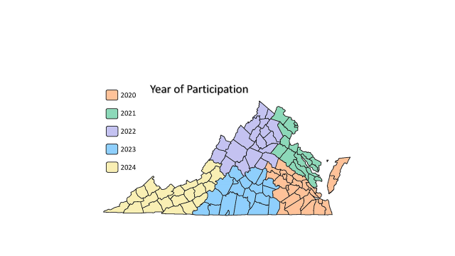
2020-2024
Pesticide Collection Program
Notes:
Once each of the 5 regions has been served, the cycle starts over. For current program information, visit the VDACS website at http://www.vdacs.virginia.gov/pesticide-collection.shtml.

Slide 26
Plastic Pesticide Container Recycling
Provide agricultural producers, pesticide dealers and pest control firms with option for the disposal of properly rinsed pesticide containers.
Program Status
  FY23 program recycled a total of ~96,000 lbs.
  Since its inception, a total of more than 2.4 million lbs. has been collected.
For more information:
http://www.vdacs.virginia.gov/pesticide-container-recycling.shtml

Slide 27
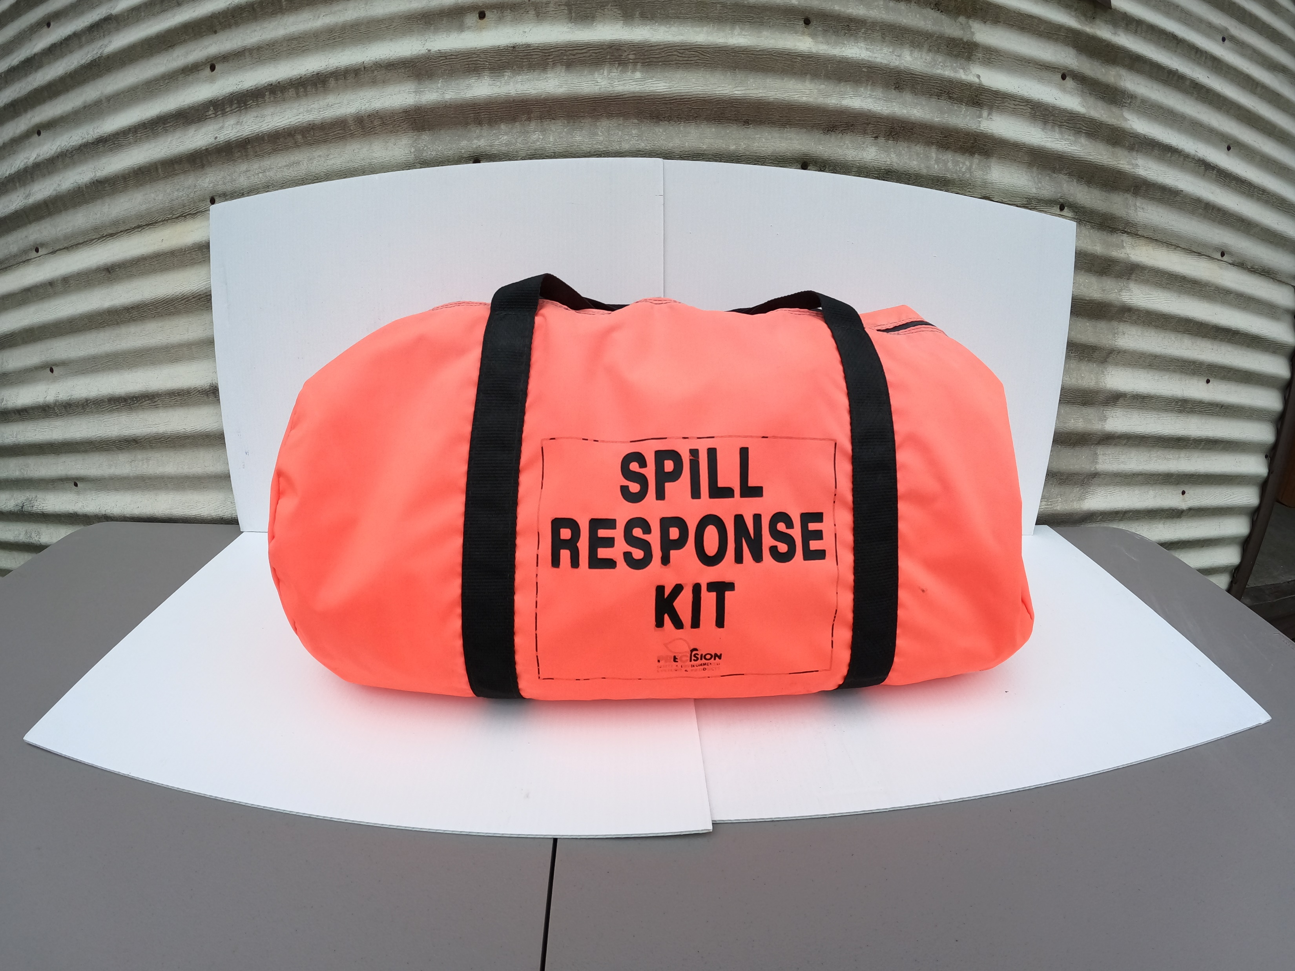
Reporting Requirements for Certified Applicators in Virginia: Accidents and Incidents*
Shall report any pesticide accident or incident in which they are involved that constitutes a threat to any person, to public health or safety, or to the environment, as a result of the use or presence of any pesticide.
Includes both general use and restricted use pesticides.
No minimum amount.
Should be reported to VDACS within 48 hours by phone and within 10 days in writing.
Reports include:
  Name of individuals involved in accident or incident;
  Name of pesticide involved;
  Quantity of pesticide spilled and containment procedures;
  Time, date, and location of accident or incident;
  Mitigating actions taken; and
  Name, or description if unnamed, and location of bodies of water nearby where contamination of such bodies of water could reasonably be expected to occur due to natural or manmade actions.
*There may be other reporting requirements outside of the Act & Regulations…
Notes:
All pesticide applicators are required to report an accident or incident involving pesticides to the Office of Pesticide Services. In addition to it being the law, while OPS is not considered a first responder, OPS can assist, as needed with technical information, copies of the label and Safety Data Sheets, and can act as the go between if needed with the pesticide manufacturer or EPA.
Suggestion: Please note that there may be additional reporting requirements outside of those required under the Virginia Pesticide Control Act and its regulations; for example, accidents and incidents involving surface or groundwater.

Slide 28
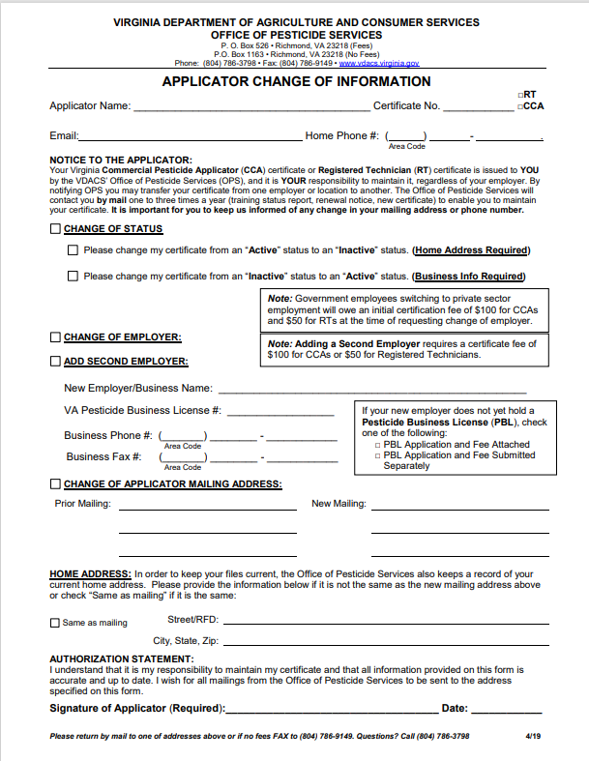
Reminder
If you don’t tell us, we won’t know!
applicators
Maintaining your certification includes:
  Ensuring OPS has your current mailing address - must complete a “Change of Information Form” to process any changes;
  Knowing when your certification expires and attend a recertification course prior to the expiration date of your certification; and
  Signing your name on the course roster and complete and sign your recertification application form.
Notes:
A pesticide applicator certification is issued to an individual thus it is the individual's responsibility to maintain their certification which includes making sure OPS has your current mailing address (where you want all correspondence regarding your certification is to be mailed); and taking a recertification course prior to the expiration of your certification. OPS will send information regarding applicator renewal prior to the expiration date of applicator certification. Applicator renewal information is sent as a courtesy. Even if you don’t get a renewal notice, you are still required to take the required recertification course. This is no different than renewing your driver’s license with DMV. You need your certification to be able to legally apply pesticides so be sure it is always up to date!
An annual pesticide business license is required for each location or outlet that sells, distributes, stores, applies, or recommends for use any pesticide.
No pesticide business may sell, distribute, or store any pesticide without a pesticide business license.
No person may apply or recommend for use any pesticide commercially without a pesticide business license and the employment of a certified commercial applicator responsible for: (i) the safe application of the pesticides; and (ii) providing recommendations for the use of pesticides.
If a pesticide business license expires or lapses (i.e. the Certificate of Insurance expires during the licensing year), the business cannot legally operate. If a firm’s business license has expired, all certifications of the firm’s pesticide applicators become invalid and the firm’s applicators cannot legally apply pesticides. Additionally, if the pesticide business license expires for a business selling pesticides, that business cannot legally sell pesticide until it renews its license. .
Like with pesticide applicator certification, even if the business owner/operator does not receive a renewal notice, or a notice of expiration of a Certificate of Insurance, it is the business owner/operator who is responsible to ensure the business has a valid pesticide business license. While OPS does send renewal notices and notifies pesticide businesses if their Certificate of Insurance expires, it is only as a courtesy A business must have a valid license so a business owner/operator must ensure they do!

Slide 29
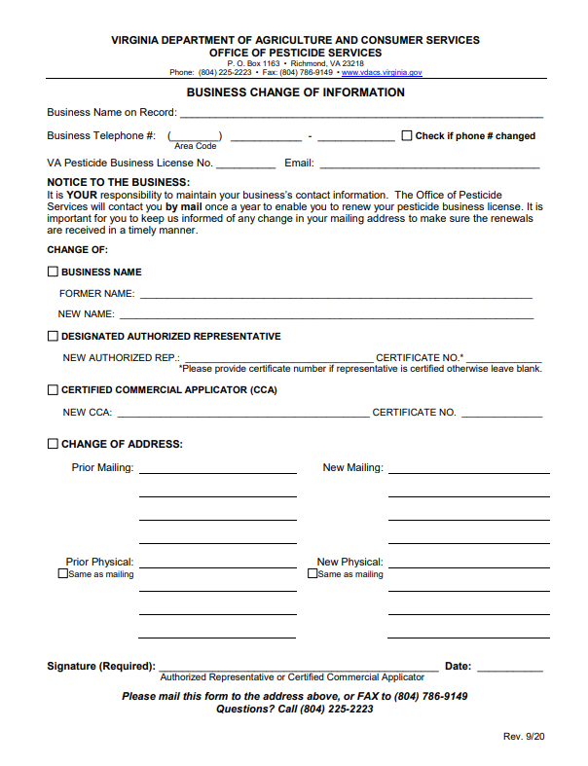
Reminder
If you don’t tell us, we won’t know!
businesses
Maintaining your license includes:
  Ensuring OPS has the business’ current mailing address - must complete a “Change of Information Form” to process any changes;
  Knowing when the business’ license expires and renew the business’ license before it expires;
  The business’ Certificate of Insurance is current and valid;
  The business has,
    If applying pesticides, a currently certified commercial applicator of record who is responsible for (i) the safe application of the pesticides; and (ii) providing recommendations for the use of pesticides; or
    If selling restricted use pesticides, or distribute restricted use pesticides for purposes of selling, must employ a certified commercial applicator of record who is present and bears immediate responsibility for the correct and safe operation of the location or outlet.
Notes:
A pesticide applicator certification is issued to an individual thus it is the individual's responsibility to maintain their certification which includes making sure OPS has your current mailing address (where you want all correspondence regarding your certification is to be mailed); and taking a recertification course prior to the expiration of your certification. OPS will send information regarding applicator renewal prior to the expiration date of applicator certification. Applicator renewal information is sent as a courtesy. Even if you don’t get a renewal notice, you are still required to take the required recertification course. This is no different than renewing your driver’s license with DMV. You need your certification to be able to legally apply pesticides so be sure it is always up to date!
An annual pesticide business license is required for each location or outlet that sells, distributes, stores, applies, or recommends for use any pesticide.
No pesticide business may sell, distribute, or store any pesticide without a pesticide business license.
No person may apply or recommend for use any pesticide commercially without a pesticide business license and the employment of a certified commercial applicator responsible for: (i) the safe application of the pesticides; and (ii) providing recommendations for the use of pesticides.
If a pesticide business license expires or lapses (i.e. the Certificate of Insurance expires during the licensing year), the business cannot legally operate. If a firm’s business license has expired, all certifications of the firm’s pesticide applicators become invalid and the firm’s applicators cannot legally apply pesticides. Additionally, if the pesticide business license expires for a business selling pesticides, that business cannot legally sell pesticide until it renews its license. .
Like with pesticide applicator certification, even if the business owner/operator does not receive a renewal notice, or a notice of expiration of a Certificate of Insurance, it is the business owner/operator who is responsible to ensure the business has a valid pesticide business license. While OPS does send renewal notices and notifies pesticide businesses if their Certificate of Insurance expires, it is only as a courtesy A business must have a valid license so a business owner/operator must ensure they do!

Slide 30
REMINDER
Credit For Recertification Course
For all in-person courses, signatures are required on both the roster(s) and the Application for Recertification Credit. When a signature is requested, it is not optional for credit. The signatures should not be significantly different.
Course sponsors/speakers seeking credit for attending their own course are required, like all attendees, to participate in the entire program and all sessions and complete all required forms as proof of attendance.
Course sponsors cannot self recertify rather the course must include presenters other than the course sponsor.
To renew by attending a recertification training program, complete one recertification course every two years for each category held. Applicators can accumulate up to four years of recertification credit beyond the certificate's expiration date in each category held
Notes:
Common issues with Recertification Course Documentation:
Individuals sign in with one name and sign out with another (same certificate no.);
Signature discrepancies – The signatures bore no resemblance (sign in/sign out; signature on roster vs application for recertification credit).
Illegible
Employer does not match that on file (Change of Information should be submitted separately)

Slide 31
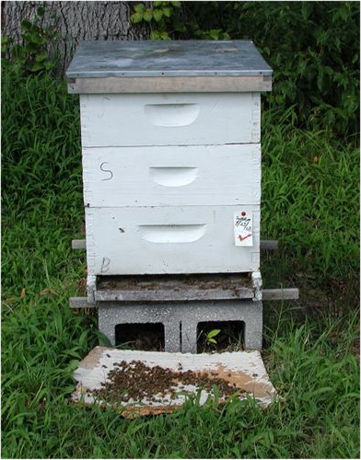
Protecting Pollinators
Voluntary Plan to Mitigate the Risk of Pesticides to Managed Pollinators
Voluntary, proactive approach which focuses on enhanced communication and coordination between pesticide applicators and beekeepers.
  Beekeepers providing information regarding the location of their hives; and
  Pesticide applicators providing advance notice of applications that have the potential to impact managed pollinators.
To facilitate the communication, VDACS has acquired an online mapping tool:
  Agricultural producers and pesticide applicators can register with FieldCheck® to view the locations of hives in the application area and notify beekeepers of planned applications.
  Beekeepers can use BeeCheck™ to map the location of their hives.
Notes:
Most of you are probably aware that a 2014 Presidential Directive included specific instructions to EPA to encourage state lead agencies for pesticide regulation, in this case, VDACS, to develop state pollinator protection plans to help mitigate the risk of pesticides to managed pollinators. While we know there are more factors than just pesticides that can potentially impact pollinators, these plans were to focus specifically on pesticides and managed pollinators. Virginia’s Voluntary Plan to Mitigate the Risk of Pesticides to Managed Pollinators was finalized in May 2017.
The Plan is voluntary and focuses on enhanced communication and coordination and the implementation of best management practices. As part of its Plan, VDACS has made available online mapping tools for both pesticide applicators and beekeepers. Pesticide applicators (including certified commercial, registered technicians, private applicators as well as agricultural producers) can register using FieldCheck. Beekeepers can use BeeCheck.
Virginia’s plan is not intended to prohibit, eliminate or further restrict the application of pesticides. As with all pesticide applications, the label is the law.

Slide 32


Registered users
346 Pesticide Applicators
965 apiaries
  4,711 beehives mapped

Slide 33


Online services
Should you need assistance using these services, please send an e-mail to us (see next slide)!!!
-Applicator Certification, Business Licensing and Product Registration are all available.
-Continue to actively work with IS to address issues and to incorporate efficiencies for both internal and external users.
-Continue to encourage use of the online system and welcome feedback from all users.

Slide 34
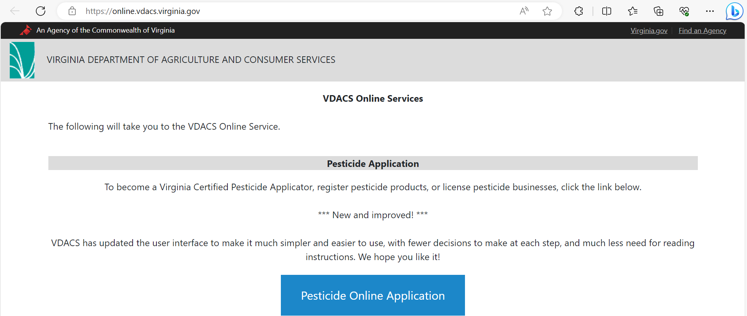
To access your online account
For pesticide applicators, tokens to access your online accounts are included in the renewal information sent to you by OPS.
Users can contact OPS to set up access if desired throughout year
opsclrt.vdacs@vdacs.virginia.gov
Requests for access should include applicator name, cert number, DOB, last five digits of SSN and email to be used to set up login (personal email/email unique to user)
VDACS will not grant employers access to employees' accounts. An employee can set up their own access and invite employer.

Slide 35

Options for Testing
All exams (commercial, private and registered technician):
  Remote Testing;
  DMV Computerized Testing; or
  Proctored Testing by Pesticide Investigators.
For both Remote Testing and DMV Computerized Testing, applicators who successfully pass their exam(s), will receive a temporary certificate and can begin to work.
Remote Testing requires an additional online testing fee that is paid directly to the provider.
  No fee for other exam options.
Proctored Testing by Pesticide Investigators is based upon availability.
IMPORTANT:
Applicators taking multiple exams must
take them in one sitting!

Slide 36
Testing reminders
Authorizations can only be used for one testing session
All listed exams must be taken during one testing session
Testers must follow testing protocols set by the test administrator and VDACS.
For example,
  DMV does not permit the use of phones during testing so exam sessions may be terminated if a phone is used for any reason.
  Remote Testing requires testers to face screen during exam and not to look off to the sides.
  Remote Testing does not allow the use of headphones during testing.

Slide 37

Remote testing
Additional fees required for remote testing. Fees are subject to change.
Once authorization issued, applicant will receive email from Everblue (provider) with information. Email will be sent to email address listed on the application. If email not received but authorization issued, contact VDACS at opsclrt.vdacs@vdacs.virginia.gov as there could be issue with the email provided.
Just as with DMV and in-person courses, all listed exams must be taken in one testing session. If exams not taken at same time, results may not be accepted.
Must follow proctoring guidelines or exam session may be rejected. This includes room scan and facing computer during exam.
Must check technology requirements prior to testing to make sure video of testing session can be recorded.

Slide 38
Spanish registered technician exam
Currently only available:
  Remote Testing; and
  In person (notify Investigator or Proctor).
DMV (forthcoming).

Slide 39
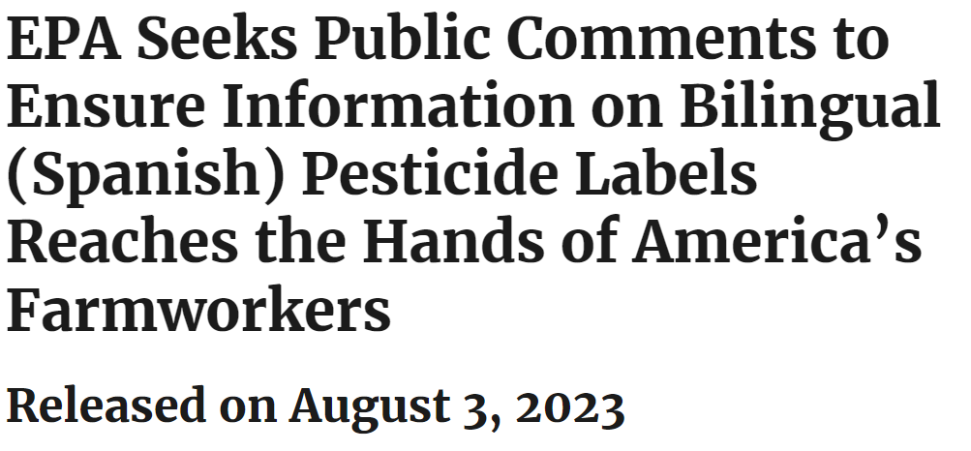
Coming soon…Bilingual Labeling
Comment period has since closed.
Pesticide Registration Improvement Act 5 requires Spanish language translation for certain sections of the end-use pesticide product labels.
Translations to be used are available in the EPA Spanish Translation Guide for Pesticide Labeling.
Only select portions of the label are required to be translated.
Translated label may not be a complete label and will not be reviewed and approved by EPA.
The sections that are required to be translated into Spanish include health and safety information.
Select sections include:
  First aid and precautionary statements label language
  Signal words
  Misuse statements
  Storage and pesticide container disposal instructions
  Personal Protection Equipment (PPE) label statements
  Worker Protection Standard (WPS) agricultural use requirements language
Phased in for all pesticide labels by December 29, 2030.

Slide 40
COMMERCIAL APPLICATORS & REGISTERED TECHNICIANS
Required additional information for all recertification courses for Commercial Applicator and Registered Technicians.
Notes:
Slides 40-52, Commercial Applicators & Registered Technicians, are required to be presented in addition to Slides 1-38, as part of all recertification courses for Commercial Applicators and Registered Technicians. Should a specific slide(s) not be appropriate for the specific audience and categories approved as part of the recertification course, they may be omitted, and other slides may be added.

Slide 41
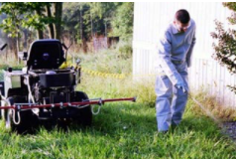
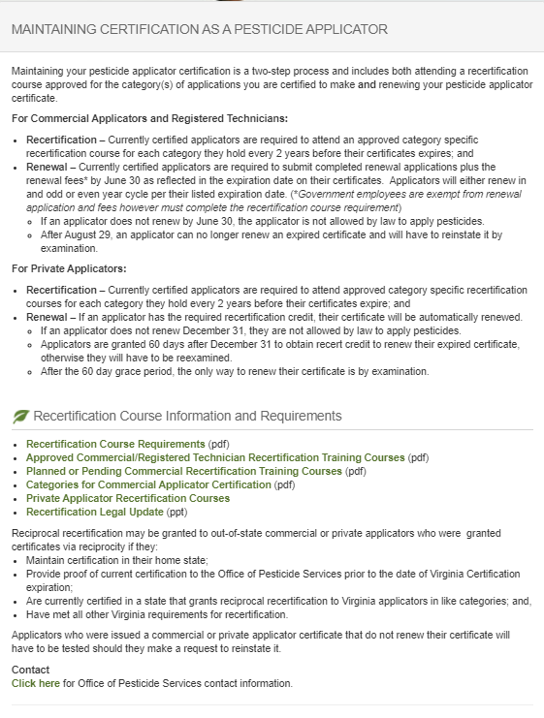
REMINDER:
Commercial Applicators & Registered Technicians
It is YOUR Responsibility to Maintain Your Certification
Maintain your pesticide applicator certification by attending an approved category specific recertification course or be retested for each category you hold every 2 years and before your certificate expires. Do so and your certificate will be automatically renewed without any associated fee.
If an applicator does not renew by June 30 of the year in which the certificate expires, the applicator certification will not be renewed and the applicator is not allowed by law to apply pesticides. While not certified, the same applicator has from July 1-August 29 of the same year to do what is required to have that certificate reinstated.
After August 29, an applicator can no longer renew an expired certificate and will have to reinstate it by examination. This requires the submission or an application and fee to retake the exam(s).
Notes:
In the Fall of each year (normally October), OPS ends notices to applicators who need recertification credit in order to renew their certificates within the next year, and remind them to attend a recertification class. Most classes are offered November to March, but you are responsible for finding them. Depending on your category or part of the state, they may be hard to find: plan ahead and have alternatives. You can take extra classes to earn credit and extend your training status up to 4 years ahead.
Government applicators (both RT and commercial) will be renewed and mailed out automatically in May if you have enough recertification credit. Make sure OPS has your correct mailing address on file.
Commercial & RT: In April of the year your certificate expires, OPS will send you a renewal notice, listing your categories and their expiration dates, reminding you again to take a class if necessary. This only works if OPS has your correct mailing address on file. Note: If you hold both RT and a Commercial (C, N or G) they may be on a different renewal cycle so pay attention to the date on the card. If you hold multiple certificates (multiple employers) within the same class they should be the same (i.e. all RT cards issued to an individual working for multiple employers should have same expiration date).
What happens if you’ve been busy or forgetful? For 60 days, from July 1-August 29, you can send in the renewal form with a 20% late fee. For 60 days, from Jul 1-Aug 29, you can try to find a class, or retake certification exams. *Until you meet both requirements, you will have an expired certificate and should not be working!
By law, after Aug. 29, you must start the entire process over and pay all fees, and retake all exams.

Slide 42
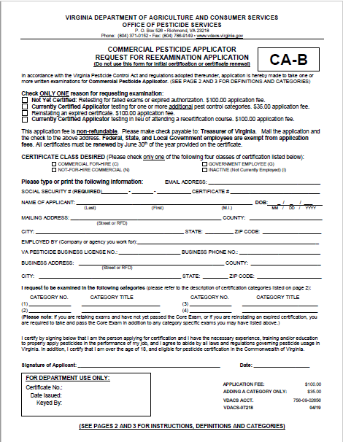
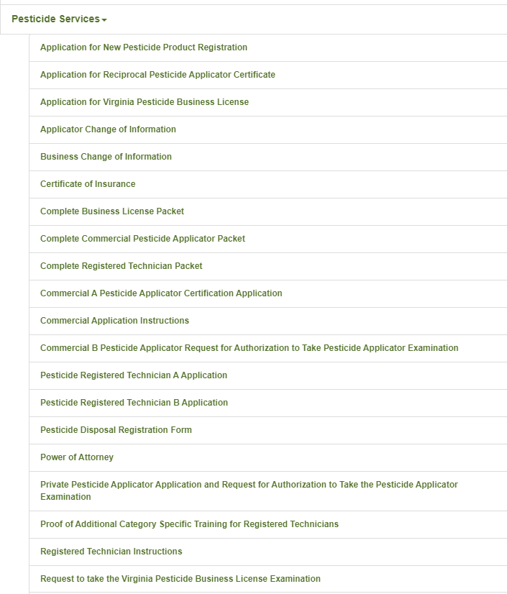
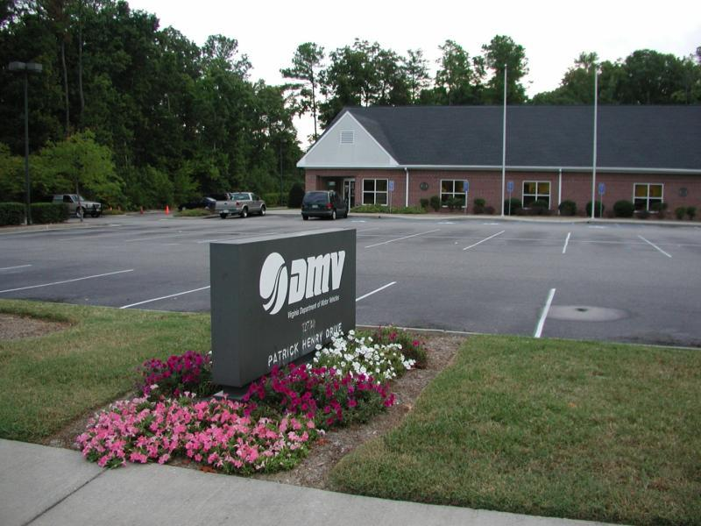
REMINDER:
Commercial Applicators & Registered Technicians
If you opt to test in lieu
of attending a recertification course:
You must submit a testing application and appropriate fee.
Notes:
In October of the year that your certificate expires we’ll send you a notice listing when your categories expire, and reminding you to attend a recertification class. Most classes are offered November to March, but you are responsible for finding them. Depending on your category or part of the state, they may be hard to find: plan ahead and have alternatives. You can take extra classes to earn credit and extend your training status up to 4 years ahead.
Government applicators (both RT and commercial) will be renewed and mailed out automatically in May if you have enough recertification credit. Make sure OPS has your correct mailing address on file.
Commercial & RT: In April of the year your certificate expires, OPS will send you a renewal notice, listing your categories and their expiration dates, reminding you again to take a class if necessary. This only works if OPS has your correct mailing address on file. Note: If you hold both RT and a Commercial (C, N or G) they may be on a different renewal cycle so pay attention to the date on the card. If you hold multiple certificates (multiple employers) within the same class they should be the same (i.e. all RT cards issued to an individual working for multiple employers should have same expiration date).
What happens if you’ve been busy or forgetful? For 60 days, from July 1-August 29, you can send in the renewal form with a 20% late fee. For 60 days, from Jul 1-Aug 29, you can try to find a class, or retake certification exams. *Until you meet both requirements, you will have an expired certificate and should not be working!
By law, after Aug. 29, you must start the entire process over and pay all fees, and retake all exams.

Slide 43
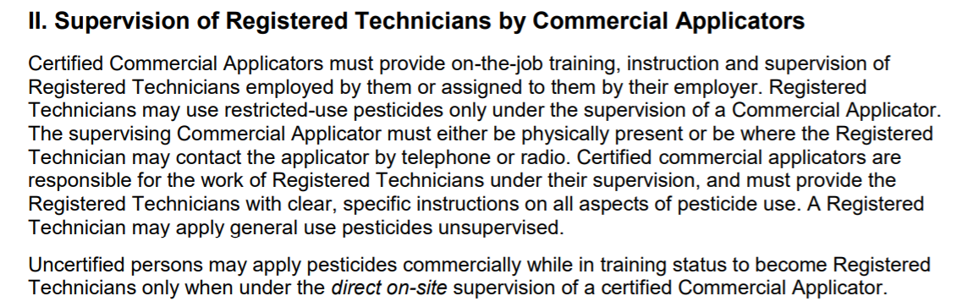
Supervision Requirements:
Registered Technicians
Only certified Commercial Applicators may supervise certified Registered Technicians (RT)
Certified Registered Technicians must have direct supervision by a certified Commercial Applicator to use Restricted Use Pesticides (RUPs)
Certified Commercial Applicators
  Must provide instructions on safe use
  Must be accessible within telephone or radio contact, or on site
  Is responsible for actions of the RT
Certified Registered Technicians may use General Use Pesticides without supervision

Slide 44
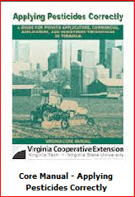
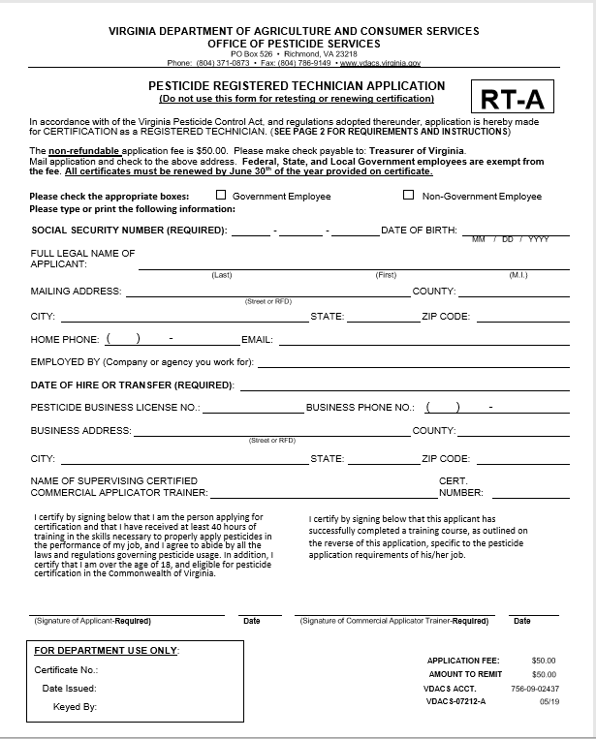
Supervision Requirements:
Training Registered Technicians
Only Certified Commercial Applicators may supervise the use of pesticides by persons training to become registered technicians
Prospective pesticide applicators (persons in training) must have DIRECT ON-SITE supervision to use any pesticide
Certified Commercial Applicator
  Must provide instructions on safe use
  Must be on site
    physically present on the property upon which the pesticide is being applied
    in constant visual contact with the person applying the pesticide.
  Is responsible for actions of uncertified person
Training must be documented and submitted to VDACS
Notes:
The trainee and the CCA who provides the training will both sign the “Pesticide Registered Technician Application” (RT-A) form and certify that all required training (40 hours total) has been provided.

Slide 45
Training Registered Technicians:
Proof of Additional Category Specific Training
Only Certified Commercial Applicators may supervise the use of pesticides
The CCA trainer must submit a completed additional training form for the RT changing or adding categories.
Training must be documented and submitted to VDACS within 10 calendar days of completion of such training.
Notes:
The RT and the CCA who provides the training will both sign the “Proof of Additional Category Specific Training for Registered Technicians” form and certify that the technician has received training in additional categories. These categories will appear on the RT Certificate under TRAINED IN section.
http://www.vdacs.virginia.gov/pdf/RegTech.AdditionalCatTraining.pdf

Slide 46
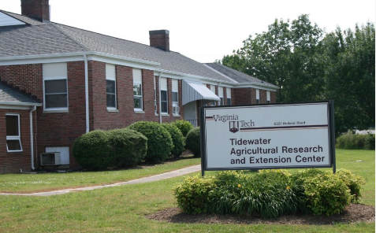
REMINDER:
Government Employees
That means, Governmental agencies need to:
  Have a certified commercial applicator on Staff to train prospective registered technicians; or
  Work with other Governmental agencies with a certified commercial applicator to train new prospective registered technicians; or
  Hire or otherwise retain a certified commercial applicator to train prospective registered technicians.
In all cases, the certified commercial applicator must be certified in the category in which the registered technician will be working!
All Government employees who apply pesticides are required to be certified:
  Commercial Not-for-Hire; or
  Registered Technician
Certification is valid only when applying or supervising application of pesticides used by such governmental agencies.
Do not work for a “pesticide business” so are not required to have a certified commercial applicator on Staff, however, only certified commercial applicators can train registered technicians.
Notes:
2VAC5-685-20. General Requirements for Certification. Part II. Certification of Pesticide Applicators, states C. Employees of local, state, and federal governmental agencies who use or supervise the use of any pesticide on any area in the performance of their official duties must be certified as either commercial applicators not for hire or registered technicians, but they are exempt from any certification fees…
Government employees are also subject to all other provisions of the Act and Regulations, including training, recertification and recordkeeping. However, as they do not work for a “pesticide business”, rather they make applications as part of their official duties, government agencies are not required to have a certified commercial applicator on Staff. This can be problematic as only a certified commercial applicator can train prospective (new) registered technicians. There are options for governmental agencies seeking to train prospective applicators:
Have a certified commercial applicator on Staff to train prospective registered technicians; or
Work with other Governmental agencies with a certified commercial applicator to train new prospective registered technicians; or
Hire or otherwise retain a certified commercial applicator to train prospective registered technicians.

Slide 47
REMINDER:
Volunteers
As a follow-up, the following exemption will go into effect on July 1, 2024:
Pesticide control exemptions; herbicide applications by unpaid volunteers. Exempts from the provisions of state pesticide laws and regulations any unpaid volunteer who uses any nonrestricted herbicide with the express authorization of a local political subdivision for the sole purpose of controlling invasive plants or noxious weeds on properties owned by such local political subdivision. The bill provides that such unpaid volunteer shall use such herbicide under the direct supervision of a certified commercial applicator and the local political subdivision shall provide instruction by a certified commercial applicator to the unpaid volunteer prior to application on (i) the risks associated with the herbicide utilized, (ii) the proper use of equipment used to apply the herbicide, (iii) the proper use of personal protective equipment, (iv) other information to prevent an unreasonable adverse effect on the environment, and (v) any other information relevant to the specific herbicide utilized.
Notes:
2VAC5-685-20. General Requirements for Certification. Part II. Certification of Pesticide Applicators, states C. Employees of local, state, and federal governmental agencies who use or supervise the use of any pesticide on any area in the performance of their official duties must be certified as either commercial applicators not for hire or registered technicians, but they are exempt from any certification fees…
Government employees are also subject to all other provisions of the Act and Regulations, including training, recertification and recordkeeping. However, as they do not work for a “pesticide business”, rather they make applications as part of their official duties, government agencies are not required to have a certified commercial applicator on Staff. This can be problematic as only a certified commercial applicator can train prospective (new) registered technicians. There are options for governmental agencies seeking to train prospective applicators:
Have a certified commercial applicator on Staff to train prospective registered technicians; or
Work with other Governmental agencies with a certified commercial applicator to train new prospective registered technicians; or
Hire or otherwise retain a certified commercial applicator to train prospective registered technicians.

Slide 48
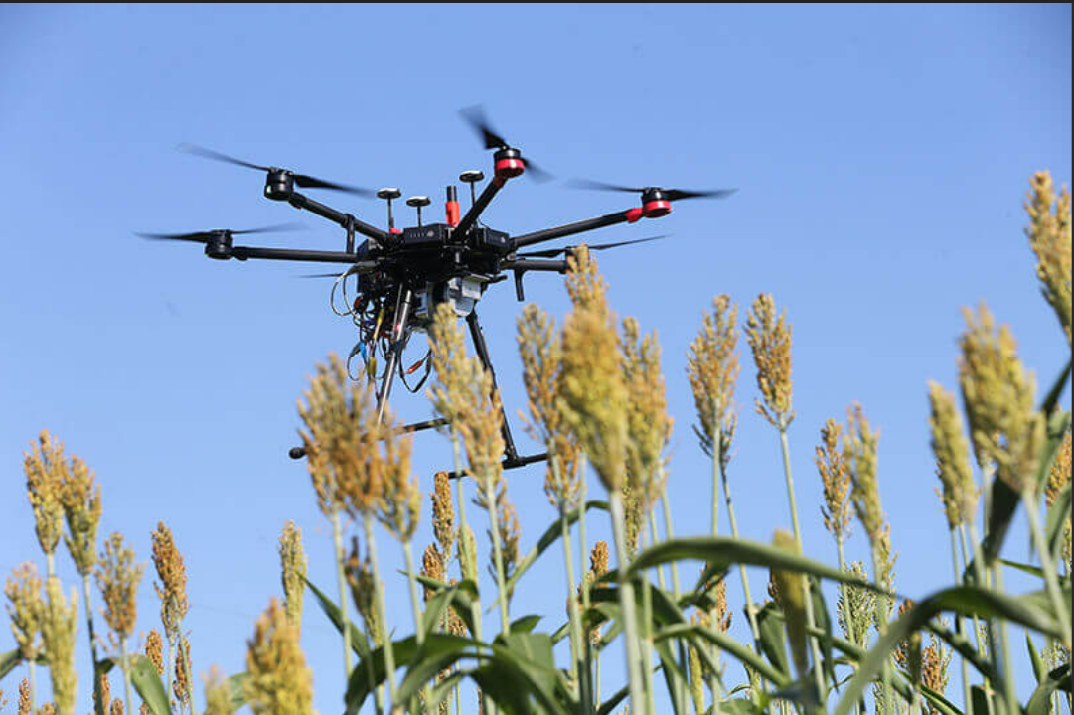
Unmanned Aerial Vehicles (UAV) and Systems (UAS) Requirements
Pesticide applicators applying pesticides using UAV/UAS are required to be certified as a commercial applicator in Category 11 or, for registered technicians, are required to have received category specific training from an applicator certified in Category 11:
  11. Aerial pesticide application. This category is for commercial applicators who will be using or supervising the use of any pesticide applied by fixed- or rotary-wing aircraft.
As always, the label is the law!
Purdue University

Slide 49
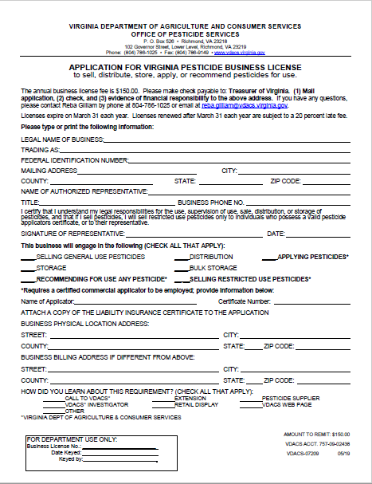
Business Licenses
Whose Responsibility Is It Anyway?
For pesticide businesses including those that sell, distribute, or store any pesticide or apply or recommend for use any pesticide commercially, it is the business owner/operator’s responsibility to maintain the pesticide business license including being sure…
OPS has the business’ current mailing address
Must complete a “Change of Information Form” to process any changes;
Know when the business’ license expires and renew the business’ license before it expires;
The business’ Certificate of Insurance is current and valid;
The business has, if applicable, a currently certified commercial applicator of record who is responsible for (i) the safe application of the pesticides; and (ii) providing recommendations for the use of pesticides; and
Businesses which sell restricted use pesticides, or distribute restricted use pesticides for purposes of selling, must employ a certified commercial applicator of record who is present and bears immediate responsibility for the correct and safe operation of the location or outlet..
Notes:
An annual pesticide business license is required for each location or outlet that sells, distributes, stores, applies, or recommends for use any pesticide.
No pesticide business may sell, distribute, or store any pesticide without a pesticide business license.
No person may apply or recommend for use any pesticide commercially without a pesticide business license and the employment of a certified commercial applicator responsible for: (i) the safe application of the pesticides; and (ii) providing recommendations for the use of pesticides.
If a pesticide business license expires or lapses (i.e. the Certificate of Insurance expires during the licensing year), the business cannot legally operate. If a firm’s business license has expired, all certifications of the firm’s pesticide applicators become invalid and the firm’s applicators cannot legally apply pesticides. Additionally, if the pesticide business license expires for a business selling pesticides, that business cannot legally sell pesticide until it renews its license. .
Like with pesticide applicator certification, even if the business owner/operator does not receive a renewal notice, or a notice of expiration of a Certificate of Insurance, it is the business owner/operator who is responsible to ensure the business has a valid pesticide business license. While OPS does send renewal notices and notifies pesticide businesses if their Certificate of Insurance expires, it is only as a courtesyA business must have a valid license so a business owner/operator must ensure they do!

Slide 50
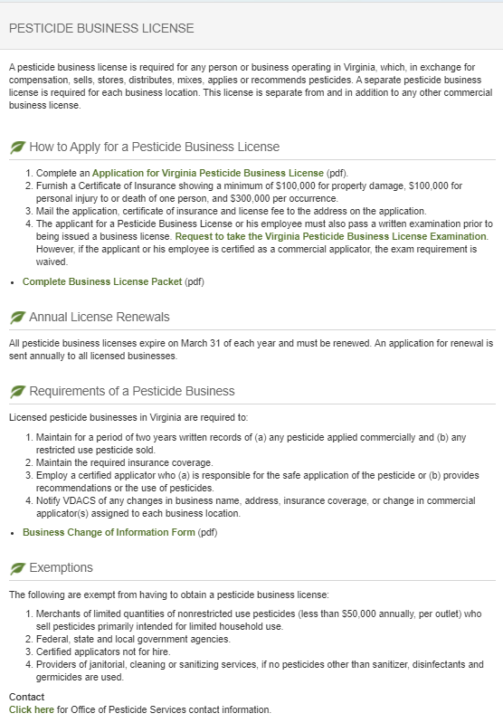
REMINDER:
Pesticide Business Licenses
All business licenses expire on March 31;
If not renewed by March 31,
  The business is not licensed and cannot conduct business until such time as the licensed is renewed, for example, sell or apply pesticides; and
  The certificates of all pesticide applicators working for the business are inactive, therefore, applicators may not apply pesticide until the business license is renewed.
Proof of insurance is required to maintain a business license. It is the business’ responsibility to ensure that a current certificate of insurance is on file throughout the license year:
  If the certificate of insurance expires at any time during the year, the pesticide business license is considered unlicensed and cannot conduct business; and
  The certificates of all pesticide applicators working for the business are inactive, therefore, applicators may not apply pesticide until the business license is valid.
Notes:
Although OPS may notify businesses when their insurance lapses, it is ultimately their responsibility to provide up to date evidence of financial responsibility (i.e. Certificate of Insurance)
Business are required to have the following amount of financial responsibility:
$100,000 for property damage;
$100,000 for personal injury or death of one person; and,
$300,000 per occurrence.

Slide 51
Pesticide Fees:
Non-Refundable and Non-Transferable
AVOID A 20% LATE FEE BY RENEWING AND PAYING ON TIME.
Fees are assessed to offset the cost of processing applications for:
  Certified applicators (commercial & registered technicians) – initial, retesting, and adding a category;
  Business licenses; and
  Product registration.
Once applications are processed, regardless of if the credential is issued, fees will not be refunded.
Fees are transaction specific (i.e. fees paid for one prospective applicator's credential cannot be used to pay for a second prospective applicator's credential).
Refunds, if due, are transaction specific. Refunds cannot be applied to offset another fee.
Notes:
Refunds are sent from OPS to Finance for processing.
Businesses should avoid sending duplicate checks if at all possible.
If a business or person believes that an overpayment has been made, they should not cancel the check. They should let us refund it.
There is a $50 fee for checks which are returned due to non-sufficient funds, cancellation, etc.

Slide 52
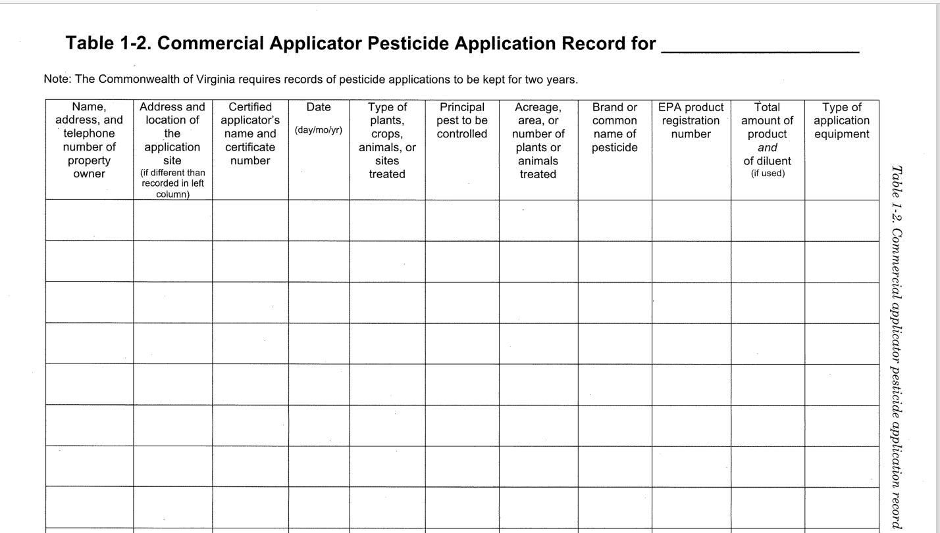
Recordkeeping
PESTICIDE APPLICATION RECORDKEEPING – A MUST!!!
  For pesticide businesses (commercial applicators and registered technicians); and
  For commercial applicators not for hire and registered technicians not for hire.
Notes:
Tell YOUR story every time you apply.

Slide 53


Recordkeeping elements
Name, address, and telephone number of customer and address or location, if different, of site of application;
Name and certification number (or certification number of the supervising certified applicator) of the person making the application;
Day, month and year of application;
Type of plants, crop, animals, or sites treated and principal pests to be controlled;
Acreage, area, or number of plants or animals treated;
Brand, trademark, or product name appearing on the product's label;
EPA registration number;
Amount of pesticide concentrate and amount of diluent used, by weight or volume, in mixture applied; and
Type of application equipment used.
Notes:
When conducting inspections or investigations, Pesticide Investigators will often review pesticide application records which are required by law for all commercial pesticide applications. Records contain information regarding how a pesticide was applied and are used to determine compliance with the label requirements.
How you keep your records is up to you. They can be paper, electronic or a combination of both. The law requires records covered in this chapter shall, upon written request, be made available for during normal business hours. Records not readily available shall be submitted to the commissioner within 72 hours if so requested in writing. Records may be submitted electronically in a manner specified by VDACS, including, but not limited to, electronic mail or by completing any forms provided online by VDACS. Records are required to be kept for 2 years. . Failure to keep the proper records is a violation and applicators may be subject to enforcement action if they do not keep records.

Slide 54
PRIVATE APPLICATORS
Required additional information for all recertification
courses for Private Applicators
Notes:
The information contained in Slides 45-48, Private Applicators, is required to presented in addition to the information contained in Slides 1-29. Additional slides may be added for specific audiences.

Slide 55



REMINDER: Private Applicator Certification
Maintaining your pesticide applicator certification is a two-step process and includes both attending a recertification course approved for the category(s) of applications you are certified to make and renewing your pesticide applicator certificate.
  Recertification – Currently certified applicators are required to attend approved category specific recertification courses for each category they hold every 2 years before their certificates expire; and
  Renewal – If an applicator has the required recertification credit, their certificate will be automatically renewed.
If an applicator does not renew December 31, they are not allowed by law to apply pesticides.
Applicators are granted 60 days after December 31 to obtain recertification credit to renew their expired certificate, otherwise they will have to be reexamined.
After the 60 day extension period, the only way to renew their certificate is by examination.
Notes:
Private applicator certificates will be renewed and mailed out automatically in December if you have enough recertification credit. Make sure OPS has your correct mailing address on file, especially if there has been a 911 change in your county. You can still take a class up until March 1, but it will delay the renewal of your certificate.

Slide 56
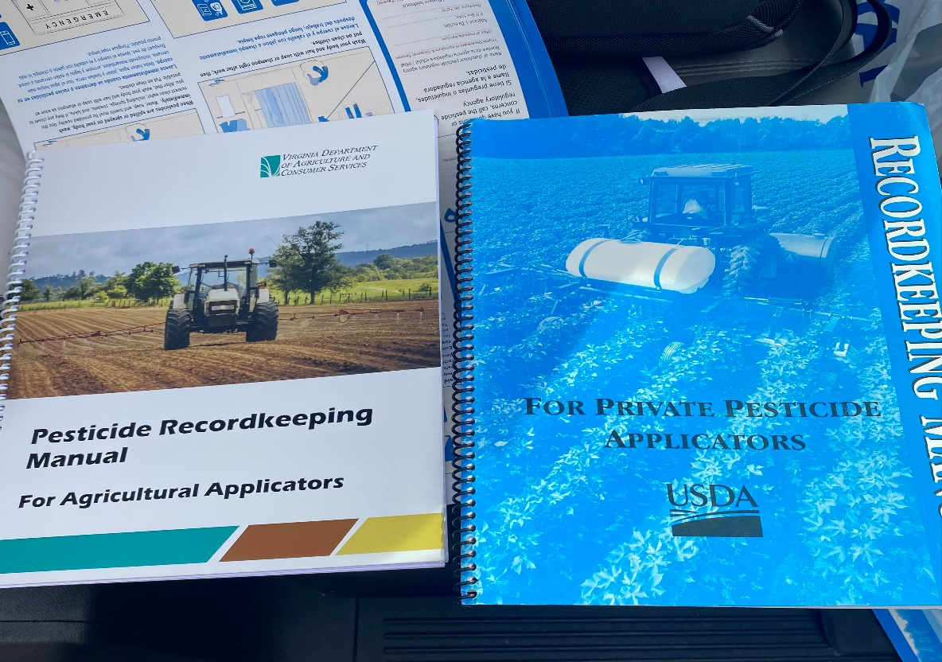
Recordkeeping
  For Private Applicators
    Requirements under the Worker Protection Standard (WPS); and
    Requirements for the use of Restricted Use Pesticides (RUP).
Notes:
Tell YOUR story every time you apply.
* The Office of Pesticides has Pesticide Recordkeeping manuals available upon request. The new requirements are on the book to the left, if you still have any “blue” USDA books they are outdated.

Slide 57

WORKER PROTECTION STANDARD
Pesticide records must contain:
Name of the pesticide applied,
Active ingredient,
EPA registration number,
REI,
Crop or site treated,
Location and description of the treated area(s), Date(s) and times application started and ended, and
Safety Data Sheet of the pesticide applied.
Pesticide records must be maintained for any covered use of a WPS labeled pesticide for either general-use or restricted-use pesticides.
RESTRICTED USE PESTICIDES
The 9 required elements that must be recorded within 14 days of each RUP application are as follows:
The brand or product name,
The EPA registration number,
The total amount applied,
The month, day, and year,
The location of the application,
The crop, commodity, stored product, or site,
The size of area treated,
The name of the certified applicator, and
The certification number of the certified applicator.
Notes:
When conducting inspections or investigations, Pesticide Investigators will often review pesticide application records which are required by law private applicators. Records contain information regarding how a pesticide was applied and are used to determine compliance with the label requirements. Private applicators are required to keep records under the Worker Protection Standard AND of all restricted use pesticide applications.
The 1990 Farm Bill required all private applicators to keep record(s) of their federally restricted use pesticide (RUP) applications for a period of 2 years. There is no standard Federal form for recording RUP applications, which allows certified private applicators the flexibility to integrate RUP applications into any recordkeeping system. The 9 required elements that must be recorded within 14 days of each RUP application are as follows:
The brand or product name
The EPA registration number
The total amount applied
The month, day, and year
The location of the application
The crop, commodity, stored product, or site
The size of area treated
The name of the certified applicator
The certification number of the certified applicator

Slide 58
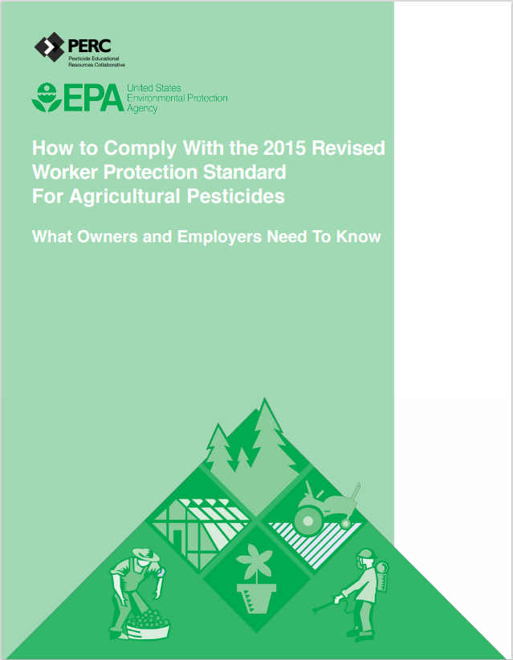
Federal Worker Protection Standard
40 CFR Part 170, Worker Protection Standard, Revised in 2015
Goal to reduce pesticide poisonings and injuries among agricultural workers and pesticide handlers.
All requirements of the revised WPS are now in effect.
Related WPS resources, including the revised How to Comply Manual, are available online and you may also request a hard copy by contacting our office.
-EPA Worker Protection Standard webpage:
https://www.epa.gov/pesticide-worker-safety/agricultural-worker-protection-standard-wps
Pesticide Educational Resources Collaborative (PERC) pesticideresources.org
Contact Sue Odom, Coordinator, at VDACS for assistance finding WPS resources.
Email: Susan.Odom@vdacs.virginia.gov or Phone: 804-786-8934
Notes:
The EPA's Agricultural Worker Protection Standard (WPS) aims to reduce pesticide poisonings and injuries among agricultural workers and pesticide handlers. The WPS offers occupational protections to over 2 million agricultural workers and pesticide handlers who work at over 600,000 agricultural establishments. In 2015, the EPA revised the WPS to decrease pesticide exposure incidents among farmworkers and their family members. Fewer incidents means a healthier workforce and fewer lost wages, medical bills and absences from work and school.
All of the requirements of the 2015 revised standard are in effect. In general, employers are responsible for WPS compliance. These include:
Owners/employers on agricultural establishments that grow and harvest for commercial production:
Fruits and vegetables on farms.
Timber and trees in forests and nurseries.
Plants in greenhouses and nurseries.
Employers of researchers who help grow and harvest plants.
Employers at commercial pesticide handling establishments
Pesticide safety training materials with the expanded content required by the 2015 WPS must be used to train workers and handlers. Pesticide training is required annually. EPA-approved training materials for national use are available from the EPA’s WPS webpage as well as the Pesticide Educational Resources Collaborative (PERC).
Key provision require all employers to do the following:
Do not retaliate against a worker or handler.
Provide annual pesticide safety training. There is no grace period for WPS training! The agricultural employer must ensure that WPS training is completed within the last 12 months before:
Any worker enters a treated area on an agricultural establishment where, within the last 30 days, a WPS-labeled pesticide product has been used or a REI for such pesticide has been in effect.
Any handler conducts any handling task.
Provide access to specific information for workers and handlers at a central location during normal work hours, including (agricultural employers only):
Pesticide applications on the establishment;
Safety Data Sheets for pesticides applied on the establishment; and
Pesticide safety information that includes emergency information.
Provide WPS-required safety, pesticide application, and hazard information to workers and handlers or their designated representative, or to treating medical personnel, if requested. For additional details, see the Designated Representative section of this webpage or Chapter 2 of the WPS How to Comply Manual. See full requirements at 40 CFR 170.311(b).
Provide decontamination supplies.
Exchange information (between a commercial handler employer and an operator of an agricultural establishment).
Provide emergency assistance by making transportation available to a medical care facility in case of a pesticide injury or poisoning and providing information about the pesticide(s) to which the person may have been exposed.
On October 30, 2020 the EPA finalized improvements to the applications exclusion zone requirements or the area surrounding pesticide application equipment that exists only during outdoor production pesticide applications.
Additional information is available from the EPA’s Worker Protection Standard webpage, your Extension Agent or the Office of Pesticide Services.

Slide 59



Free Worker Protection Standard Training
Telamon is funded by the Virginia Department of Agriculture and Consumer Services to provide WPS training for workers and handlers at no cost to growers or workers.
Trainings can be completed at your farm in-person or online anywhere in Virginia for any number of workers, and we have trainers that can offer the training in English, Spanish, French, Haitian Creole, Arabic, and Kurdish.
Sign up here
https://forms.office.com/r/RMZUttunt4
Email MidAtlanticWPSSafety@telamon.org
Phone 1 800 285 1676

Slide 60
If you don’t know…ask us!
Certification, License Registration, & Training (CLRT)
804-786-3798
Enforcement & Field Operations
804-371-6560
Compliance
804-371-8485
Environmental Programs
804-371-6561
Program Manager
804-371-6559
http://www.vdacs.virginia.gov/pesticides.shtml
Email: opsclrt.vdacs@vdacs.virginia.gov
robert.christian@vdacs.virginia.gov
757-334-3966
Notes:
If you don’t know, call the Office of Pesticide Services or visit the website!

Slide 61
2023-2024
Pesticide Regulatory Update
Virginia Department of Agriculture and Consumer Services
Office of Pesticide Services
Notes:
This 2020-2021 Pesticide Regulatory Update meets the requirements for the legal update as part of all approved pesticide applicator recertification programs. All information contained in Slides 1-27 must be presented as part of all approved recertification courses including those for commercial applicators (all categories), registered technicians and private applicators. In addition, for recertification of commercial applicators and registered technicians, the information contained in Slides 27-51 must be presented. For recertification courses for private applicators, the information contained in Slides 52-67 must be presented. The items in the Legal Update are required for the Board to approve the training for credit. Should the complete Legal Update not be provided, recertification credit will not be given to attendees.
Presenters are free to add to this presentation to suit different audiences, if appropriate. Slides may be added as appropriate for course attendees.
Talking points are provided in the notes for many of the slides. Should you have any questions, please contact:
-Applicator Certification, Business License, Product Registration, and Training – Micah Raub, Supervisor, at micah.raub@vdacs.virginia.gov or 804-786-4845;
-Enforcement & Field Operations – Clint Shettle, Supervisor, at clinton.shettle@vdacs.virginia.gov or 804-786-8943;
-Compliance – Christine Trostler, Compliance Officer, at christine.trostler@vdacs.virginia.gov or 804-371-8485;
-Pesticide Disposal & Recycling Programs – Jeff Rogers, Environmental Program Planner, at jeffrey.rogers@vdacs.virginia.gov or 804-371-6561.
All other inquiries should be directed to the Office of Pesticide Services at 804-786-3798.
Contact information for the Office of Pesticide Services is also included at the end of the presentation.
Notes:
When offering testing as part of a recertification course, sponsors should ensure that the applications are submitted in a timely manner well in advance of the test date. Applications should be received no less than 30 days in advance of the testing date to allow for processing and issuance of a Letter of Authorization (LOA). Some sponsors are waiting until a week or two before the exam date to get applications submitted and expecting that OPS will expedite the processing and email or fax the LOAs at the last minute. If applications are not submitted in a timely manner, it is possible that sponsors and prospective applicators will not have them by the exam date. A LOA is required to sit for examination.
For course sponsors/instructors seeking recertification credit for their own course, you are required, like all attendees, to participate in the entire program and all sessions and complete all required forms. Course sponsors can not “self recertify” rather the course must include presenters others than the course sponsor.

Slide 62
QUIZ QUESTION
THE AGENCY THAT REGISTERS PESTICIDES IN VIRGINIA IS:
A. THE VIRGINIA DEPARTMENT OF AGRICULTURE AND CONSUMER SERVICES
B. VDACS
C. THE SAME ONE THAT EMPLOYS TODAY’S PRESENTER, ROBERT CHRISTIAN
D. ALL OF THE ABOVE AND YES THIS IS THE BEST CHOICE (READ THE LABEL)

