Slide 1
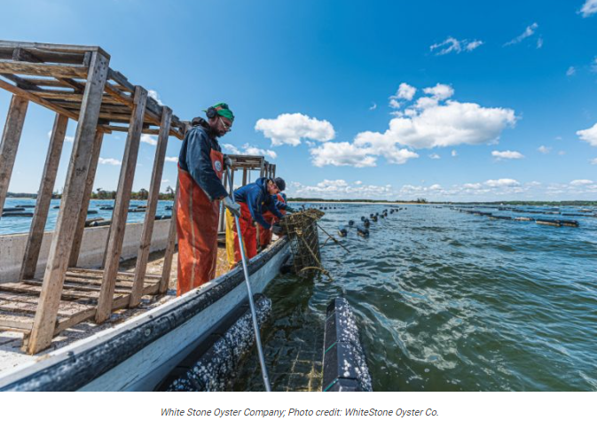

2022-2023
Pesticide Regulatory Update
Virginia Department of Agriculture and Consumer Services
Office of Pesticide Services
Notes:
This 2020-2021 Pesticide Regulatory Update meets the requirements for the legal update as part of all approved pesticide applicator recertification programs. All information contained in Slides 1-27 must be presented as part of all approved recertification courses including those for commercial applicators (all categories), registered technicians and private applicators. In addition, for recertification of commercial applicators and registered technicians, the information contained in Slides 27-51 must be presented. For recertification courses for private applicators, the information contained in Slides 52-67 must be presented. The items in the Legal Update are required for the Board to approve the training for credit. Should the complete Legal Update not be provided, recertification credit will not be given to attendees.
Presenters are free to add to this presentation to suit different audiences, if appropriate. Slides may be added as appropriate for course attendees.
Talking points are provided in the notes for many of the slides. Should you have any questions, please contact:
-Applicator Certification, Business License, Product Registration, and Training – Micah Raub, Supervisor, at micah.raub@vdacs.virginia.gov or 804-786-4845;
-Enforcement & Field Operations – Clint Shettle, Supervisor, at clinton.shettle@vdacs.virginia.gov or 804-786-8943;
-Compliance – Christine Trostler, Compliance Officer, at christine.trostler@vdacs.virginia.gov or 804-371-8485;
-Pesticide Disposal & Recycling Programs – Jeff Rogers, Environmental Program Planner, at jeffrey.rogers@vdacs.virginia.gov or 804-371-6561.
All other inquiries should be directed to the Office of Pesticide Services at 804-786-3798.
Contact information for the Office of Pesticide Services is also included at the end of the presentation.
Notes:
When offering testing as part of a recertification course, sponsors should ensure that the applications are submitted in a timely manner well in advance of the test date. Applications should be received no less than 30 days in advance of the testing date to allow for processing and issuance of a Letter of Authorization (LOA). Some sponsors are waiting until a week or two before the exam date to get applications submitted and expecting that OPS will expedite the processing and email or fax the LOAs at the last minute. If applications are not submitted in a timely manner, it is possible that sponsors and prospective applicators will not have them by the exam date. A LOA is required to sit for examination.
For course sponsors/instructors seeking recertification credit for their own course, you are required, like all attendees, to participate in the entire program and all sessions and complete all required forms. Course sponsors can not “self recertify” rather the course must include presenters others than the course sponsor.

Slide 2
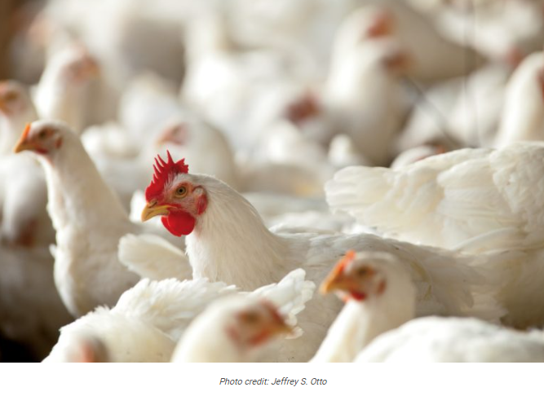
Discussion points
Regulatory Authority
Common Violations & Enforcement Actions
Label is the Law
Storage, Disposal & Recycling
Supervision
Recordkeeping
Incident Reporting
Pesticide Product Registration
Federal and State Regulatory Activities
Notes:
During today’s presentation, we will be covering those items that are required as part of recertification as a pesticide applicator. This includes:
The laws and regulations that govern the use of pesticides;
The most common violations during the last fiscal year and what can happen if you don’t follow the law and regulations;
Important reminders about following the label; storage and disposal of pesticides and recycling of empty containers; who can supervise who; recordkeeping; what do to if there is an incident and registration requirements for pesticides; and
Ongoing federal and state regulatory activities that affect you
As a reminder, you can add additional information to the presentation that is appropriate for your specific audience.

Slide 3


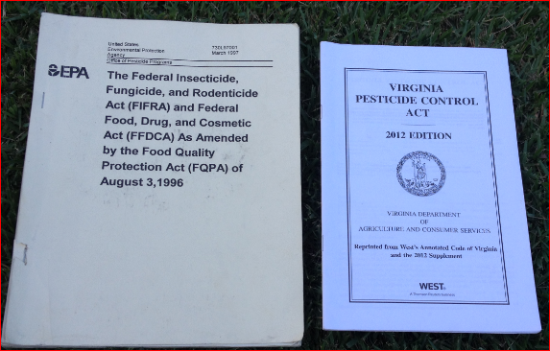
Pesticide Regulation in Virginia
(Co)Regulated by the US Environmental Protection Agency and Virginia Department of Agriculture and Consumer Services (VDACS)
VDACS’ Office of Pesticide Services (OPS) administers the pesticide program and supports VDACS and the Board of Agriculture and Consumer Services (Board):
  Protect consumers and the environment; and
  Ensure the safe and effective control of pests that adversely affect crops, structures, health, and domestic animals.
OPS authority is derived from the Virginia Pesticide Control Act (Act) and the Regulations Pursuant to the Act (Regulations).
Staff also has federal credentials to enforce provisions of the Federal Insecticide, Fungicide and Rodenticide Act (FIFRA).
Notes:
The Virginia Department of Agriculture and Consumer Services (VDACS) Office of Pesticide Services (OPS) is responsible for regulating pesticides in Virginia. Simply stated, OPS regulates pesticides and the people and businesses that use or sell them. Regulatory requirements are contained within the Virginia Pesticide Control Act (Act) and Regulations Pursuant to the Act (Regulations). In addition to ensuring compliance with the Act and Regulations, OPS also has the authority to enforce the Federal Insecticide, Fungicide and Rodenticide Act (FIFRA).

Slide 4

Ensuring Proper Use of Pesticides
Certifying pesticide applicators to ensure they have the minimum competencies necessary to apply pesticides.
Registering pesticide products to ensure only those pesticides that meet the federal requirements for registration, with limited exceptions, are used.
Licensing businesses to ensure they have knowledge of pesticides and evidence of financial responsibility.
Conducting inspections and investigations to ensure pesticides are used properly and all other provisions of the Act & Regulations are met.
Reviewing and approving recertification courses to ensure pesticide applicators receive the information required to maintain their certification.
Coordinating recycling and collection programs to ensure to assist with the final disposition of containers and unwanted pesticides.
All OPS activities work to ensure pesticides are used in accordance with the law and regulations.

Slide 5
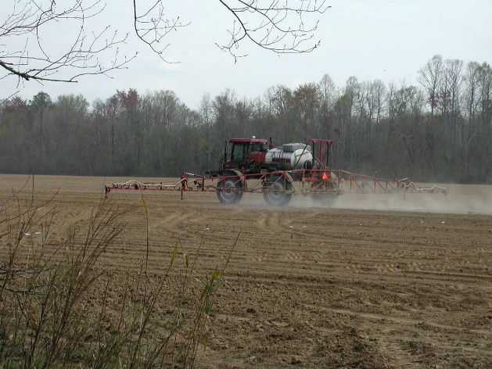
Inspections & Investigations
OPS conducts routine inspections and investigations to determine compliance with all applicable laws & regulations;
Standard inspection/investigation procedures may include:
  Conducting interviews
  Visiting site
  Observing an application
  Taking photographs
  Collecting samples (residue/formulation)
  Collecting weather data
  Reviewing pesticide label and application records
Totality of evidence collected will be reviewed in a two stage independent review process to determine if the application was made in compliance with all applicable laws and regulations;
Respondents will be notified of any alleged violations prior to any final enforcement action is taken; and
Should there be an enforcement action, for example, a monetary penalty, the respondent will have the right to appeal in keeping with the Administrative Process Act.
Notes:
Pesticide Investigators conduct routine inspections and investigate all tips/complains/reports alleging potential violations of pesticide laws or regulations. As part of any inspection or investigation, the Pesticide Investigator may complete one or more of the following activities:
Conducting interviews
Visiting site
Observing an application
Taking photographs
Collecting samples (residue/formulation)
Collecting weather data
Reviewing pesticide label and application records
Once all the information is collected, the totality of the information or evidence that the Pesticide Investigator is able to collect is reviewed in a 2 stage process. In those cases in which there is substantial evidence of a violation is found, the respondent is notified and provided an opportunity, by law, to provide additional information prior to any final action. Should an enforcement action be taken, the respondent has the right to appear the action.

Slide 6

Violations Enforcement Actions
Types of Enforcement Actions
VDACS can take enforcement action against any person, business or agency that violates any provision of the Virginia Pesticide Control Act, Regulations, or the Federal Insecticide, Fungicide and Rodenticide Act (FIFRA).
Letter of Caution
Civil Penalties per violation
  Up to $1,000 for a non-serious first time violation
  Up to $20,000 for knowing or repeat violations
  Up to $100,000 additional in the event of death or serious physical harm to any person.
Suspension, modification, revocation or denial of business license and/or applicator certification
Filing of criminal charges
Refer to U.S. Environmental Protection Agency for federal action
Notes:
VDACS has the legal authority to take an enforcement action for any violation of the Act or Regulation against any person (including certified applicators and the general public), businesses and other agencies. There are a number of different types of actions that VDACS can take depending on the circumstances including:
1. type of violation;
2. damages or potential for damage;
3. culpability;
4. history of violations; and
5. good faith attempt to come into compliance.
For any enforcement action, the person, business or agency has the right to appeal.
VDACS may also refer any violations to the US Environmental Protection Agency for action.

Slide 7
FY22 Violations & Enforcement Actions
Top 5 Violations
Actions for Non-Compliance
#1: Not Certified
#2: Misuse
#3: Unregistered Pesticide
#4: No Business License
#5: Recordkeeping
56 Unique Cases
  Civil Penalties = $30,530
  Stop Sale = 10
  Other Actions = 12
  Letter of Caution
  Advisory Letter
1 July 2021 - 30 June 2022
Notes:
The most common violations for FY21 are the same as in past years – just in a different order.
#1: Sale or Use of Unregistered Product: Every product that is manufactured, distributed, sold, offered for sale, used or offered for use must be registered both by United States Environmental Protection Agency (EPA) and with VDACS (there are some exemptions to the requirement to be federally registered, however, ALL pesticides must be registered in Virginia). Investigators inspecting pesticide businesses and retailers found a number of products not registered in VA but offered for sale. Violations included both discontinued products and those that were never registered.
#2: Not Certified: This includes both applicators that have never been certified as well as applicators that did not maintain their certification or did not renew their certification as required. The Virginia Pesticide Control Act requires:
Any person who uses (except under supervised conditions of training for certification) or supervises the use of any pesticide in exchange for compensation of any kind be certified as either a commercial applicator or registered technician. All commercial applicator or registered technician certifications expire on June 30 of either the odd or even year; and
Any person who applies restricted use on any property in the production of an agricultural commodity be certified as private applicator. All private applicator certifications expire on December 31 of either the odd or even year.
#3: Misuse and Negligence:
Misuse covers a wide range of things, including failure to wear the personal protection equipment (PPE) required by the label. However, any failure to follow the label is “misuse”.
Negligence refers to “applying any pesticide in a negligent manner” and includes pesticides applied in a way that may have adverse impacts to human health or the environment.
#4: No Business License: This is includes those companies that apply pesticides for-hire or sell pesticides that have never had a business license or who did not renew their business license. All pesticide business licenses expire annually on March 31.
#5: Recordkeeping: This refers to not keeping complete records of applications by applicators and pesticide businesses. For Private Applicators, this includes Worker Protection Standards (WPS) records and records of Restricted Use Products (RUPs). Commercial Applicators, Registered Technicians, and Licensed Pesticide Businesses (for-hire applicators) must keep records of ALL pesticides they apply including general use and restricted use pesticides. (In addition, licensed Pesticide Businesses must keep sales records of RUPs.)

Slide 8
§ 3.2-3930. All applicators must be certified as a commercial applicator or a registered technician when making a pesticide application in exchange for compensation of any kind.
Read, Understand and Follow the Act and Regulations!
2VAC5-685-210. Commercial applicators not-for hire and registered technicians not-for-hire must maintain a record of every pesticide applied. The record must contain the 9 requirements listed.
2VAC5-680-65. All licensed pesticide businesses must keep a record of every pesticide applied. The record must contain the 9 requirements listed.
§ 3.2-3932. In order to lawfully use or supervise the use of a RUP on any property, an applicator must be certified as a private applicator.
§ 3.2-3939. It is a violation to use or cause someone else to use a product in a manner that is inconsistent with the label or the regulations.
§ 3.2-3914. All pesticide sold, offered for sale, used, or offered for use in VA must be registered by paying an annual fee.
§ 3.2-3940(B)(3). It is a violation for a certified applicator to apply any pesticide in a negligent manner.
§ 3.2-3924. A business must have a pesticide business license in order to sell, distribute or store any pesticide unless the business meets one of the exemptions. If a person wants to apply or recommend for use any pesticide commercially, they must obtain a pesticide business license and employ a certified commercial applicator.
Notes:
To avoid violations and a possible enforcement action, all pesticide applicators must follow the Virginia Pesticide Control and its related regulations. A violation can be avoided by following the requirements contained in the Act and regulations. The sections included here are only highlights of the many requirement for applying a pesticide in Virginia. It is the responsibility of all pesticide applicators and all pesticide businesses to read, understand, and follow the Act and Regulations!

Slide 9
Appeal Process: If You Don’t Agree
Informal Fact Finding
Formal Hearing
Officer appointed by the Program Manager (Office of Pesticide Services)
Opportunity for respondent to offer additional information, ask questions
Officer is authorized to affirm, raise, lower, abate or negotiate a settlement
Decision can be appealed to Formal Hearing
Officer is Court appointed Attorney
Hears all relevant information and considers facts of all violations in the case
Makes recommendation to Board to affirm, raise, lower, abate or may recommend another outcome
Notes:
The person, business or agency (known as the respondent) issued a letter of caution or a civil penalty by VDACS has the right to appeal either the fact of the violation or any civil penalty taken.
The first level of appeal is to an “Informal Fact Finding Conference”. In an informal fact finding conference, a member of the Office of Pesticide Services Staff not involved in either enforcement or compliance will serve as the fact finding conference officer. He/she will listen to any information from the respondent regarding the violation and may ask additional questions. The fact finding conference officer will make a decision at the end of the conference. If the respondent does not agree with the decision of the fact finding conference officer, they have the right to appeal during a “Formal Hearing”.
In a formal hearing, the Hearing Officer is an attorney appointed by the Supreme Court of Virginia. During a formal hearing, VDACS will be represented by the Office of the Attorney General who will present the Department’s case. The respondent may present their own case or may elect to have an attorney. After listening to both sides, the Hearing Officer will have 30 days to make a recommendation to the Board of Agriculture and Consumer Services. The Board will make the final decision regarding the case.

Slide 10
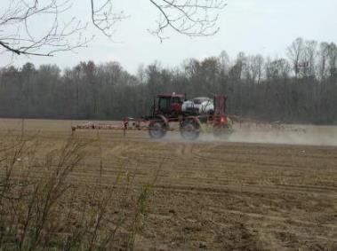

The Label is the Law
ALWAYS READ AND FOLLOW PESTICIDE PRODUCT LABELING
It is a violation of Federal and state law to use any pesticide product in a manner inconsistent with its labeling.​​​​​​​​​..
In Virginia, "pesticide use" is defined as the application or supervision of an application of a pesticide.
This includes all of the routine activities that are part of a normal pesticide application:
  mixing,
  loading,
  applying,
  handling a pesticide after the container seal is broken,
  clean up, and
  storage and disposal of excess product & empty containers.
Notes:
Virginia is what is referred to as a “label state”. This means that the legal application of a pesticide is determined by compliance with the label. Some states have additional requirements to the label, for example, for termiticide applications. Virginia does not currently have any additional requirements outside the Act and Regulations and of course the label.

Slide 11
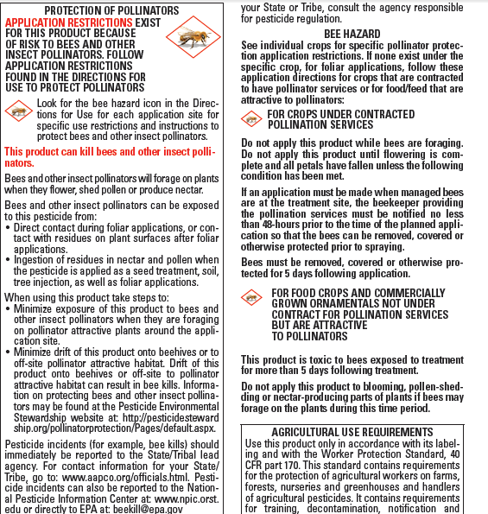
The Label…
Is a legal agreement between the registrant, the EPA, the end-user and the State Lead Agency for pesticide regulation.
Mitigates the risk of the use of the pesticide to an acceptable level
  Human Health
  Environmental Health
Includes risk mitigation measures that may be implemented throughout label, for example: use rate; use site; PPE; weather conditions; buffer zones; storage; disposal, etc…
Prescribes proper use which ensures continued use and availability of pesticide.

Slide 12
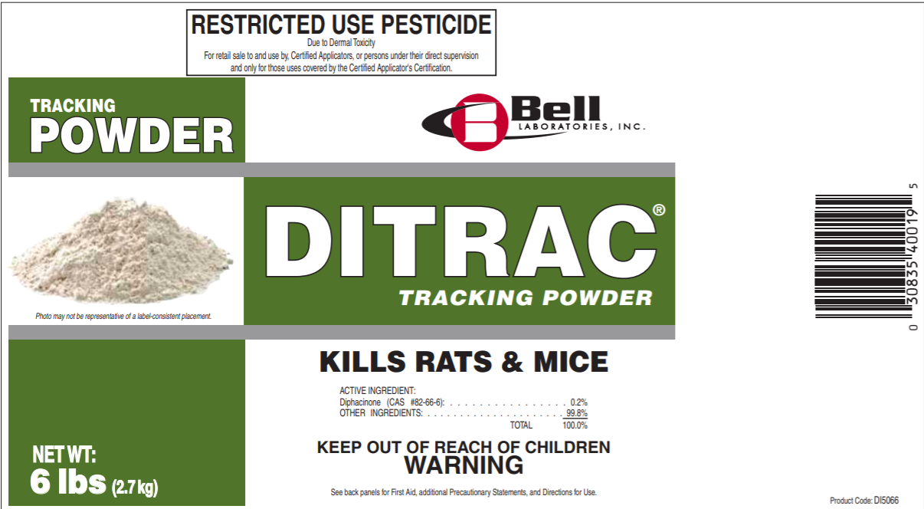
Why read the label each and every time you use the product?
Because…
  Labels change…all the time.
  The legal application of any pesticide is determined by the label on the container containing the pesticide that is used during a given application.
  Product use limitations (for example, frequency of application, rate, and use sites) are specific to a product and may differ for other products containing the same active ingredient.
Notes:
While companies often add uses they may also remove uses, particularly if phasing out a product. EPA may also request additional information or restrictions be added to the label to mitigate risks associated with human health or the environment. Recent examples include changes to the labels for Paraquat and Dicamba.

Slide 13
Quiz Time
It is a violation of ____________ to use any pesticide in a manner inconsistent with its product labeling.
  A. State Law
  B. Federal Law
  C. Robert’s Rules of Order
  D. Both A and B

Slide 14

Implications of Label PROVISION
“To be used By Certified Applicators only”
RESTRICTED USE PESTICIDE
To be used by certified applicators only; NOT to be used by uncertified persons working under the supervision of a certified applicator
While some restricted use pesticides allow uncertified persons to work under the supervision of a certified applicator, pesticides that contain the above statement may only be applied by certified (commercial and private) applicators (i.e.: Dicamba and Paraquat); and
Virginia’s Certified Registered Technicians do not meet the federal definition of a certified applicator thus are prohibited from making applications of any pesticide with the above statement (40 CFR Part 171).

Slide 15
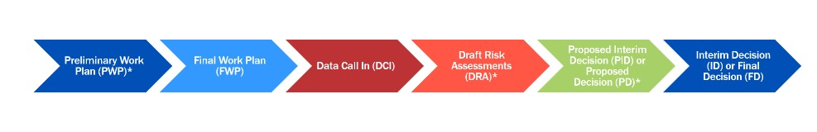
DICAMBA
Pesticide Federal review registration
EPA released on August 18, 2022, Human Health and Ecological Risk Assessments for Dicamba
There has been a substantial increase in drift/volatilization for the 2021 year, regardless of the additional measurement taken.
EPA is reviewing whether over the top Dicamba can be used in a manner that does not pose unreasonable risk to non-target crops and other plants, or to listed species and their designated critical habitats.
Public comments are being accepted for 60 days in the Dicamba registration review docket EPA-HQ-OPP-2016-0223 at www.regulations.gov
The deadline to submit comments is October 17, 2022.
Notes:
The Federal Insecticide, Fungicide and Rodenticide Act (FIFRA) requires the Agency to re-evaluate pesticides every 15 years to ensure that risk assessments and pesticide decisions reflect the best available science. The draft risk assessments (DRAs) are part of the legally required registration review process to identify risks as well as actions that can mitigate those risks for all registered uses across all Dicamba products.
Dicamba is an herbicide used to target annual, biennial, and perennial broadleaf weeds in agricultural and non-agricultural settings. The herbicide is registered for use on agricultural crops such as corn, cotton, sorghum, soybeans, sugarcane, and other crops. Some Dicamba products can be sprayed over-the-top (OTT) of genetically engineered soybeans and cotton after the crops have emerged from the ground. Non-agricultural use settings include grasslands, golf courses, brush, residential areas, and other non-agricultural settings. In general, non-OTT products are applied earlier in the growing season before crop emergence and OTT product are applied later in the growing season after crop emergence. However, because non-OTT Dicamba selectively removes broadleaf weeds in grass use sites, it can also be used later in the season for grass sites (e.g., corn, turf, pasture).
The registration review DRAs are the result of an extensive evaluation of available data on dicamba’s potential human health and environmental impacts, and cover all registered uses on all products, including both the OTT and non-OTT uses and products.
Human Health Risk Assessment
In March 2016, EPA issued a human health risk assessment for proposed new uses of Dicamba. The March 2016 new use risk assessment identified no inhalation risks of concern, except for certain occupational handler activities. In May 2016, EPA issued an addendum that expanded the March 2016 assessment to include additional formulations and application methods to capture all uses subject to registration review. The May addendum identified additional inhalation risks of concern for certain occupational handler activities. In 2021, EPA completed a second addendum that superseded both of the 2016 assessments to reflect updated occupational handler exposure data. Based on the updated data, the addendum only identifies occupational handler inhalation risks of concern for mixing/loading of dry flowable formulations for aerial and groundboom applications. EPA found no dietary, residential, aggregate, or post-application risks of concern. Today, (Aug 18) the Agency is issuing the 2021 addendum for public comment.
Ecological Risk Assessment
The draft ecological risk assessment also released August 18, 2022 identifies potential adverse effects to non-listed birds, mammals, bees, freshwater fish, aquatic vascular plants, and non-target terrestrial plants. The primary risk of concern is for non-target terrestrial plants from exposure through spray drift and volatilization. Numerous non-target plant incidents have been reported to be associated with the use of Dicamba. Since the initial registration of OTT uses in 2016, there has been a substantial increase in the overall number of reported non-target plant incidents which appear to be linked to the OTT uses. EPA continues to monitor the incidents information for Dicamba. This draft risk assessment does not include an analysis under the Endangered Species Act (ESA) of risk to listed species and critical habitats.
Upon publication of the Federal Register notice, public comments will be accepted for 60 days in the Dicamba registration review docket EPA-HQ-OPP-2016-0223EXITEXIT EPA WEBSITE at www.regulations.govEXITEXIT EPA WEBSITE.
Next Steps
After reviewing and considering the public comments received on the DRAs, EPA will proceed with the next step in the FIFRA registration review process, which is the proposed interim decision (PID), expected to be completed in 2023. The PID may include potential risk mitigation to address any potential risks of concern identified in the Dicamba DRAs.
Additionally, in December 2021, EPA released a summary of OTT dicamba-related incident reports from the 2021 growing season. The 2021 incidents were primarily associated with drift and/or volatilization. Despite the control measures implemented in EPA’s October 2020 Dicamba registration decision, the 2021 incident reportsEXITEXIT EPA WEBSITE showed little change in number, severity, or geographic extent of dicamba-related incidents when compared to the reports it received before the 2020 control measures were required. EPA is currently working with states and affected stakeholders to gather available incident information for the 2022 growing season.
EPA is reviewing whether OTT Dicamba can be used in a manner that does not pose unreasonable risks to non-target crops and other plants, or to listed species and their designated critical habitats. EPA is also evaluating all regulatory options for addressing future dicamba-related incidents.
EPA’s decisions will continue to consider information submitted by, as well as discussions with, scientists, academics, state agriculture extension agents, pesticide registrants, growers, the U.S. Department of Agriculture, the Association of American Pesticide Control Officials, and the State FIFRA Research and Evaluation Group. The Agency is committed to acting in a transparent manner, following well established regulatory processes, while upholding its mission of protecting human health and the environment.

Slide 16

Pesticide Product Registration
All Pesticides
Restricted Use Products (RUP)
§ 3.2-3914 of the Virginia Pesticide Control Act requires…Every pesticide manufactured, distributed, sold, offered for sale, used, or offered for use shall be registered …
Pesticides classified by EPA as 25(b) Exempt products are not exempt from state registration.
To check the state registration status of a pesticide or to find a registered pesticide for a specific pest visit the Pesticide Product Registration page of our website.
For use only by certified (private or commercial) applicators or by certified registered technicians under the direct supervision of certified (private or commercial) applicators.
Restricted use products are designated as restricted use based on risk, for example:
  Acute toxicity threat to humans & wildlife.
  Ground water contamination concern.
  Threat to aquatic organisms.
http://www.vdacs.virginia.gov/pesticide-product-registration.shtml
Notes:
All pesticides manufactured, distributed, sold, offered for sale, used, or offered for use are required to be registered in Virginia. Pesticides are registered annually and registrations expire December 31 of each year. Even if you have a product you bought in 2021, if the company does not renew the registration for 2022, it is not legal to sell or use in Virginia.
Suggestion: Please note that there may be additional reporting requirements outside of those required under the Virginia Pesticide Control Act and its regulations; for example, accidents and incidents involving surface or groundwater.

Slide 17
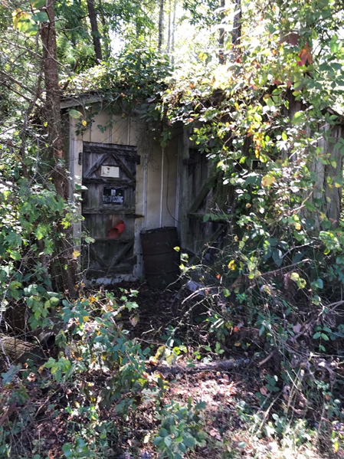
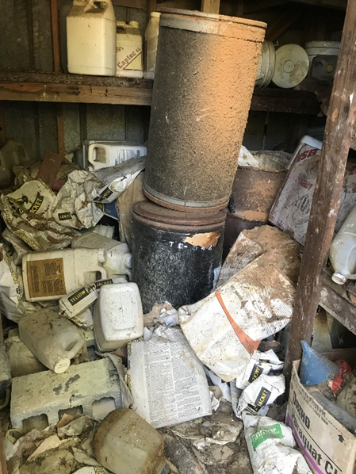
Storage
Store pesticides in original container in a well-ventilated area and away from food, pet food, feed, seed, fertilizers, and veterinary supplies.
Avoid cross-contamination with other pesticides. Keep container closed to prevent spills and contamination
NEVER store pesticides, for even a short time, in a food or drink container.
JUST SAY NO!
Notes:
As we covered earlier, “storage” is considered part of the routine use of pesticides. It is very important to store pesticides correctly. Proper storage ensures the integrity of the product and may help reduce the incidences of accidental poisonings. Check the pesticide label for storage requirements. Every year there are cases where pesticides have been stored improperly resulting in accidental ingestion or other exposure. These two photos are perfect examples of what NOT to do.

Slide 18
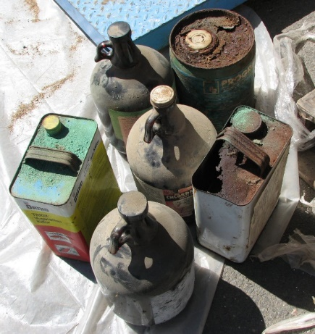
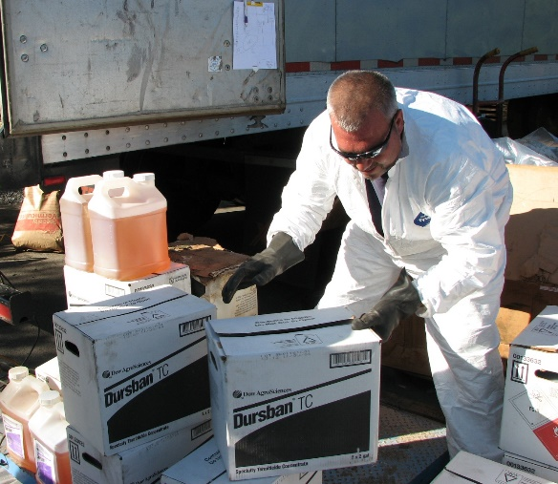
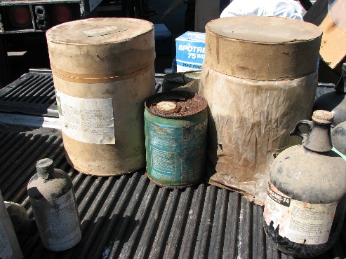
Pesticide Collection Program
The disposal of canceled, banned or unwanted pesticides poses a significant challenge to agricultural producers and other pesticide users due to its high cost.
Program Status
  FY2022 program collected a total of ~60,000 lbs.
  Since its’ inception, a total of over 1.7 million lbs. has been collected.
  .
For more information:
http://www.vdacs.virginia.gov/pesticide-collection.shtml
Notes:
Like with pesticide storage, pesticide labels provide specific information about how to properly dispose of unused products.
To reduce the potential for unused pesticides, mix only enough pesticide for the job(s) you have planned and if possible, use up small amounts of excess pesticides. Should you have unwanted pesticides, they can be stored until the program is again available in your area:
• Pesticides should be stored out of reach of children and pets and in a secure location that is well-ventilated.
• Pesticides should never be stored in cabinets with or near food, animal feed, or medical supplies and should not be stored in places where flooding is possible or where they might spill or leak into wells, drains, ground water, or surface water.
• Always store pesticides in their original containers with their tops tightly closed if possible. If the pesticide label is damaged, provide as much information about the product as possible.
• If the integrity of the packing is compromised, place inside another container.
If you are unable to store your unwanted pesticides please be aware that, unless allowed on the pesticide label, pesticides cannot be disposed of in the same manner as other household trash since they are considered hazardous substances, As hazardous substances, pesticides need to be carried to a hazardous waste collection site or facility. Some municipalities may offer hazardous waste collection sites or hold annual hazardous waste collections. If a hazardous waste collection program is not offered in your area and you are unable to store your unwanted pesticides until the pesticide disposal program is in your area, you should contact an Environmental/Hazardous Waste Contractor to dispose of your unwanted pesticides.

Slide 19
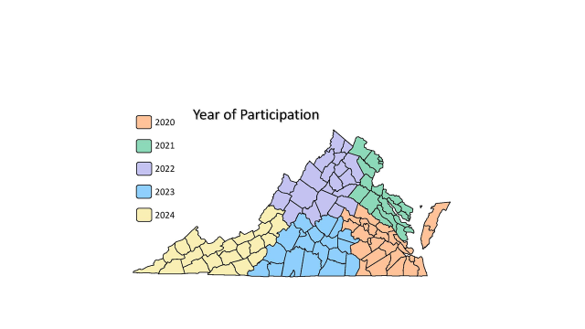
2020-2024
Pesticide Collection Program
Notes:
Once each of the 5 regions has been served, the cycle starts over. For current program information, visit the VDACS website at http://www.vdacs.virginia.gov/pesticide-collection.shtml.

Slide 20
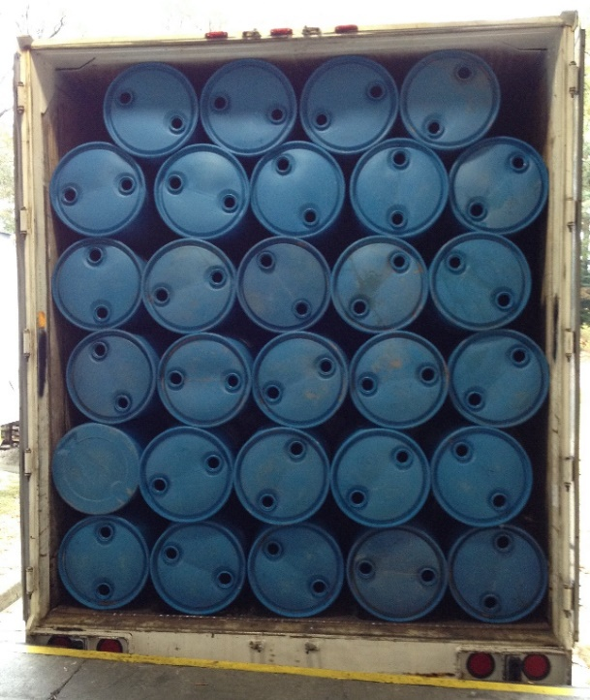
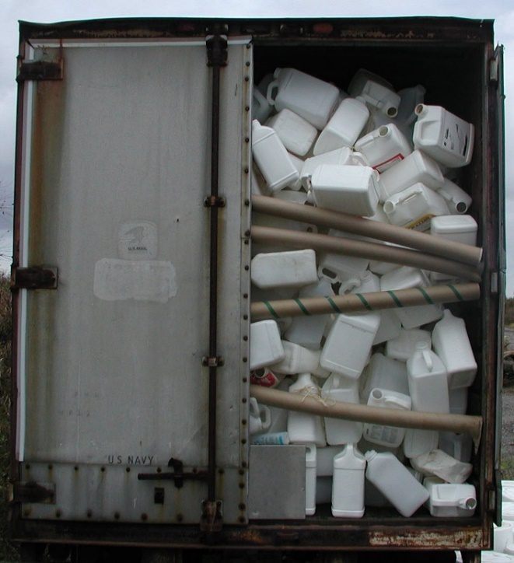
Plastic Pesticide Container Recycling
Provide agricultural producers, pesticide dealers and pest control firms with option for the disposal of properly rinsed pesticide containers.
Program Status
  FY2022 program recycled a total of ~70,000 lbs.
  Since its inception, a total of more than 2.4 million lbs.. has been collected.
For more information:
http://www.vdacs.virginia.gov/pesticide-container-recycling.shtml

Slide 21
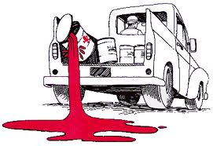
Reporting Requirements:
Accidents and Incidents*
Certified commercial or private applicators or registered technicians shall report any pesticide accident or incident in which they are involved that constitutes a threat to any person, to public health or safety, or to the environment, as a result of the use or presence of any pesticide.
Includes both general use and restricted use pesticides.
No minimum amount.
Pesticide accidents/incidents should be reported to VDACS within 48 hours by phone and within 10 days in writing.
Reports include:
  Name of individuals involved in accident or incident;
  Name of pesticide involved;
  Quantity of pesticide spilled and containment procedures;
  Time, date, and location of accident or incident;
  Mitigating actions taken; and
  Name, or description if unnamed, and location of bodies of water nearby where contamination of such bodies of water could reasonably be expected to occur due to natural or manmade actions.
*There may be other reporting requirements outside of the Act & Regulations…
Notes:
All pesticide applicators are required to report an accident or incident involving pesticides to the Office of Pesticide Services. In addition to it being the law, while OPS is not considered a first responder, OPS can assist, as needed with technical information, copies of the label and Safety Data Sheets, and can act as the go between if needed with the pesticide manufacturer or EPA.
Suggestion: Please note that there may be additional reporting requirements outside of those required under the Virginia Pesticide Control Act and its regulations; for example, accidents and incidents involving surface or groundwater.

Slide 22
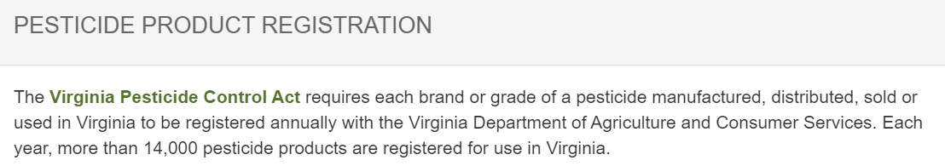
Ecommerce – Buyer Beware
Due diligence is required when purchasing pesticides via the internet.
Remember, all pesticides must be registered in Virginia…this includes those that are bought on the internet.
All pesticide businesses are required to have a license to sell pesticides in Virginia…this includes businesses that sell pesticides on the internet.
  There are limited exceptions to the business license requirements for businesses
To check if a pesticide business is licensed to sell pesticides in Virginia:
http://www.vdacs.virginia.gov/pdf/reports-businesses.pdf
Notes:
It is important to check the registration status and the business license status for any online purchases. The requirements for both apply whether it is a brick and mortar store or a virtual store. There are limited exceptions for businesses who sell limited quantities of general use pesticide intended primarily for household use (less than $50,000).

Slide 23
Certification
Whose Responsibility Is It Anyway?
For certified applicators including commercial applicators, registered technicians, and private applicators, it is YOUR responsibility to maintain your certification including being sure…
  OPS has your current mailing address
    Must complete a “Change of Information Form” to process any changes;
  Know when your certification expires and renew your certification before it expires;
  Attend a recertification course prior to the expiration date of your certification; and
  Sign your name on the course roster and complete and sign your recertification application form.
Notes:
A pesticide applicator certification is issued to an individual thus it is the individuals responsibility to maintain their certification. This includes making sure OPS has your current mailing address (where you want all correspondence regarding your certification is to be mailed); taking a recertification course prior to the expiration of your certification and completing all the required paperwork; and submitting a renewal application with fees prior to the date your certification expires.
While OPS sends out status reports and renewal applications, this is only a courtesy. Even if you don’t get a renewal notice, you are still required to renew your certification prior to the expiration date! This is no different than renewing your driver’s license with DMV. You need your certification to be able to legally apply pesticides so be sure it is always up to date!

Slide 24
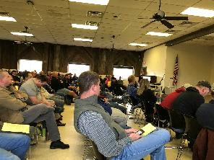
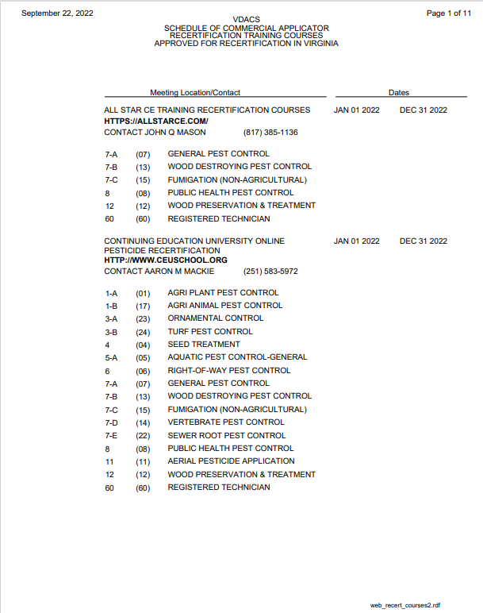
REMINDER:
Credit For Recertification Course
For all in-person courses, signatures are required on both the roster(s) and the Application for Recertification Credit. When a signature is requested, it is not optional for credit. The signatures should not be significantly different.
Course sponsors/speakers seeking credit for attending their own course are required, like all attendees, to participate in the entire program and all sessions and complete all required forms as proof of attendance.
Course sponsors can not self recertify rather the course must include presenters others than the course sponsor.
To renew by attending a recertification training program requires completion of one recertification course every two years.
Notes:
Staff have seen occasions where individuals signed in with one name and out with another (same certificate no.); they’ve also seen where the signatures bore no resemblance.

Slide 25
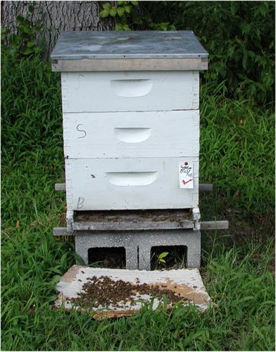
Protecting Pollinators
Voluntary Plan to Mitigate the Risk of Pesticides to Managed Pollinators
Voluntary, proactive approach which focuses on enhanced communication and coordination between pesticide applicators and beekeepers.
  Beekeepers providing information regarding the location of their hives; and
  Pesticide applicators providing advance notice of applications that have the potential to impact managed pollinators.
To facilitate the communication, VDACS has acquired an online mapping tool:
  Agricultural producers and pesticide applicators can register with FieldCheck® to view the locations of hives in the application area and notify beekeepers of planned applications.
  Beekeepers can use BeeCheck™ to map the location of their hives.
Notes:
Most of you are probably aware that a 2014 Presidential Directive included specific instructions to EPA to encourage state lead agencies for pesticide regulation, in this case, VDACS, to develop state pollinator protection plans to help mitigate the risk of pesticides to managed pollinators. While we know there are more factors than just pesticides that can potentially impact pollinators, these plans were to focus specifically on pesticides and managed pollinators. Virginia’s Voluntary Plan to Mitigate the Risk of Pesticides to Managed Pollinators was finalized in May 2017.
The Plan is voluntary and focuses on enhanced communication and coordination and the implementation of best management practices. As part of its Plan, VDACS has made available online mapping tools for both pesticide applicators and beekeepers. Pesticide applicators (including certified commercial, registered technicians, private applicators as well as agricultural producers) can register using FieldCheck. Beekeepers can use BeeCheck.
Virginia’s plan is not intended to prohibit, eliminate or further restrict the application of pesticides. As with all pesticide applications, the label is the law.

Slide 26
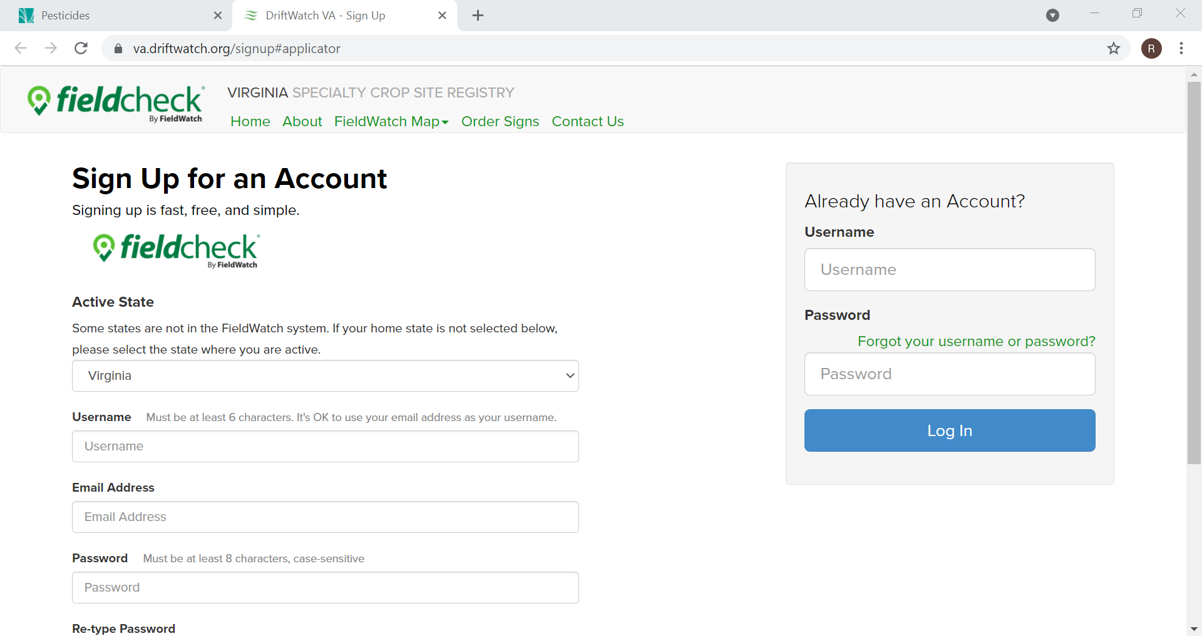
FieldCheck® for Applicators
FieldCheck is the online and mobile portal for applicators
FieldCheck is free to register for pesticide applicators
FieldCheck data may be streamed to Precision Ag platforms
FieldCheck provides location and contact information to promote communications between specialty crop growers, beekeepers, and applicators
FieldCheck may be used by applicators spraying lawns, mosquito abatement, right of way, and vegetation management
Pesticide applicators should register in FieldCheck to maximize benefits

Slide 27
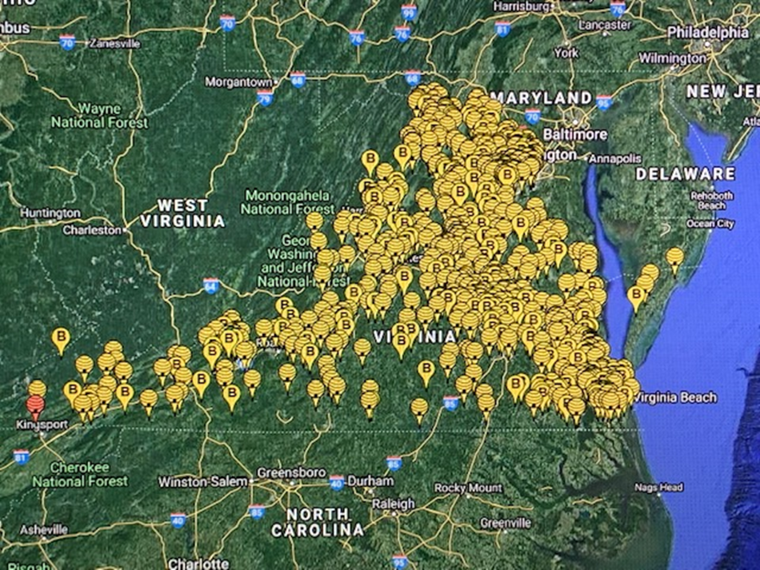
Applicator Access – Three Ways
Public Map (FREE)
All crop sites
Most beehives
Register with FieldCheck (FREE)
All beehives
Email notifications of new sites
Member Data Subscription
All sites
Downloadable or live stream through software provider
For information; https://va.driftwatch.org/
Notes:
Pesticide applicators have three ways to access information regarding the location of bee hives including utilization of the public map, registering with FieldCheck or a member data subscription.

Slide 28
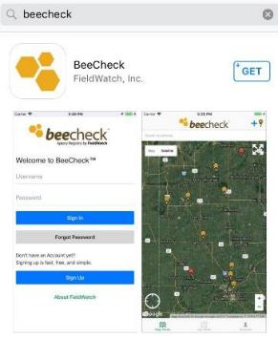
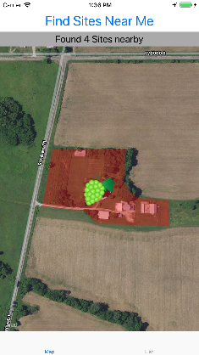
New for Users – Mobile Apps!
FieldCheck for Applicators
  Map: Detailed Site, Contact View, Find Sites Near Me
  Options on defined “Alert Area”
  Notification when sites added or removed
  Increased functionality and visibility
  API design to communicate with other technology platforms
  Available for FREE on Apple/Android systems
BeeCheck for Beekeepers
  Increased functionality; ease of moving hives with GPS
  Same security functions (allows for privacy)
  Available for FREE on Apple/Android systems
Notes:
Two new mobile apps are now available! Like registering for either FieldCheck or BeeCheck, both are free!

Slide 29
Online Services – A Work In Progress
Product Registration – October 2021
Applicator Certification – March 2022
Business License – 2023

Slide 30
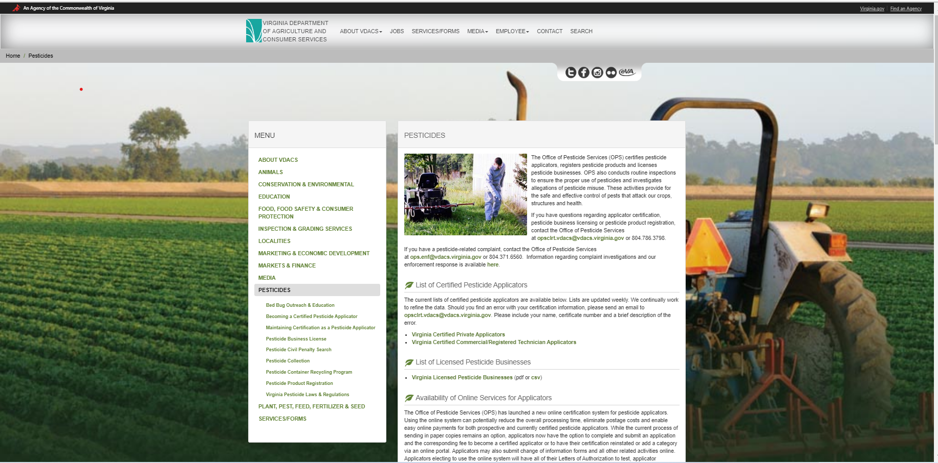
Implementation: Online Services
Implementation of both product registration and certification systems were challenging;
Temporary delays in processing applications and related activities due to technological issues;
Developed short term, temporary processes to address the impacts from implementation
For both product registration and certification, in second renewal season;
As new issues are identified, IS and OPS actively work to address issue and implement fix;
Continue to refine system to increase usability and functionality for external and internal users; and
System benefits are realized as more users utilize online option.

Slide 31

Coming Soon!!! Remote Testing
All exams (commercial, private and registered technician).
Ensure exam security and integrity
  Proctored – in person, AI or combination
Widely used in academia and other industries.
Available 24/7/365.
Fee for service paid to “third party” provider.
Not required – in addition to current testing options.
Once ready, extensive marketing regarding availability including “how to” webinars.
Anticipate availability beginning January 2023.

Slide 32
COMMERCIAL APPLICATORS & REGISTERED TECHNICIANS
Required additional information for all recertification courses for Commercial Applicator and Registered Technicians.
Notes:
Slides 31-43, Commercial Applicators & Registered Technicians, are required to be presented in addition to Slides 1-29, as part of all recertification courses for Commercial Applicators and Registered Technicians. Should a specific slide(s), for example, Dicamba, not be appropriate for the specific audience and categories approved as part of the recertification course, they may be omitted and other slides may be added.

Slide 33
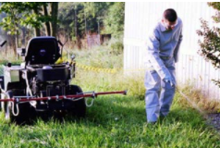
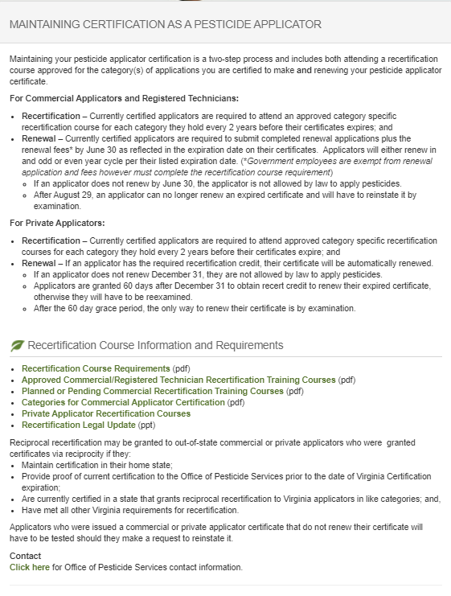
REMINDER:
Commercial Applicators & Registered Technicians
It is YOUR Responsibility to Maintain Your Certification
Maintaining your pesticide applicator certification requires you attend an approved category specific recertification course or be retested for each category you hold every 2 years before your certificate expires; and
If an applicator does not renew by June 30 of the year in which the certificate expires, the applicator certification will not be renewed and the applicator is not allowed by law to apply pesticides.
After August 29, an applicator can no longer renew an expired certificate and will have to reinstate it by examination. This requires the submission or an application and fee to retake the exam(s).
Notes:
In the Fall of each year (normally October), OPS ends notices to applicators who need recertification credit in order to renew their certificates within the next year, and remind them to attend a recertification class. Most classes are offered November to March, but you are responsible for finding them. Depending on your category or part of the state, they may be hard to find: plan ahead and have alternatives. You can take extra classes to earn credit and extend your training status up to 4 years ahead.
Government applicators (both RT and commercial) will be renewed and mailed out automatically in May if you have enough recertification credit. Make sure OPS has your correct mailing address on file.
Commercial & RT: In April of the year your certificate expires, OPS will send you a renewal notice, listing your categories and their expiration dates, reminding you again to take a class if necessary. This only works if OPS has your correct mailing address on file. Note: If you hold both RT and a Commercial (C, N or G) they may be on a different renewal cycle so pay attention to the date on the card. If you hold multiple certificates (multiple employers) within the same class they should be the same (i.e. all RT cards issued to an individual working for multiple employers should have same expiration date).
What happens if you’ve been busy or forgetful? For 60 days, from July 1-August 29, you can send in the renewal form with a 20% late fee. For 60 days, from Jul 1-Aug 29, you can try to find a class, or retake certification exams. *Until you meet both requirements, you will have an expired certificate and should not be working!
By law, after Aug. 29, you must start the entire process over and pay all fees, and retake all exams.

Slide 34
Virginia Regulatory Activities
    Elimination of Pesticide Applicator Renewal Fees
Effective March 17, 2022, the fee for pesticide applicators to renew their certificates has been eliminated.
Pesticide applicators are still required to take one recertification course every 2 years, before their certificate expires.
Applicators who take the required recertification course will have their certificate automatically renewed and a new certificate will be sent to them.
For applicators who do not take a recertification course or successfully take the certification exams again by June 30, 2023, their certificates will expire; and
Applicators who do not take a recertification course by August 29 of the expiration year or do not successfully take the certification exams again by that time are required by law to retest which requires submission of an application and fee; and
Applicators whose certificate expires on June 30, 2023 will receive a letter with additional information about the renewal process.
Notes:
The fees prescribed in 2 VAC 5-675 are utilized to operate the agency’s pesticide programs, which protect human health and the environment by ensuring the proper use of pesticides used to control pests that adversely affect crops, structures, health, and domestic animals. Program activities include certifying approximately 24,000 pesticide applicators, licensing of approximately 3,000 pesticide businesses, registering approximately 16,000 pesticide products, and conducting route inspections and investigations
The current fees became effective on July 11, 2019. With their approval of the fee increases in 2019, the Board of Agriculture and Consumer Services agreed to convene a Pesticide Fee Regulatory Advisory Panel two years after the effective date of current fees. At its July 20, 2021 meeting, the Pesticide Fee Regulatory Advisory Panel recommended to the Board that the renewal fee be eliminated for pesticide applicators.
Until such time as the fee amendment is final, the current fee structure remains in place.

Slide 35
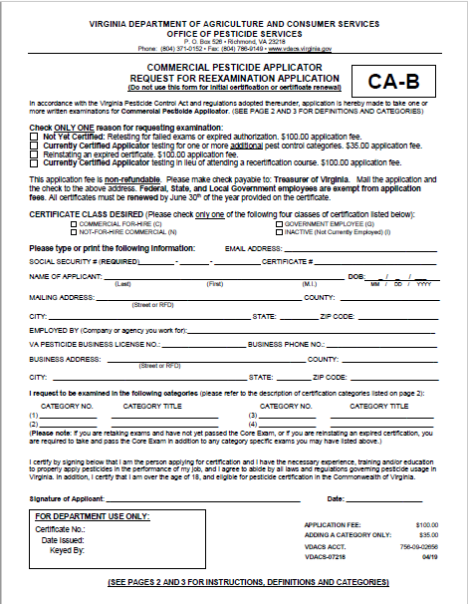
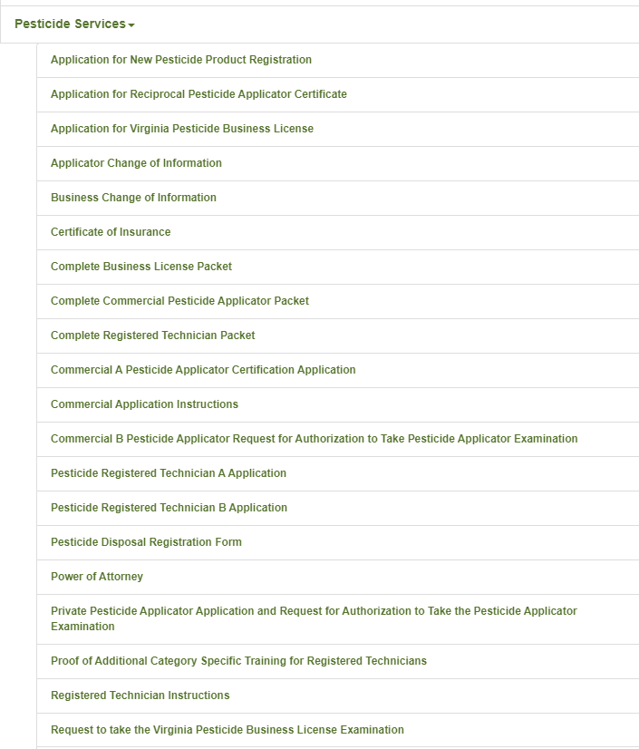
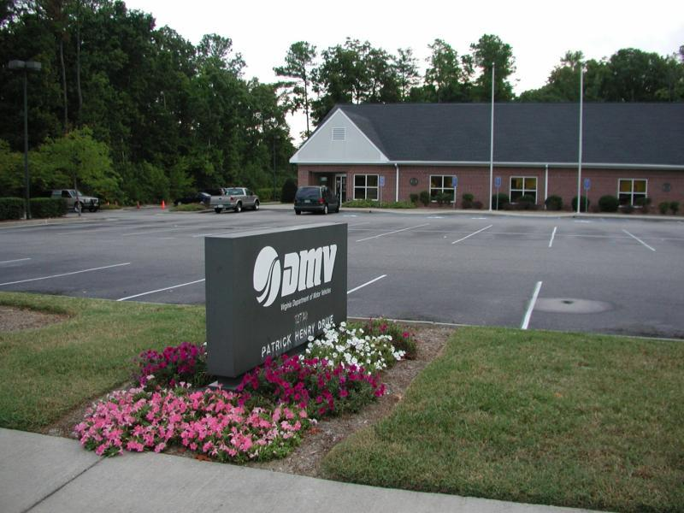
REMINDER:
Commercial Applicators & Registered Technicians
If you opt to test in lieu
of attending a recertification course:
You must submit a testing application and appropriate fee.
Notes:
In October of the year that your certificate expires we’ll send you a notice listing when your categories expire, and reminding you to attend a recertification class. Most classes are offered November to March, but you are responsible for finding them. Depending on your category or part of the state, they may be hard to find: plan ahead and have alternatives. You can take extra classes to earn credit and extend your training status up to 4 years ahead.
Government applicators (both RT and commercial) will be renewed and mailed out automatically in May if you have enough recertification credit. Make sure OPS has your correct mailing address on file.
Commercial & RT: In April of the year your certificate expires, OPS will send you a renewal notice, listing your categories and their expiration dates, reminding you again to take a class if necessary. This only works if OPS has your correct mailing address on file. Note: If you hold both RT and a Commercial (C, N or G) they may be on a different renewal cycle so pay attention to the date on the card. If you hold multiple certificates (multiple employers) within the same class they should be the same (i.e. all RT cards issued to an individual working for multiple employers should have same expiration date).
What happens if you’ve been busy or forgetful? For 60 days, from July 1-August 29, you can send in the renewal form with a 20% late fee. For 60 days, from Jul 1-Aug 29, you can try to find a class, or retake certification exams. *Until you meet both requirements, you will have an expired certificate and should not be working!
By law, after Aug. 29, you must start the entire process over and pay all fees, and retake all exams.

Slide 36
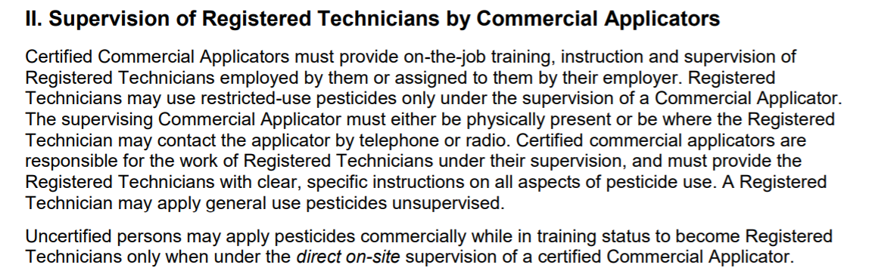
Supervision Requirements:
Registered Technicians
Only certified Commercial Applicators may supervise certified Registered Technicians (RT)
Certified Registered Technicians must have direct supervision by a certified Commercial Applicator to use Restricted Use Pesticides (RUPs)
Certified Commercial Applicators
  Must provide instructions on safe use
  Must be accessible within telephone or radio contact, or on site
  Is responsible for actions of the RT
Certified Registered Technicians may use General Use Pesticides without supervision

Slide 37
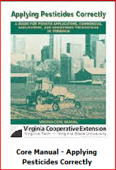
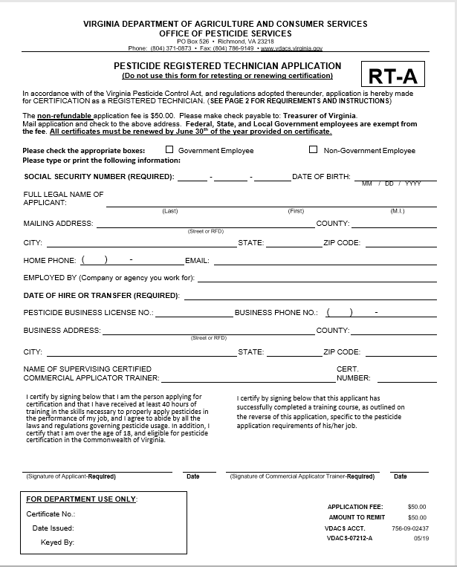
Supervision Requirements:
Training Registered Technicians
Only Certified Commercial Applicators may supervise the use of pesticides
Prospective pesticide applicators (persons in training) must have DIRECT ON-SITE supervision to use any pesticide
Certified Commercial Applicator
  Must provide instructions on safe use
  Must be on site
    physically present on the property upon which the pesticide is being applied
    in constant visual contact with the person applying the pesticide.
  Is responsible for actions of uncertified person
Training must be documented and submitted to VDACS
Notes:
The trainee and the CCA who provides the training will both sign the “Pesticide Registered Technician Application” (RT-A) form and certify that all required training (40 hours total) has been provided.

Slide 38
Quiz Time
Unless otherwise required by the pesticide label, a certified registered technician in Virginia must be provided direct supervision by a certified commercial applicator only when applying ______________ pesticides.
  A. general use
  B. restricted use
  C. registered
  D. unregistered

Slide 39
Training Registered Technicians:
Proof of Additional Category Specific Training
Only Certified Commercial Applicators may supervise the use of pesticides
The CCA trainer must submit a completed additional training form for the RT changing or adding categories.
Training must be documented and submitted to VDACS within 10 calendar days of completion of such training.
Notes:
The RT and the CCA who provides the training will both sign the “Proof of Additional Category Specific Training for Registered Technicians” form and certify that the technician has received training in additional categories. These categories will appear on the RT Certificate under TRAINED IN section.
http://www.vdacs.virginia.gov/pdf/RegTech.AdditionalCatTraining.pdf

Slide 40
New
Spanish registered technician exam
Developed a new exam for Registered Technicians in Spanish.
Ensures that Registered Technicians with Limited English Proficiency have the minimum qualifications needed to apply pesticides.
Available beginning in 2023.
  In person (notify Investigator or Proctor);
  DMV and Remote Testing (forthcoming).

Slide 41
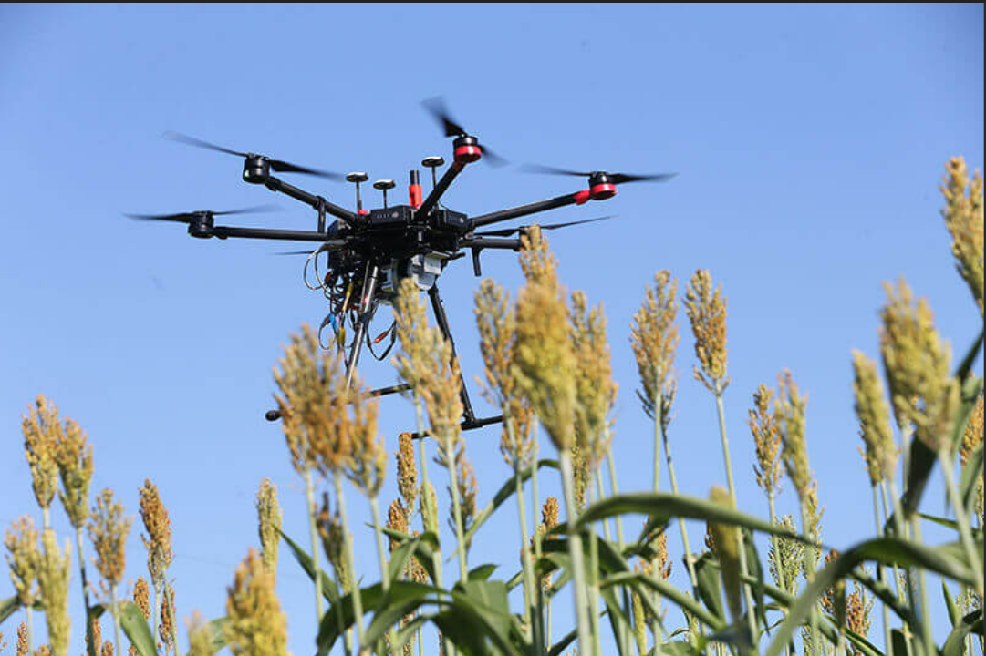
Unmanned Aerial Vehicles (UAV) and Systems (UAS) Requirements
Pesticide applicators applying pesticides using UAV/UAS are required to be certified as a commercial applicator in Category 11 or, for registered technicians, are required to have received category specific training from an applicator certified in Category 11:
  11. Aerial pesticide application. This category is for commercial applicators who will be using or supervising the use of any pesticide applied by fixed- or rotary-wing aircraft.
As always, the label is the law!
Purdue University

Slide 42
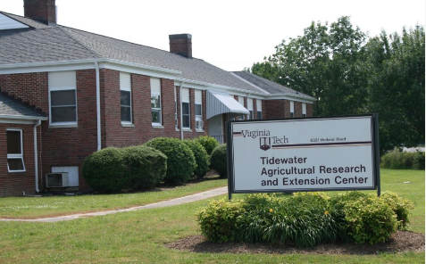

REMINDER:
Government Employees and Volunteers
That means, Governmental agencies need to:
  Have a certified commercial applicator on Staff to train prospective registered technicians; or
  Work with other Governmental agencies with a certified commercial applicator to train new prospective registered technicians; or
  Hire or otherwise retain a certified commercial applicator to train prospective registered technicians.
In all cases, the certified commercial applicator must be certified in the category in which the registered technician will be working!
All Government employees who apply pesticides are required to be certified:
  Commercial Not-for-Hire; or
  Registered Technician
Certification is valid only when applying or supervising application of pesticides used by such governmental agencies.
Do not work for a “pesticide business” so are not required to have a certified commercial applicator on Staff, however, only certified commercial applicators can train registered technicians.
    These same requirements also apply to volunteers applying and using pesticides for a governmental organization -
      for example, state parks.
Notes:
2VAC5-685-20. General Requirements for Certification. Part II. Certification of Pesticide Applicators, states C. Employees of local, state, and federal governmental agencies who use or supervise the use of any pesticide on any area in the performance of their official duties must be certified as either commercial applicators not for hire or registered technicians, but they are exempt from any certification fees…
Government employees are also subject to all other provisions of the Act and Regulations, including training, recertification and recordkeeping. However, as they do not work for a “pesticide business”, rather they make applications as part of their official duties, government agencies are not required to have a certified commercial applicator on Staff. This can be problematic as only a certified commercial applicator can train prospective (new) registered technicians. There are options for governmental agencies seeking to train prospective applicators:
Have a certified commercial applicator on Staff to train prospective registered technicians; or
Work with other Governmental agencies with a certified commercial applicator to train new prospective registered technicians; or
Hire or otherwise retain a certified commercial applicator to train prospective registered technicians.

Slide 43
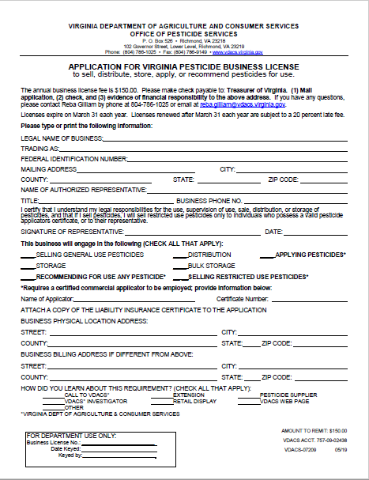
Business Licenses
Whose Responsibility Is It Anyway?
For pesticide businesses including those that sell, distribute, or store any pesticide or apply or recommend for use any pesticide commercially, it is the business owner/operator’s responsibility to maintain the pesticide business license including being sure…
OPS has the business’ current mailing address
Must complete a “Change of Information Form” to process any changes;
Know when the business’ license expires and renew the business’ license before it expires;
The business’ Certificate of Insurance is current and valid;
The business has, if applicable, a currently certified commercial applicator of record who is responsible for (i) the safe application of the pesticides; and (ii) providing recommendations for the use of pesticides; and
Businesses which sell restricted use pesticides, or distribute restricted use pesticides for purposes of selling, must employ a certified commercial applicator of record who is present and bears immediate responsibility for the correct and safe operation of the location or outlet..
Notes:
An annual pesticide business license is required for each location or outlet that sells, distributes, stores, applies, or recommends for use any pesticide.
No pesticide business may sell, distribute, or store any pesticide without a pesticide business license.
No person may apply or recommend for use any pesticide commercially without a pesticide business license and the employment of a certified commercial applicator responsible for: (i) the safe application of the pesticides; and (ii) providing recommendations for the use of pesticides.
If a pesticide business license expires or lapses (i.e. the Certificate of Insurance expires during the licensing year), the business cannot legally operate. If a firm’s business license has expired, all certifications of the firm’s pesticide applicators become invalid and the firm’s applicators cannot legally apply pesticides. Additionally, if the pesticide business license expires for a business selling pesticides, that business cannot legally sell pesticide until it renews its license. .
Like with pesticide applicator certification, even if the business owner/operator does not receive a renewal notice, or a notice of expiration of a Certificate of Insurance, it is the business owner/operator who is responsible to ensure the business has a valid pesticide business license. While OPS does send renewal notices and notifies pesticide businesses if their Certificate of Insurance expires, it is only as a courtesyA business must have a valid license so a business owner/operator must ensure they do!

Slide 44
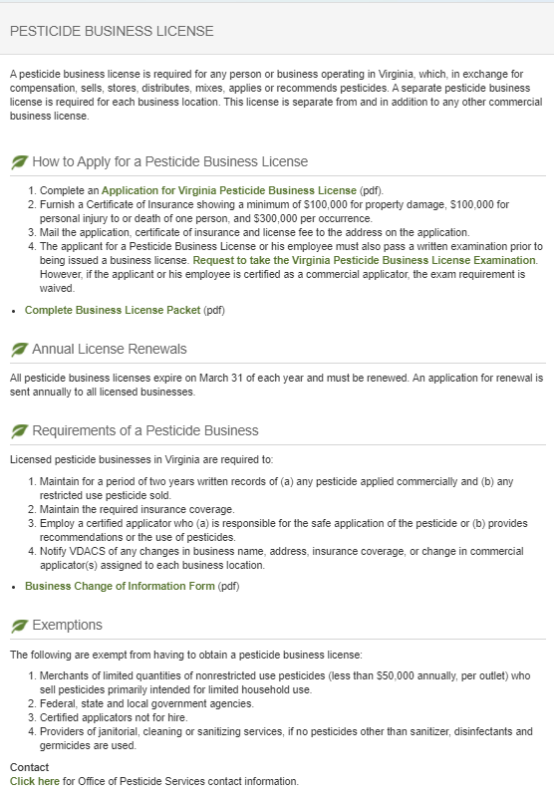
REMINDER:
Pesticide Business Licenses
All business licenses expire on March 31;
If not renewed by March 31,
  The business is not licensed and cannot conduct business until such time as the licensed is renewed, for example, sell or apply pesticides; and
  The certificates of all pesticide applicators working for the business are inactive, therefore, applicators may not apply pesticide until the business license is renewed.
Proof of insurance is required to maintain a business license. It is the business’ responsibility to ensure that a current certificate of insurance is on file throughout the license year:
  If the certificate of insurance expires at any time during the year, the pesticide business license is considered unlicensed and cannot conduct business; and
  The certificates of all pesticide applicators working for the business are inactive, therefore, applicators may not apply pesticide until the business license is valid.
Notes:
Although OPS may notify businesses when their insurance lapses, it is ultimately their responsibility to provide up to date evidence of financial responsibility (i.e. Certificate of Insurance)
Business are required to have the following amount of financial responsibility:
$100,000 for property damage;
$100,000 for personal injury or death of one person; and,
$300,000 per occurrence.

Slide 45
Pesticide Fees:
Non-Refundable and Non-Transferable
AVOID A 20% LATE FEE BY RENEWING AND PAYING ON TIME.
Fees are assessed to offset the cost of processing applications for:
  Certified applicators (commercial & registered technicians) – initial, retesting, and adding a category;
  Business licenses; and
  Product registration.
Once applications are processed, regardless of if the credential is issued, fees will not be refunded.
Fees are transaction specific (i.e. fees paid for one prospective applicator's credential cannot be used to pay for a second prospective applicator's credential).
Refunds, if due, are transaction specific. Refunds cannot be applied to offset another fee.
Notes:
Refunds are sent from OPS to Finance for processing.
Businesses should avoid sending duplicate checks if at all possible.
If a business or person believes that an overpayment has been made, they should not cancel the check. They should let us refund it.
There is a $50 fee for checks which are returned due to non-sufficient funds, cancellation, etc.

Slide 46

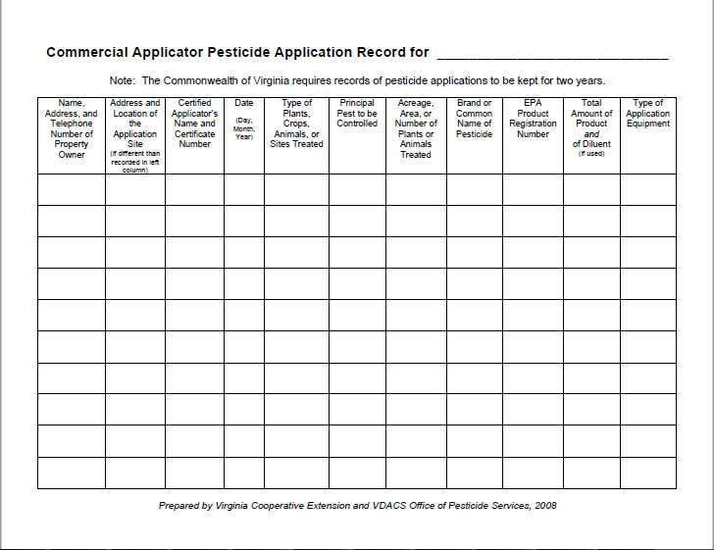
Recordkeeping
  For pesticide businesses (commercial applicators and registered technicians)
  For commercial applicators not for hire and registered technicians not for hire
Notes:
Tell YOUR story every time you apply.

Slide 47


Recordkeeping elements
Name, address, and telephone number of customer and address or location, if different, of site of application;
Name and certification number (or certification number of the supervising certified applicator) of the person making the application;
Day, month and year of application;
Type of plants, crop, animals, or sites treated and principal pests to be controlled;
Acreage, area, or number of plants or animals treated;
Brand, trademark, or product name appearing on the product's label;
EPA registration number;
Amount of pesticide concentrate and amount of diluent used, by weight or volume, in mixture applied; and
Type of application equipment used.
Notes:
When conducting inspections or investigations, Pesticide Investigators will often review pesticide application records which are required by law for all commercial pesticide applications. Records contain information regarding how a pesticide was applied and are used to determine compliance with the label requirements.
How you keep your records is up to you. They can be paper, electronic or a combination of both. The law requires records covered in this chapter shall, upon written request, be made available for during normal business hours. Records not readily available shall be submitted to the commissioner within 72 hours if so requested in writing. Records may be submitted electronically in a manner specified by VDACS, including, but not limited to, electronic mail or by completing any forms provided online by VDACS. Records are required to be kept for 2 years. . Failure to keep the proper records is a violation and applicators may be subject to enforcement action if they do not keep records.

Slide 48
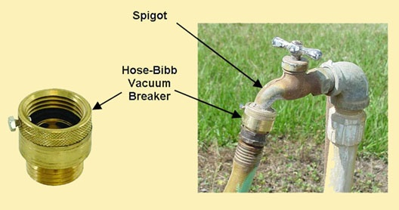
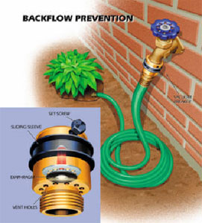
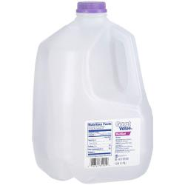

BACKFLOW PREVENTION
Required when filling
service containers
from a hose

Slide 49
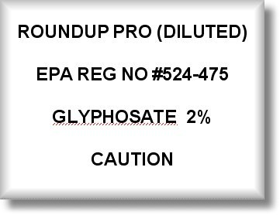
SERVICE CONTAINER LABELS
Required for service containers exceeding
3-gallon volume or 3lbs dry
If the pesticide being temporarily stored or transported will be applied without further dilution, the container must have a securely attached label completed in a manner as shown above.

Slide 50
If you don’t know…ask us!
Certification, License Registration, & Training (CLRT)
804-786-3798
Enforcement & Field Operations
804-371-6560
Compliance
804-371-8485
Environmental Programs
804-371-6561
Program Manager
804-371-6559
http://www.vdacs.virginia.gov/pesticides.shtml
Email: opsclrt.vdacs@vdacs.virginia.gov
robert.christian@vdacs.virginia.gov
757-334-3966
Notes:
If you don’t know, call the Office of Pesticide Services or visit the website!

