Slide 1

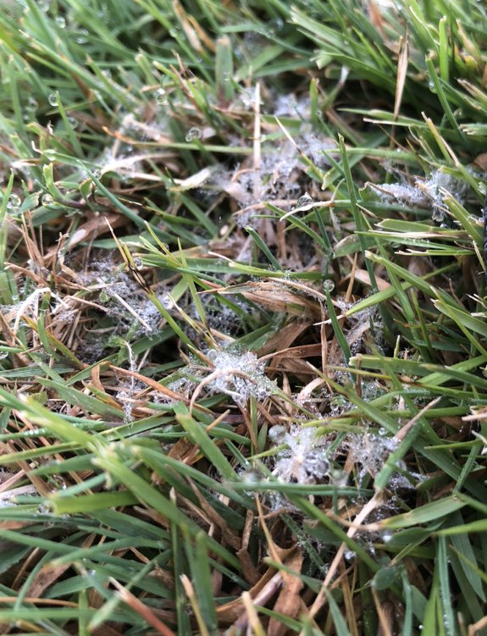
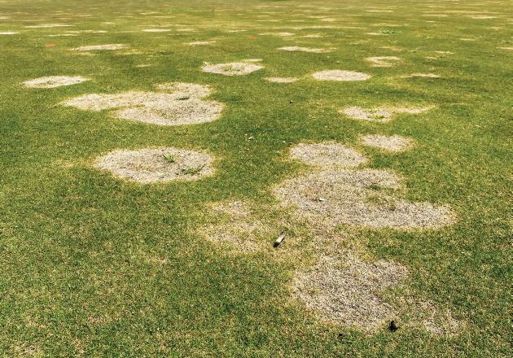
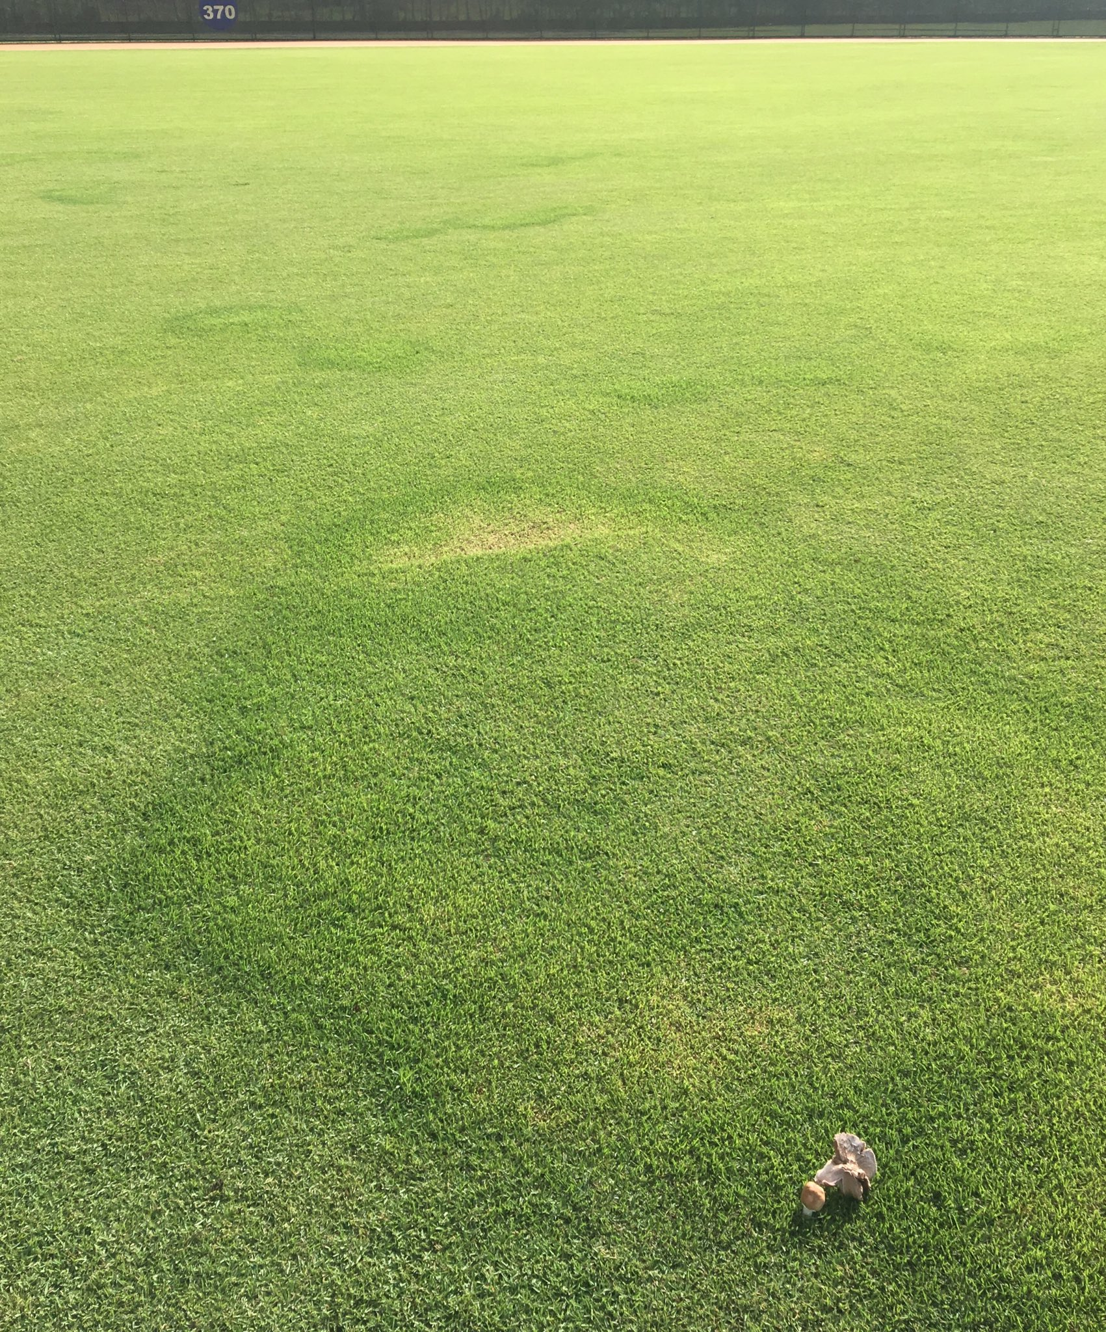
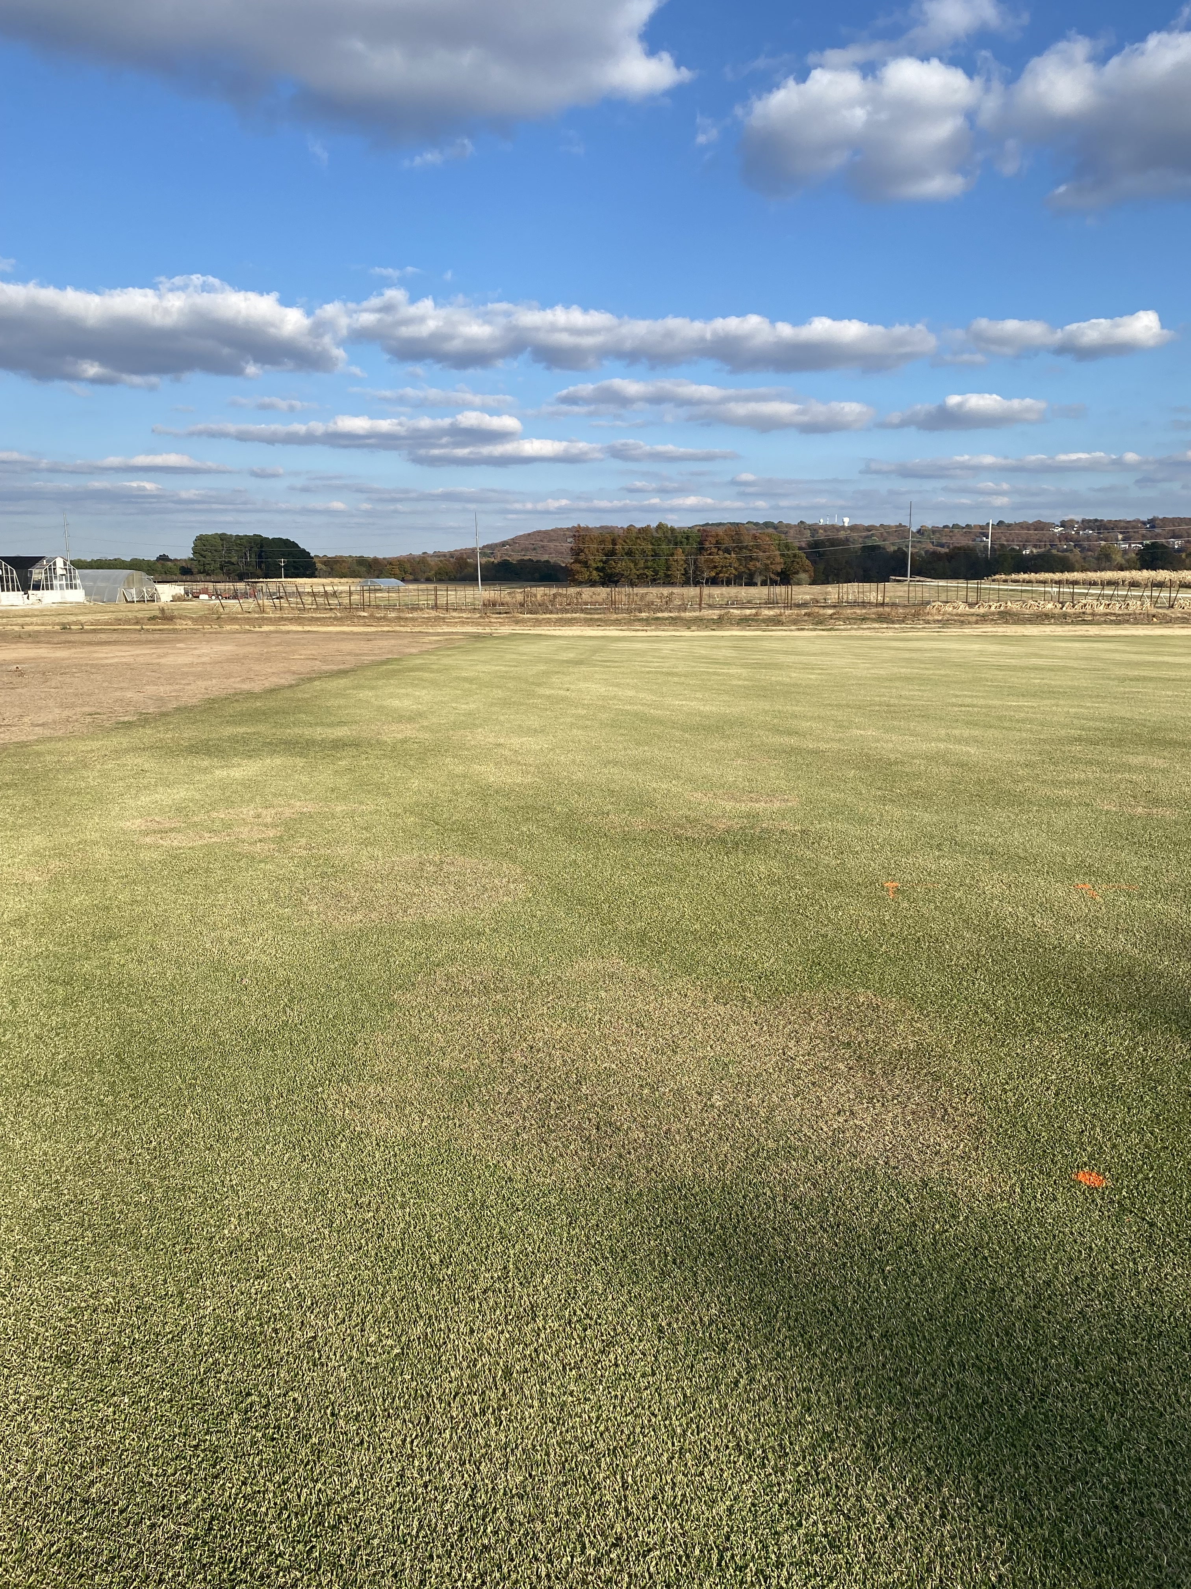
Getting the Most Out of Your Fungicide Applications
Wendell Hutchens, Ph.D.
Assistant Professor of Turfgrass Science
University of Arkansas

Slide 2
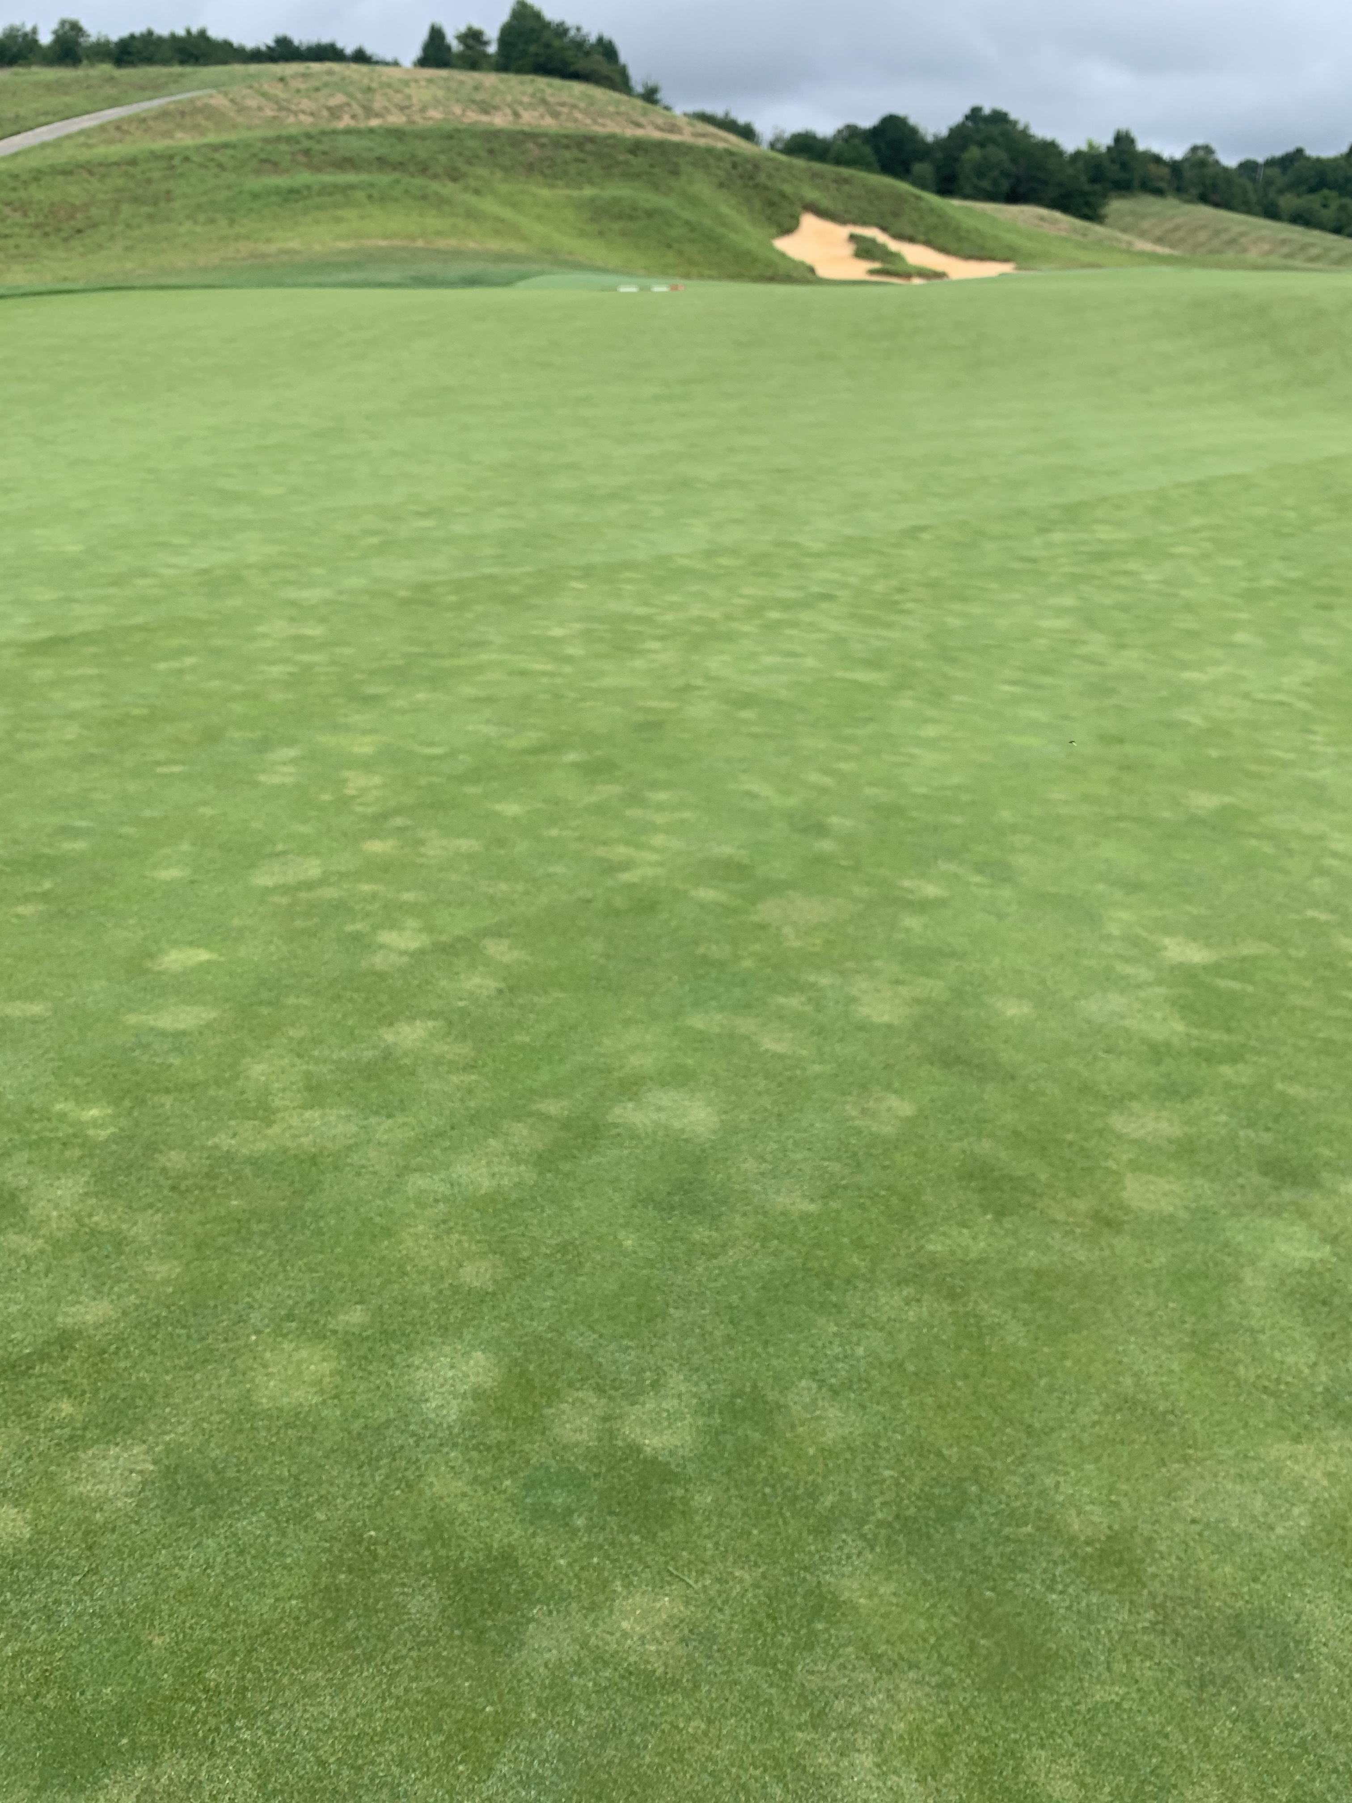
Considerations for managing turf diseases with fungicides…
Disease???
Properly identify the disease
Select the proper fungicide
Apply the fungicide at the correct timing
Apply the fungicide with the correct application method

Slide 3
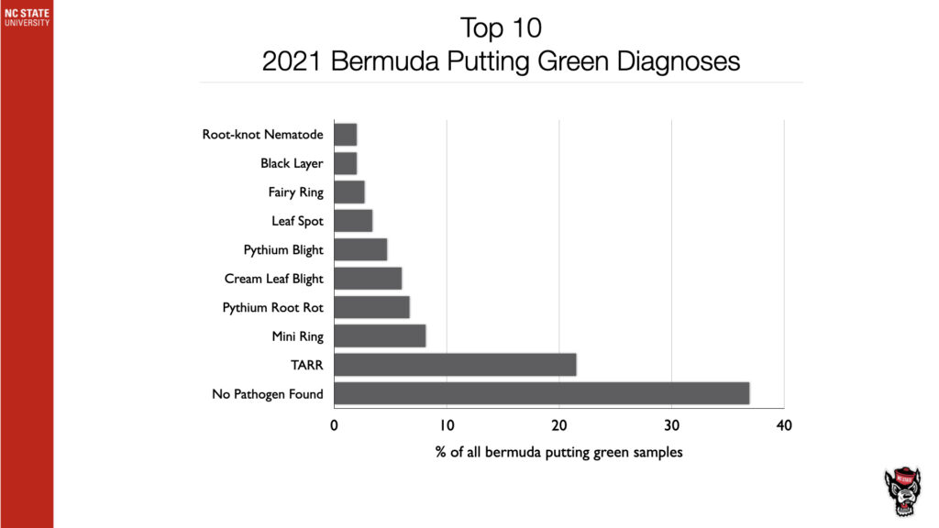
Data from NC State Turf Disease Diagnostic Lab
Many samples submitted were NOT disease!
Dr. Jim Kerns and Lee Butler

Slide 4
Considerations for managing turf diseases with fungicides…
Properly identify the disease
Select the proper fungicide
Apply the fungicide at the correct timing
Apply the fungicide with the correct application method

Slide 5
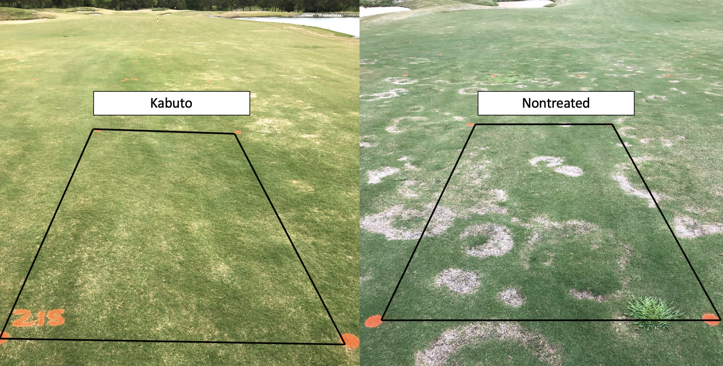
Suppression of Spring Dead Spot with Kabuto

Slide 6
Considerations for managing turf diseases with fungicides…
Properly identify the disease
Select the proper fungicide
Apply the fungicide at the correct timing
Apply the fungicide with the correct application method

Slide 7
A-D
Excellent control with Kabuto (isofetamid) at soil temps from 59-66°F in the fall.

Slide 8
Considerations for managing turf diseases with fungicides…
Properly identify the disease
Select the proper fungicide
Apply the fungicide at the correct timing
Apply the fungicide with the correct application method
  What we will focus on today…

Slide 9
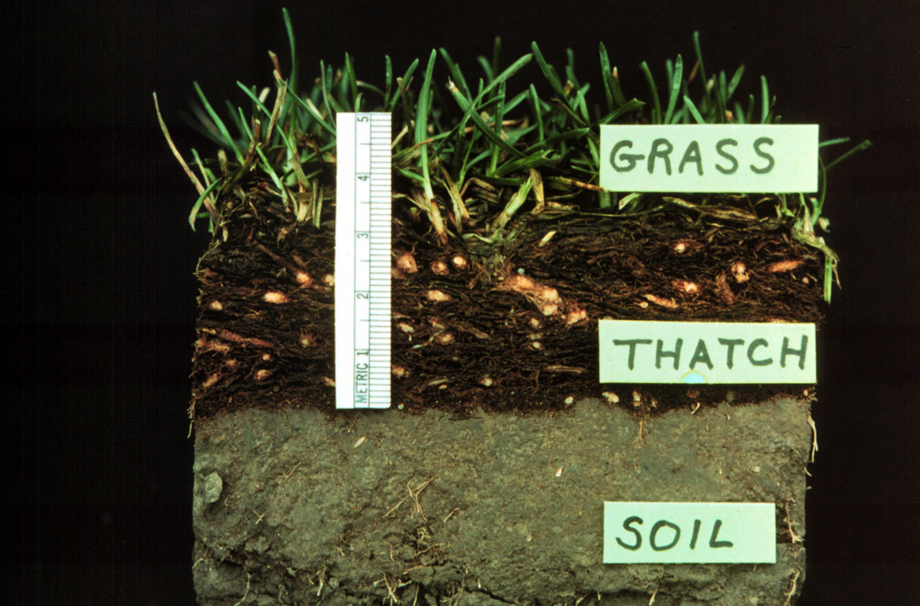
Pathogens love turfgrass…why?
Great medium for pathogens
  Organic material
    Thatch Layer!
  Maintains soil moisture
  Plenty of plant material
Poor medium for fungicides
  Organic material/thatch readily binds fungicide
  Dense canopy reducing penetration to rootzone

Slide 10
Fungicide Applications for Root Diseases
Root diseases are a major issue in turfgrass
Optimal application methods for root diseases include:
  Spraying at high carrier volumes (2-4 gal/1,000 ft²)
  Irrigating after application
  Tank-mixing soil surfactants

Slide 11
Hypotheses
Post-application irrigation will increase downward movement of fungicides thereby increasing fungicide efficacy against root disease.
Applying soil surfactants will increase downward movement of fungicides and increase efficacy against root disease.

Slide 12
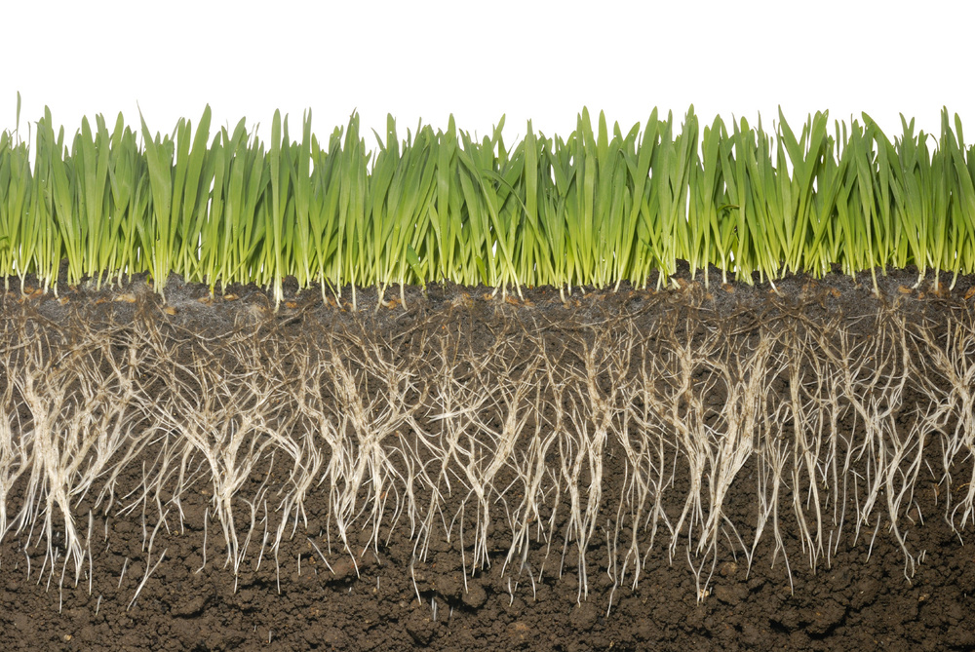

Slide 15
4 in.

Slide 16
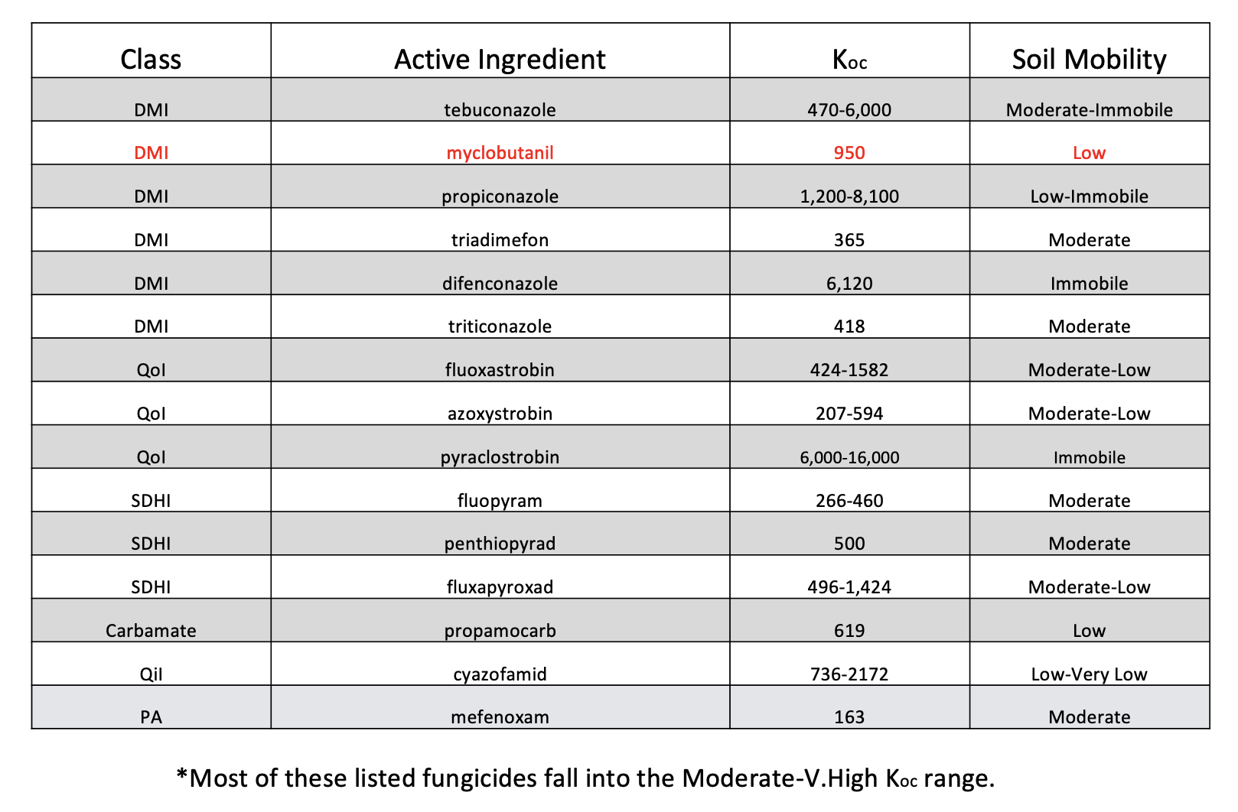

Slide 17
Study Objectives
Study 1: Determine how various post-application irrigation amounts (0, 1/8, 1/4, 1/2, and 1 in.) affect fungicide movement in a bare 90% sand/10% peat moss (v/v) putting green mix using:
  ¹⁴C tebuconazole
  ¹⁴C myclobutanil
Study 2: Determine the effects of pre-treating soil three times biweekly with three different soil surfactants on ¹⁴C myclobutanil and solution movement.
Study 3: Examine how various post-application irrigation amounts (0, 1/10, 1/8, and 1/4 in.) affect summer patch (Magnaporthiopsis poae) control on ‘Penn A-4’ creeping bentgrass when treated with azoxystrobin.

Slide 18
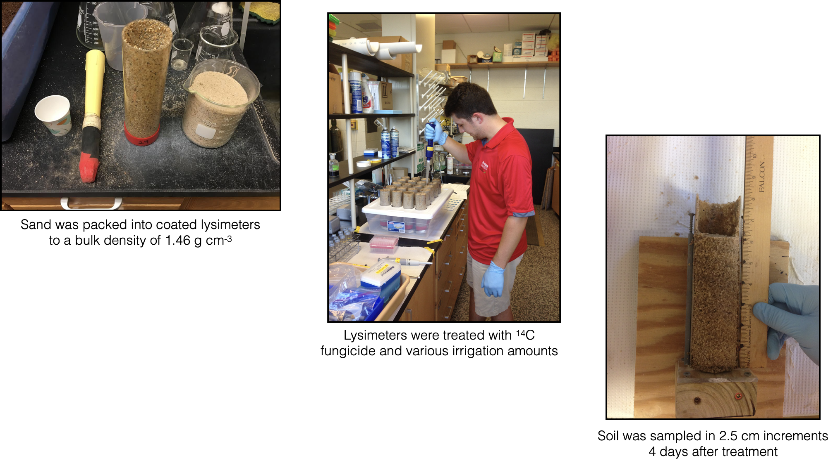
Materials and Methods: Studies 1 & 2

Slide 19
Pesticide was applied to the soil column
Soil

Slide 20
For Study 1, we then applied different irrigation treatments (0, 1/8, 1/4, 1/2, and 1 in.)
Pesticide on the soil surface

Slide 21
Pesticide
Soil column was then sectioned into 1-inch increments to determine the concentration of fungicide in each sampling depth

Slide 22
Samples were analyzed for percentage of the applied pesticide that made it to each soil sampling depth

Slide 23
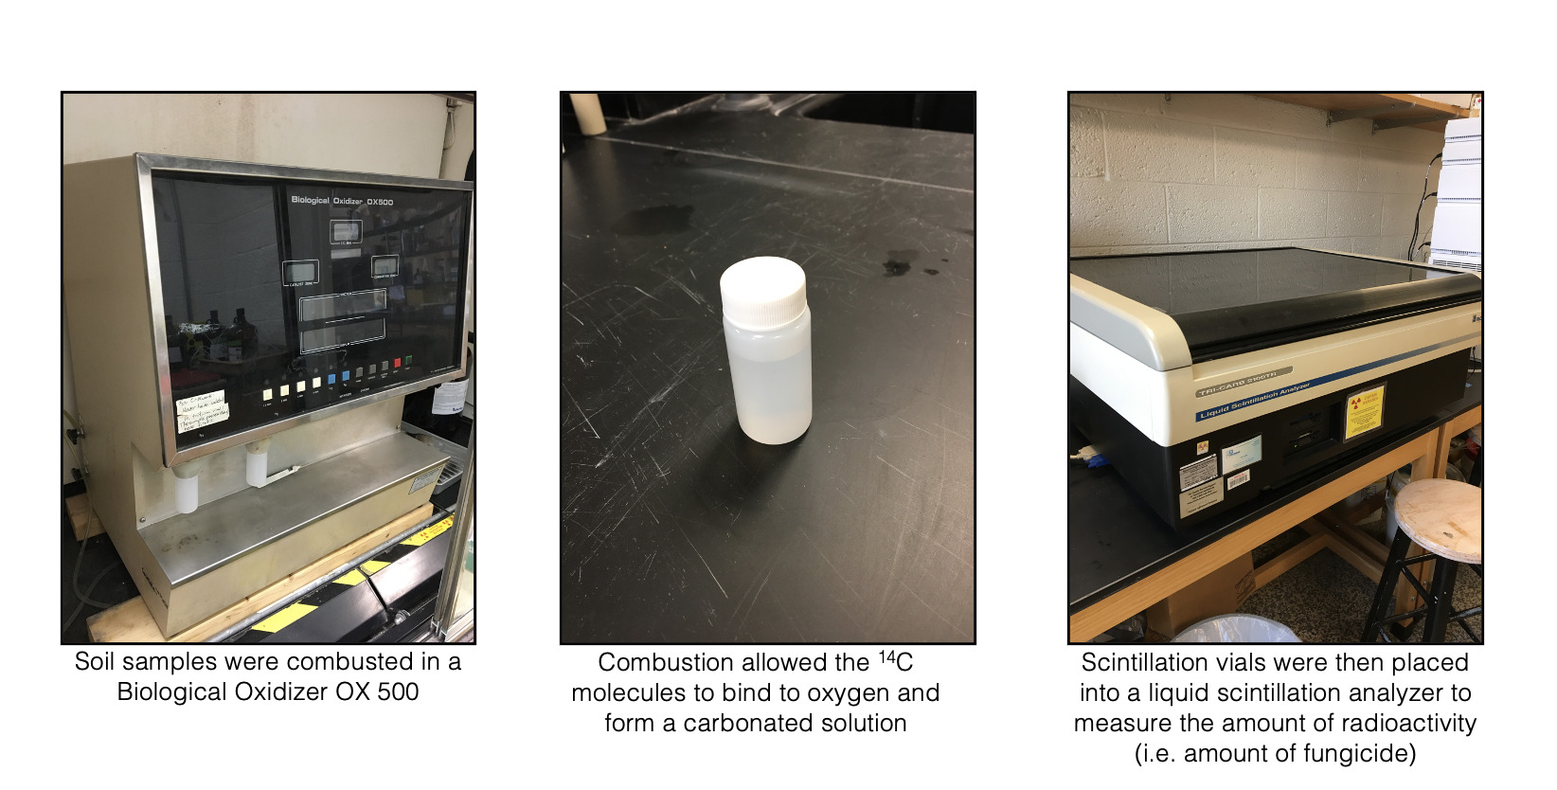
Materials and Methods: Studies 1 & 2

Slide 24
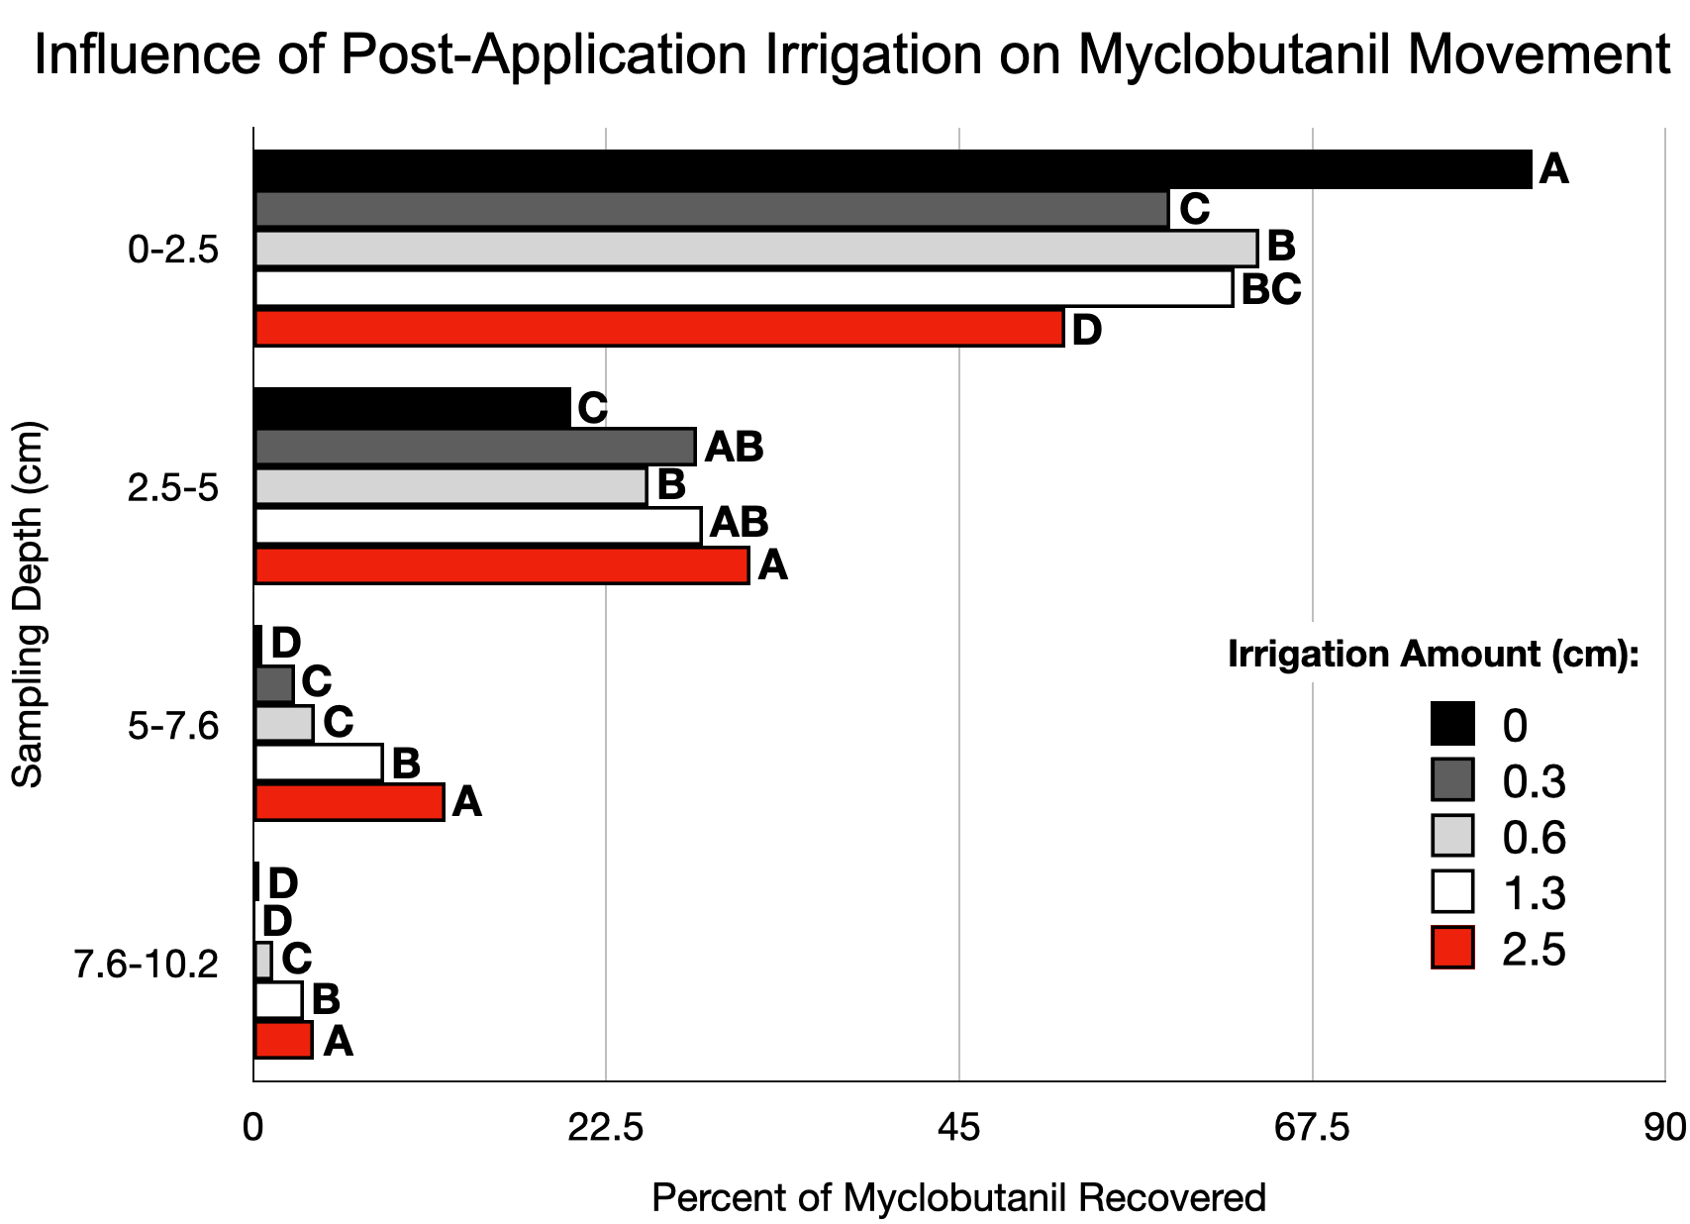
0-1”
1-2”
in.
2-3”
0
1/8
1/4
1/2
3-4”
1

Slide 25
0-1”
1-2”
in.
2-3”
0
1/8
Critical zone
1/4
1/2
3-4”
1

Slide 26
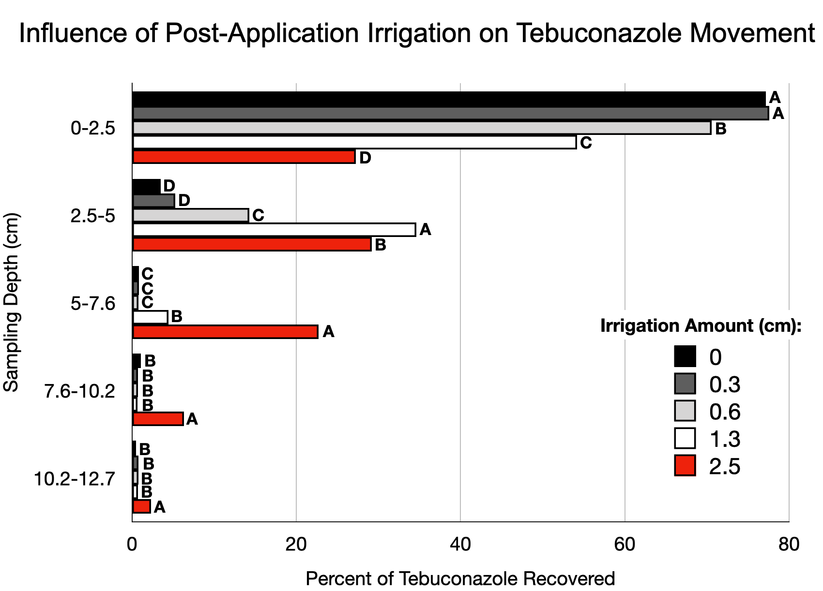
0-1”
1-2”
2-3”
in.
0
3-4”
1/8
1/4
1/2
4-5”
1

Slide 27
0-1”
1-2”
2-3”
in.
0
3-4”
1/8
1/4
Fungicide is NOT readily washed through the rootzone
1/2
4-5”
1

Slide 28
What about soil surfactants?

Slide 29
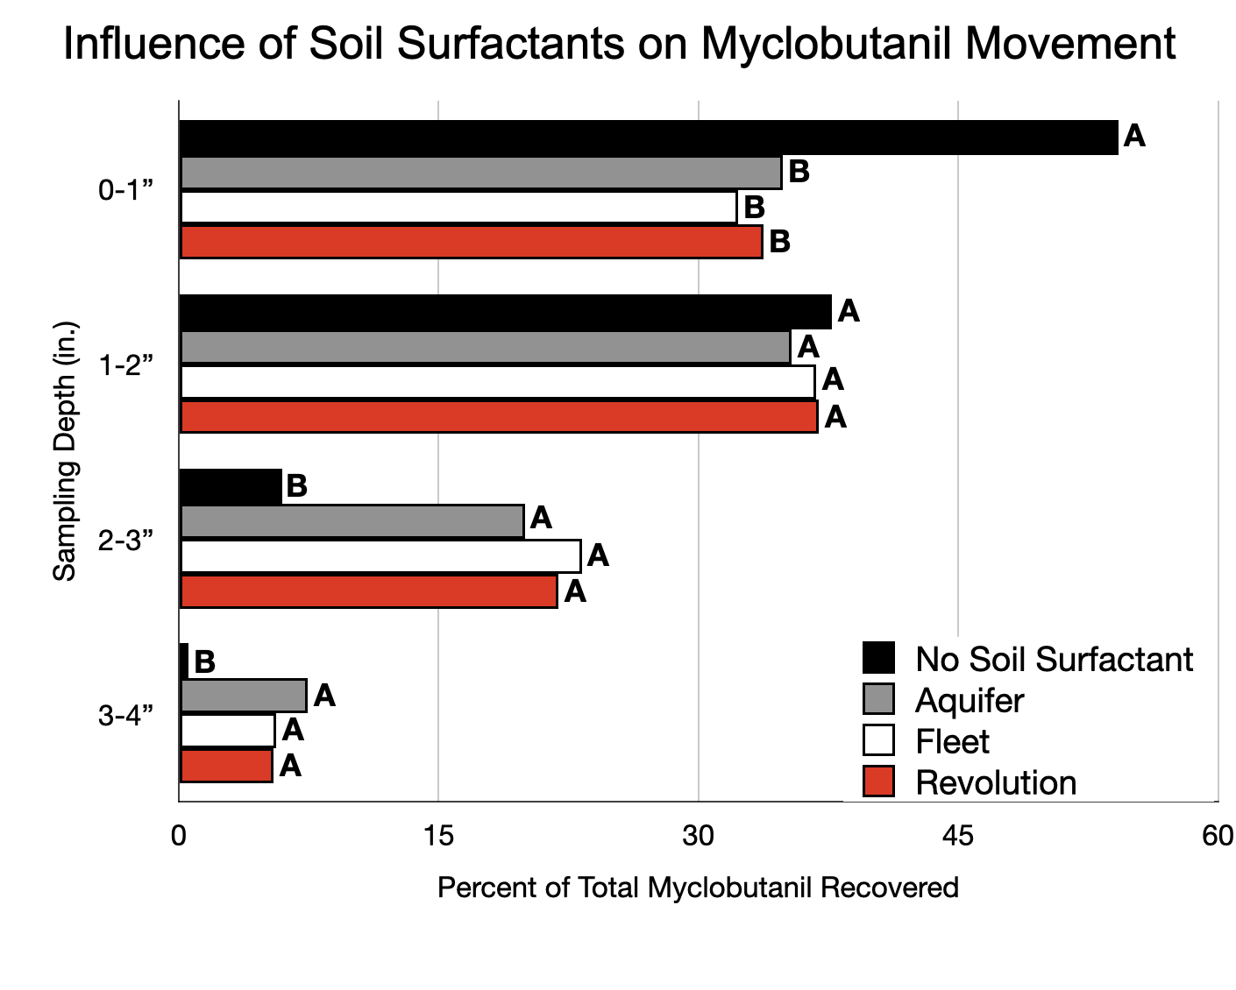

Slide 30
Soil surfactants increased the downward movement of the fungicide

Slide 31
Soil surfactants increased the downward movement of the fungicide, yet there were no differences between soil surfactants!

Slide 32
Summary of Studies 1 and 2
Regardless of irrigation amount, over 50% of the fungicide was retained in the top 2 inches of soil showing that neither myclobutanil nor tebuconazole are highly mobile.
Fungicide did not move past 5 inches in any study.
Increasing irrigation amount and pre-treating soil with soil surfactants increases downward distribution of fungicides.

Slide 33
Do these findings translate to increased root disease control?

Slide 34
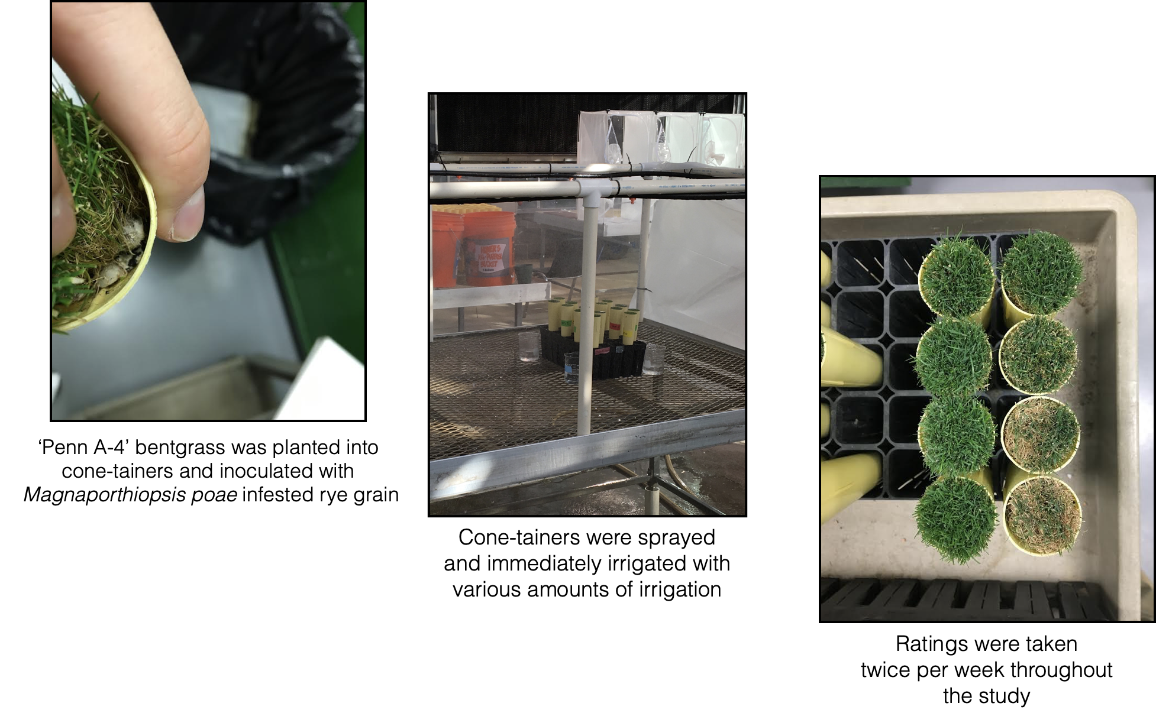
Materials and Methods for Study 3

Slide 35
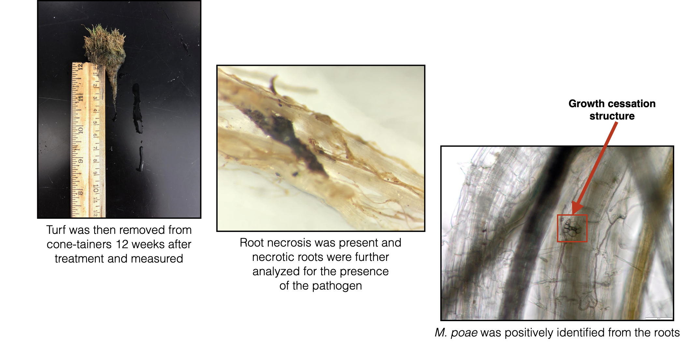
Materials and Methods for Study 3

Slide 36
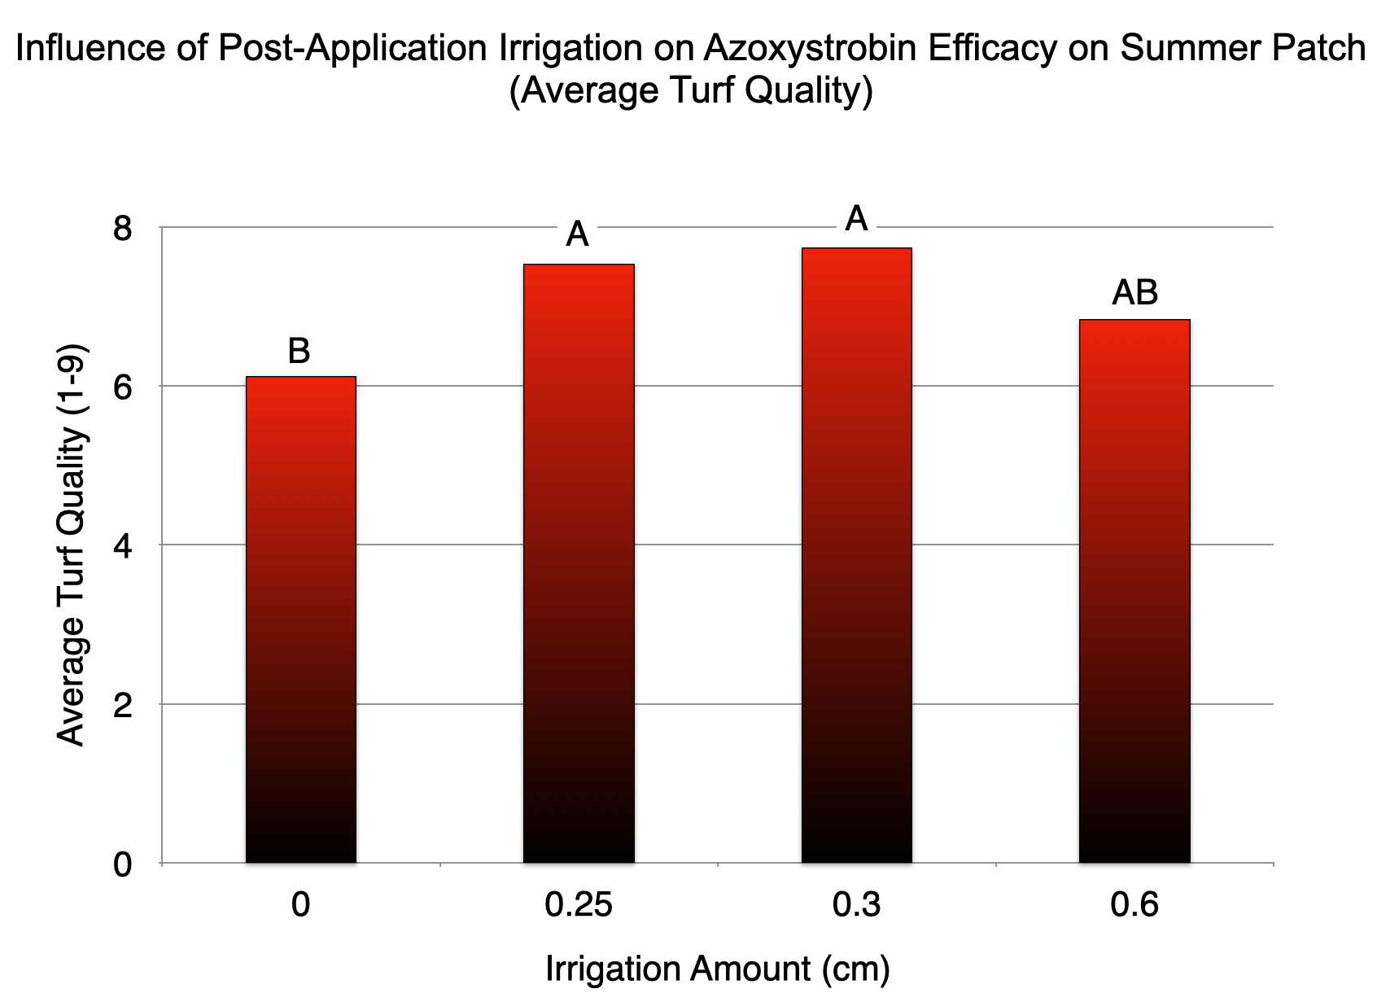
0”
1/10”
1/8”
1/4”

Slide 37
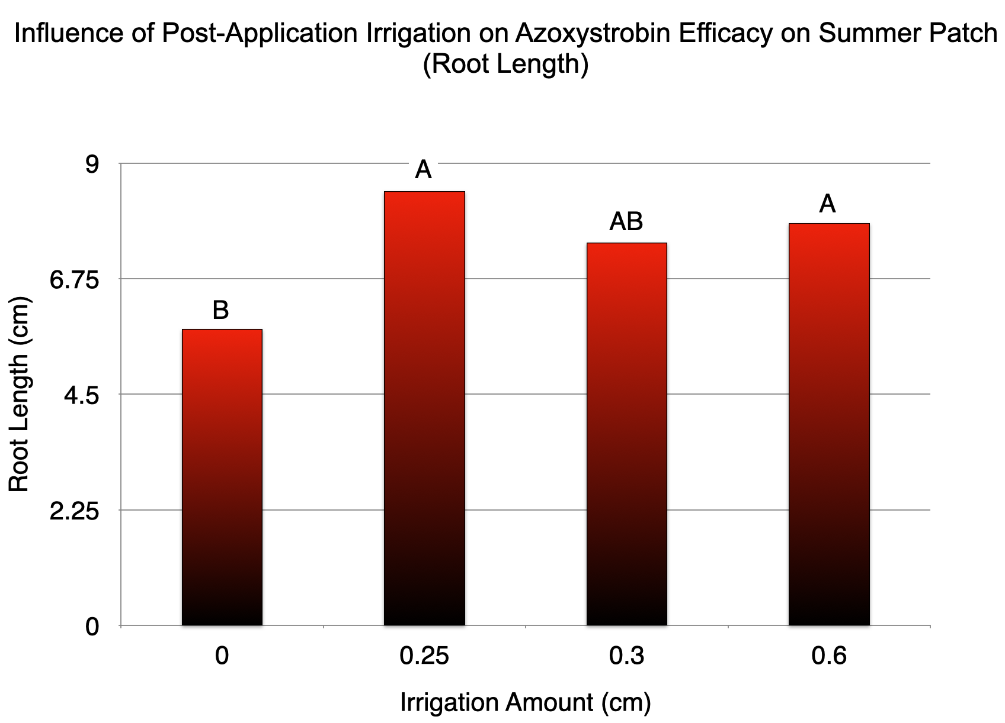
0”
1/10”
1/8”
1/4”

Slide 38
Summary of Study 3
Post-application irrigation increased turf quality.
Post-application irrigation increased root length.
Differences in turf quality and root length were variable.
These principles can be applied to other root and crown diseases
  Spring dead spot, Pythium root rot, take-all root rot, nematodes, etc.

Slide 39
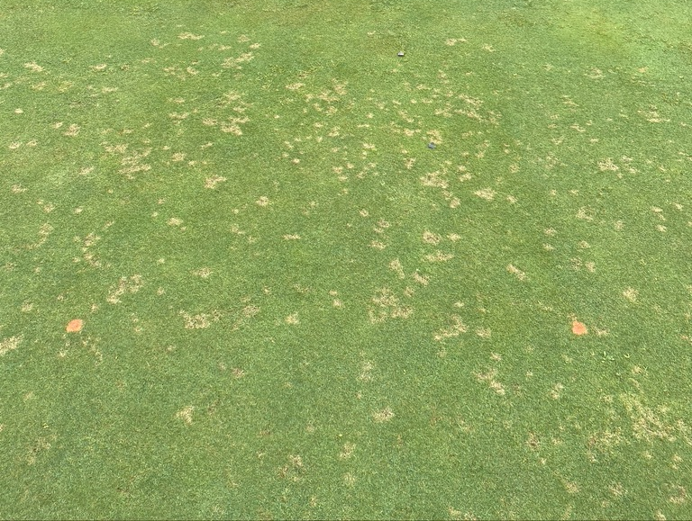
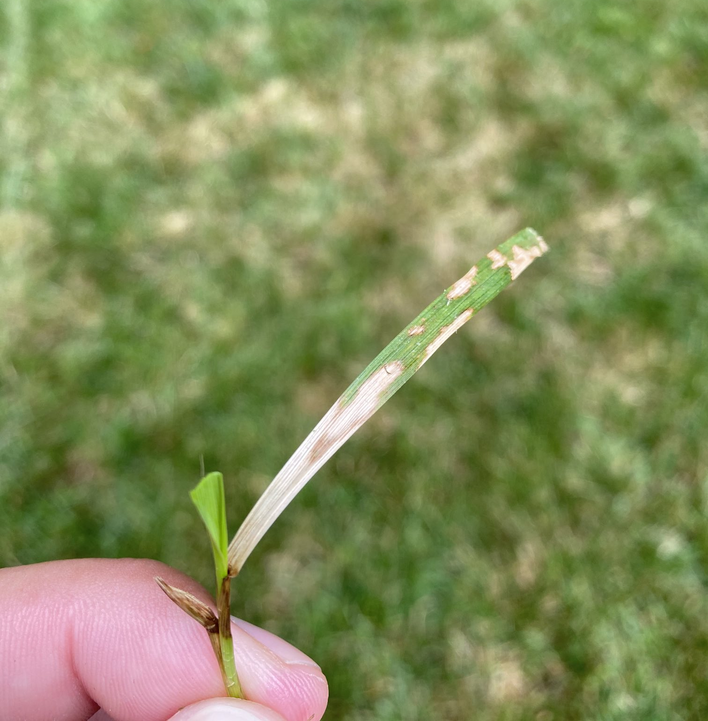
What about foliar diseases?

Slide 40
Fungicide Applications for Foliar Turf Diseases
Foliar diseases are a major issue in turfgrass
  Dollar spot, brown patch, gray leaf spot, large patch, etc.
Optimal application methods for foliar diseases include:
  Spraying with higher coverage nozzles at lower carrier volumes (0.5-1 gal/1000ft²)
  NOT watering in contact or localized penetrant products (chlorothalonil, fluazinam, pyraclostrobin, etc.)
  NOT mowing within 48 hours after application
    If mown, return clippings

Slide 41
Fungicide Applications for Foliar Turf Diseases
Foliar diseases are a major issue in turfgrass
  Dollar spot, brown patch, gray leaf spot, large patch, etc.
Optimal application methods for foliar diseases include:
  Spraying with higher coverage nozzles at lower carrier volumes (0.5-1 gal/1000ft²)
  NOT watering in contact or localized penetrant products (chlorothalonil, fluazinam, pyraclostrobin, etc.)
  NOT mowing within 48 hours after application
    If mown, return clippings

Slide 42
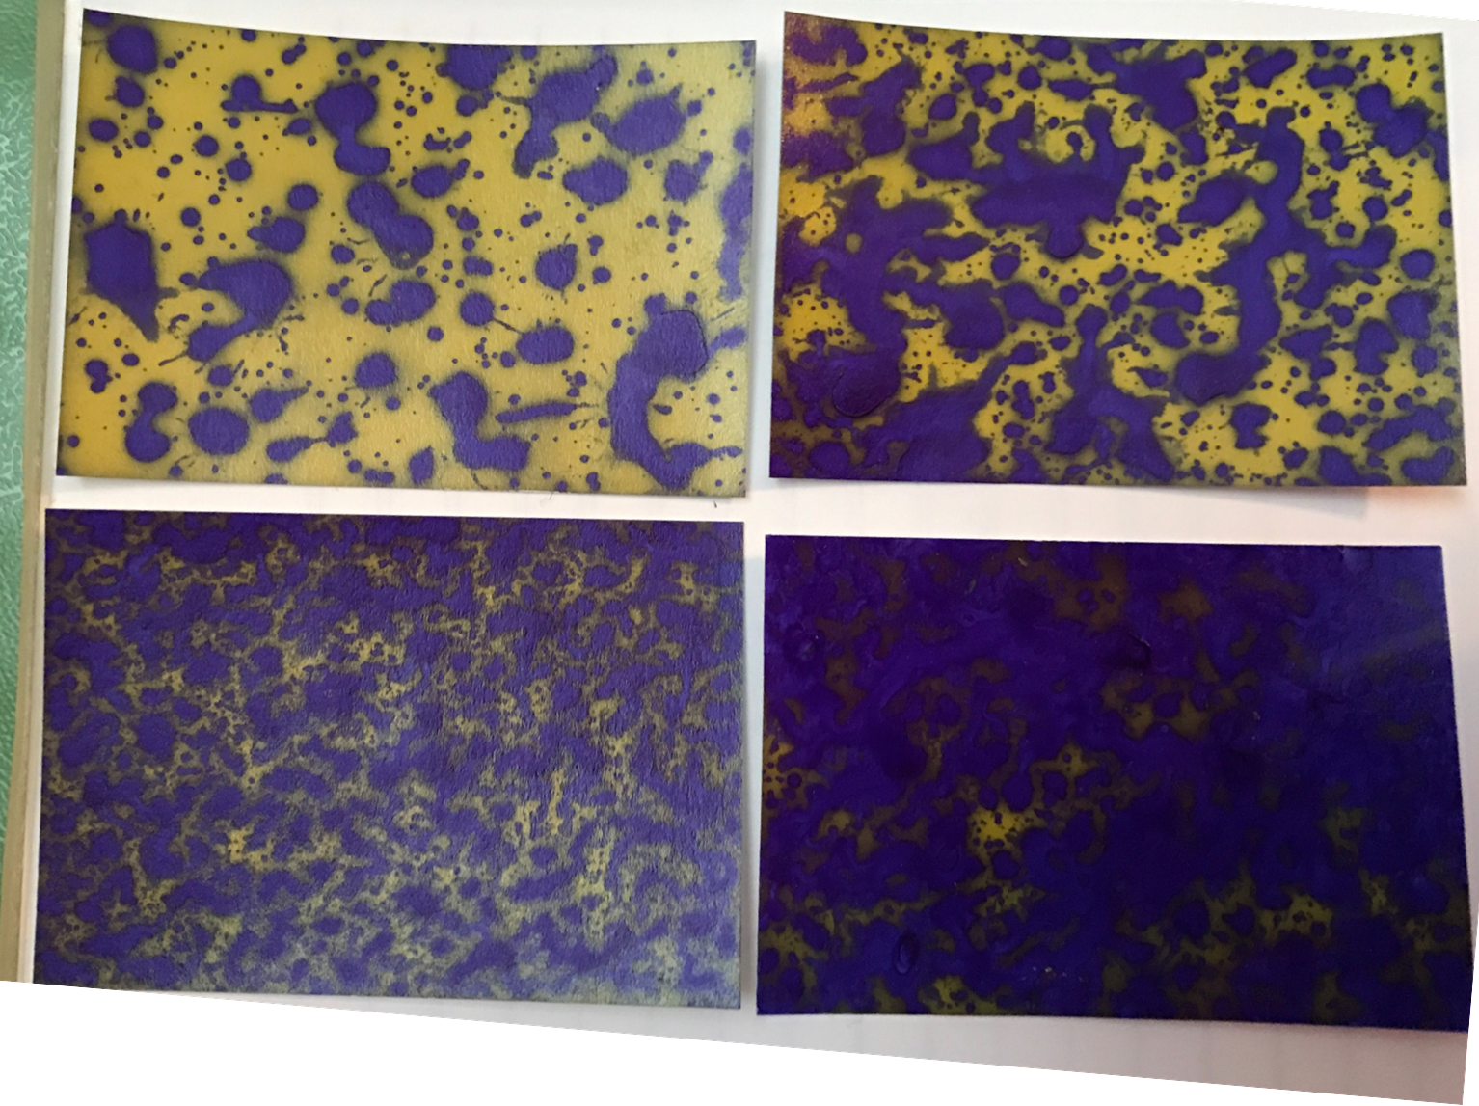
Nozzle selection is crucial for foliar diseases (THINK COVERAGE)
Flood Jet (extremely coarse)
TTI (ultra coarse)
Air Induction
XRFF (medium)
TTJ Twin (very coarse)

Slide 43
Influence of Ferrous Sulfate Applied with Different Nozzles on Dollar Spot Counts

Slide 44
Influence of Ferrous Sulfate Applied with Different Nozzles on Dollar Spot Counts

Slide 45
Influence of Ferrous Sulfate Applied with Different Nozzles on Dollar Spot Counts
Finer droplet nozzles increased dollar spot suppression.

Slide 46
Influence of Secure (fluazinam) Applied at Different Carrier Volumes on Dollar Spot Area Under the Disease Progress Curve
*Research by Jim Kerns, Lee Butler, and Jill Ploetz at NC State University
Secure at 2 gal/1000ft²
Secure at 0.5 gal/1000ft²

Slide 47
Influence of Secure (fluazinam) Applied at Different Carrier Volumes on Dollar Spot Area Under the Disease Progress Curve
Lower carrier volume increased dollar spot suppression.
*Research by Jim Kerns, Lee Butler, and Jill Ploetz at NC State University
Secure at 2 gal/1000ft²
Secure at 0.5 gal/1000ft²

Slide 48
Fungicide Applications for Foliar Turf Diseases
Foliar diseases are a major issue in turfgrass
  Dollar spot, brown patch, gray leaf spot, large patch, etc.
Optimal application methods for foliar diseases include:
  Spraying with higher coverage nozzles at lower carrier volumes (0.5-1 gal/1000ft²)
  NOT watering in contact or localized penetrant products (chlorothalonil, fluazinam, pyraclostrobin, etc.)
  NOT mowing within 48 hours after application
    If mown, return clippings

Slide 49
Contact or localized penetrant fungicide

Slide 50
Irrigation Event

Slide 51
Irrigation Event

Slide 52
Irrigation Event
Moves fungicide beyond the foliage

Slide 53
Fungicide Applications for Foliar Turf Diseases
Foliar diseases are a major issue in turfgrass
  Dollar spot, brown patch, gray leaf spot, large patch, etc.
Optimal application methods for foliar diseases include:
  Spraying with higher coverage nozzles at lower carrier volumes (0.5-1 gal/1000ft²)
  NOT watering in contact or localized penetrant products (chlorothalonil, fluazinam, pyraclostrobin, etc.)
  NOT mowing within 48 hours after application
    If mown, return clippings

Slide 54
Fungicide

Slide 55
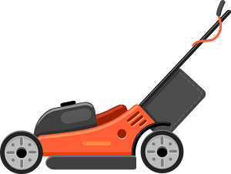
Can remove 17-30% of fungicide by mowing within first 24 hours after fungicide application (Jeffries et al., 2016)

Slide 56
Summary of Optimizing Fungicides for Turf Diseases
Root/Crown Diseases
Foliar Diseases
Consider phytomobility and physicochemical properties of fungicides
Water in products at least 1/8” of post-application irrigation
Pre-treat and tank-mix wetting agents
Remove thatch!
Consider phytomobility and physicochemical properties of fungicides
Do not water in contacts or localized penetrants
  Apply at 1 gal/1000 ft² with air-induction nozzle
Do not mow within 48 hours after application

Slide 57
Questions?
For additional follow up questions contact me at wendellh@uark.edu or via Twitter @HutchensWendell

